Slide 1

Welcome
To our new slide deck

Slide 2
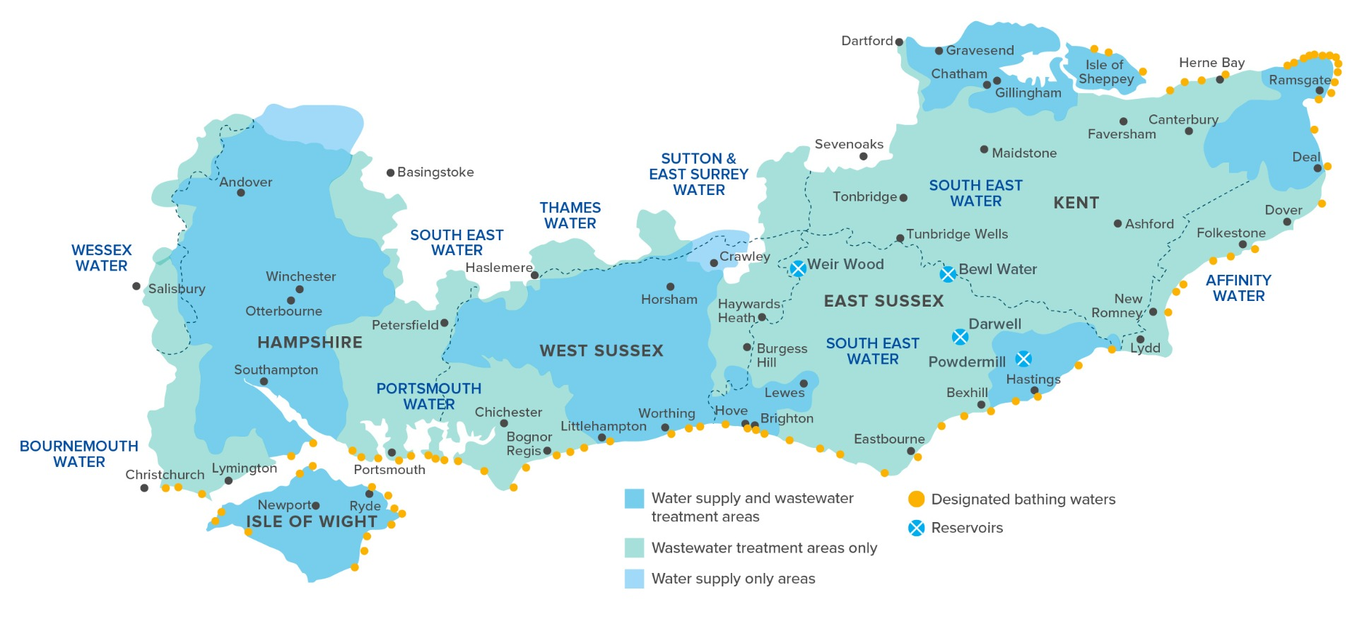
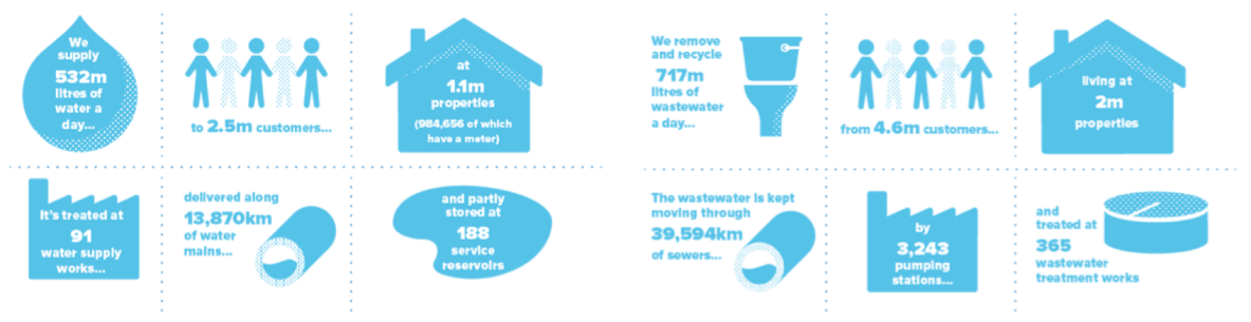
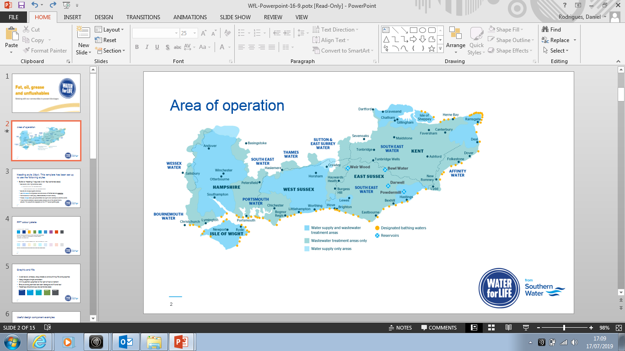
Area of operation

Slide 3
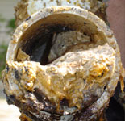
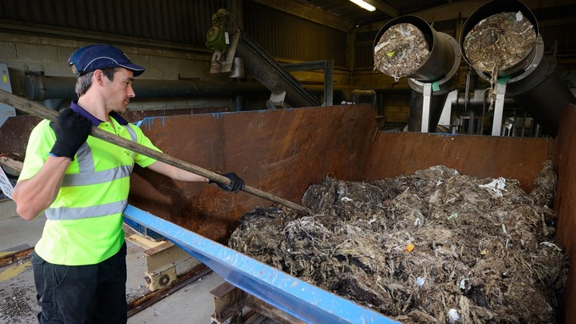
Background
We were clearing over 23,000 blockages a year
65-70% of blockages are preventable
Over 9,000 tons of wet wipes and unflushables were removed over a year
In the UK each year, more than 3,000 homes are flooded because sewer misuse

Slide 4
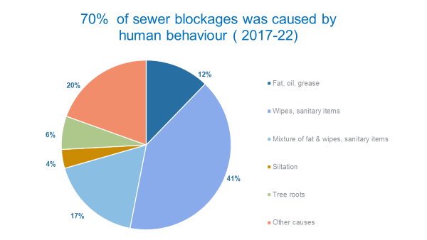

Slide 5
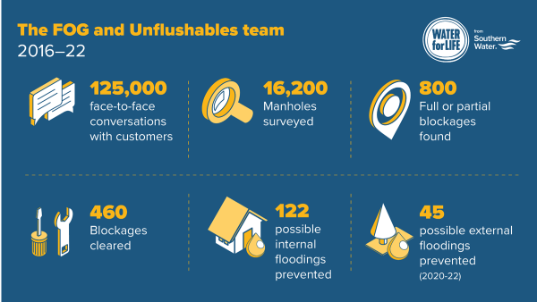
Reaching out to customers, our achievements:

Slide 6
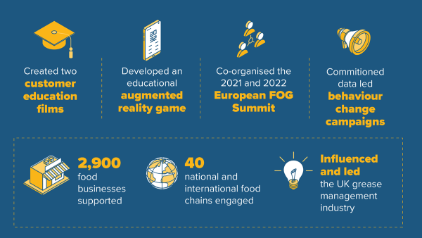

Slide 7

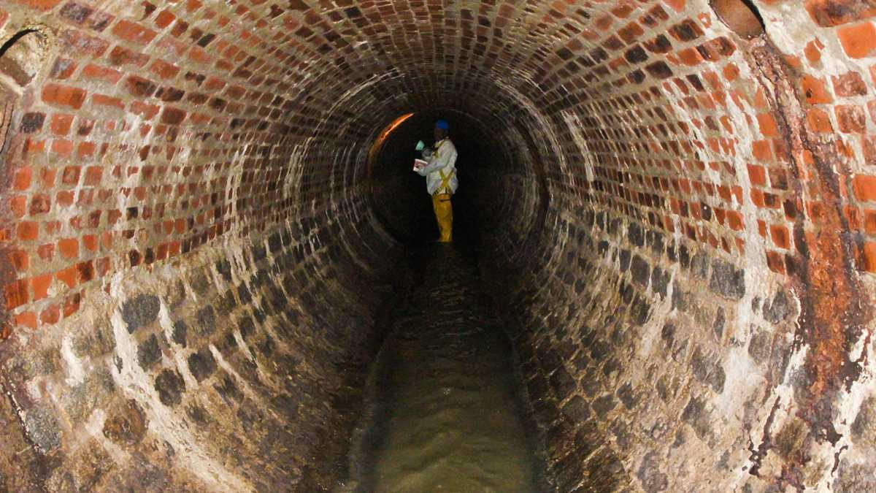
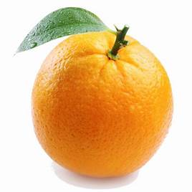
How big are our sewer pipes at home?

Slide 8
UnFlushables

Slide 9
Plastic in products
What percentage of wet wipe products contain some form of plastic?
A: 55% B: 75% C: 90%
Would you flush a plastic Bag?
Sanitary pads can contain up to 5 plastic bags in one towel
Notes:
Plastics (Wet Wipes) - Hansard - UK Parliament

Slide 10

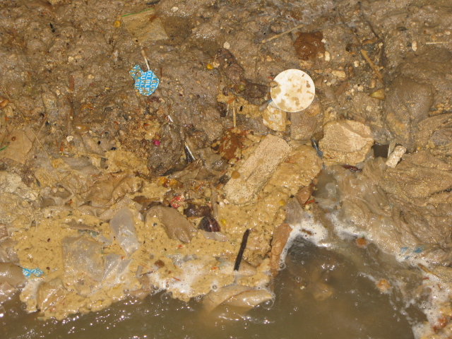

Slide 11
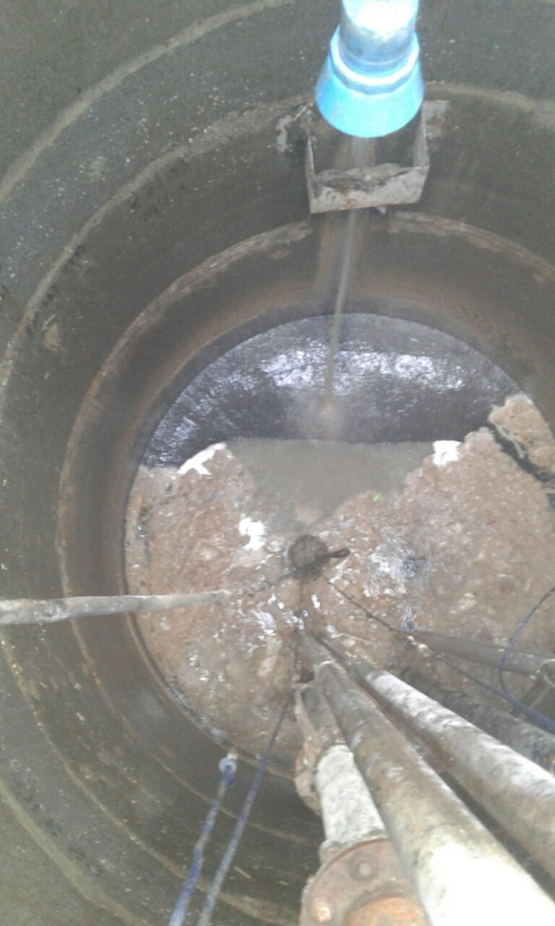
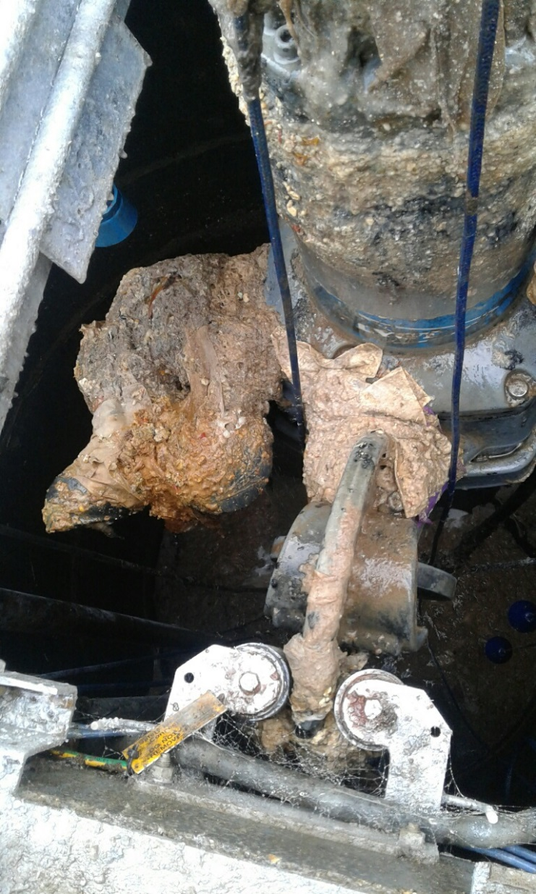
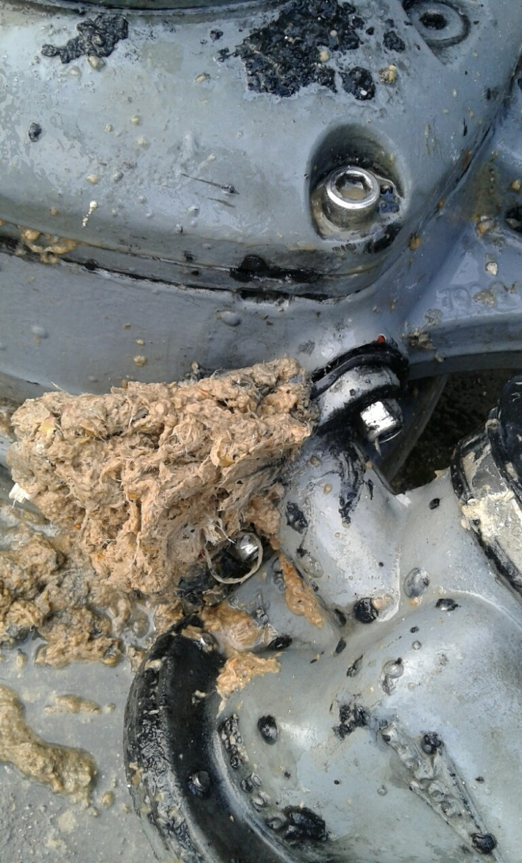

Slide 12
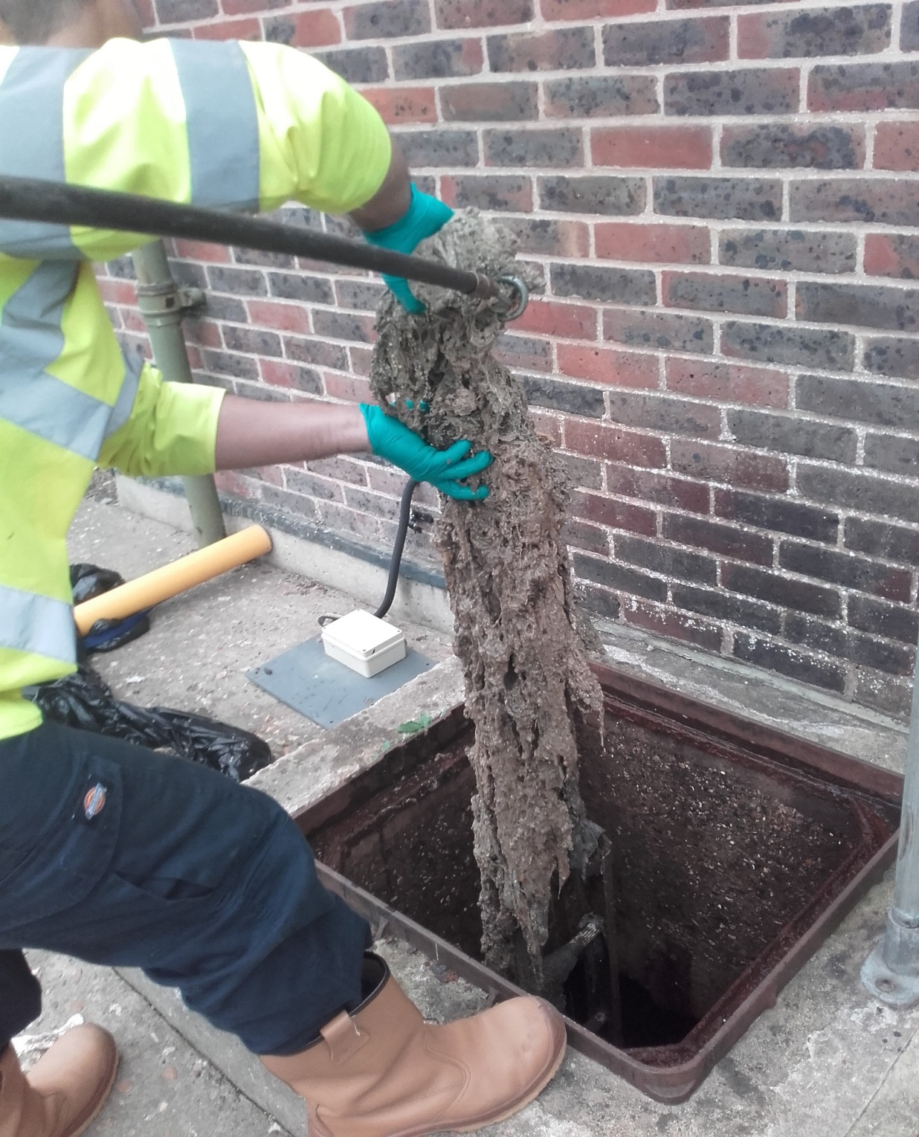
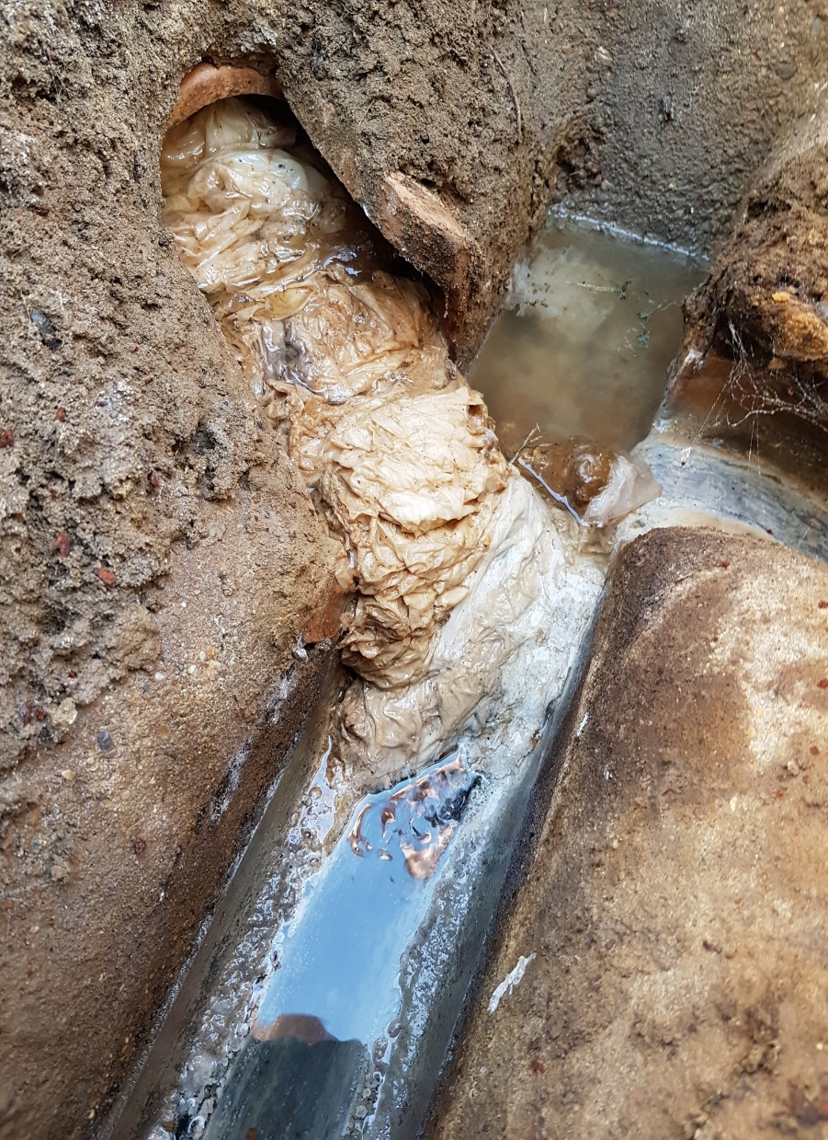
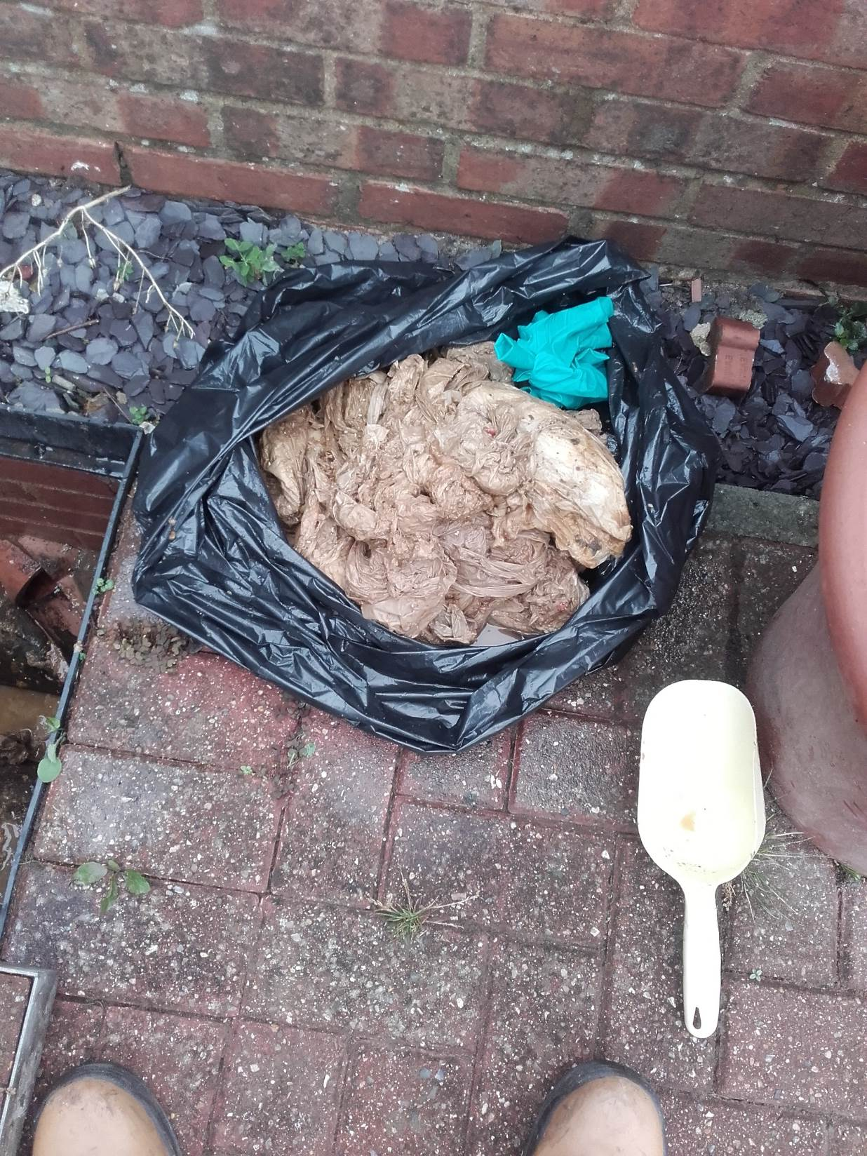

Slide 13
Fat Oil & Grease

Slide 14
Fat oil and grease facts
What percentage of the nation washes FOG down the drain?
A: 38% B: 48% C: 68%
Does washing-up liquid dissolve FOG ?
Unfortunately not, it has a chemical reaction called saponification turning into a soap like material

Slide 15
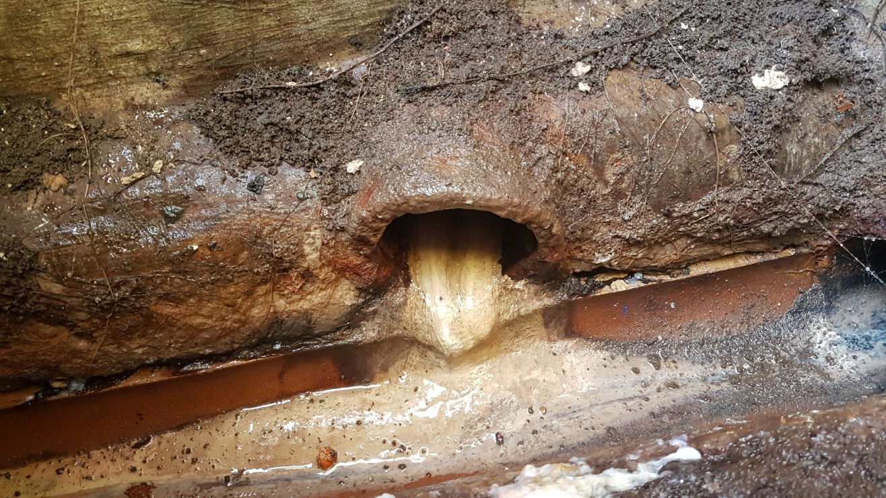
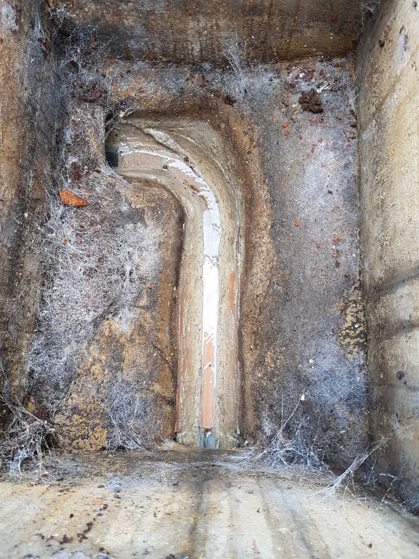
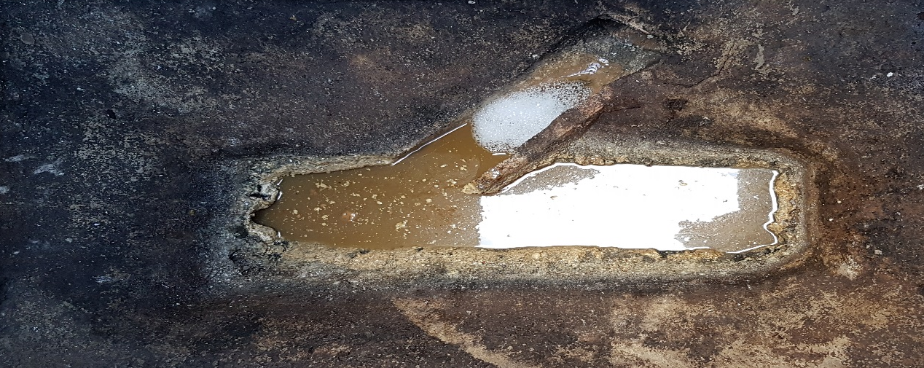

Slide 16
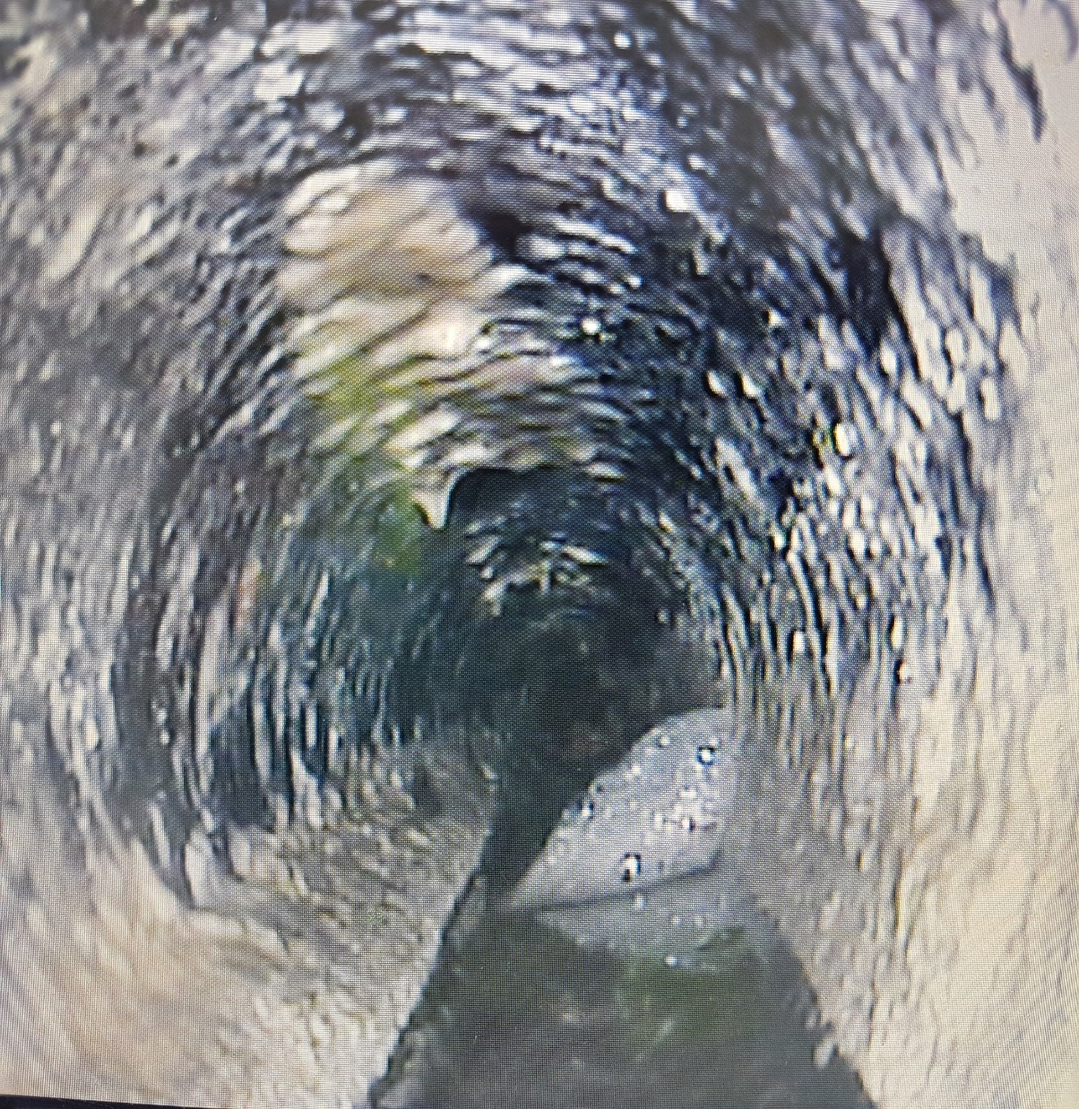
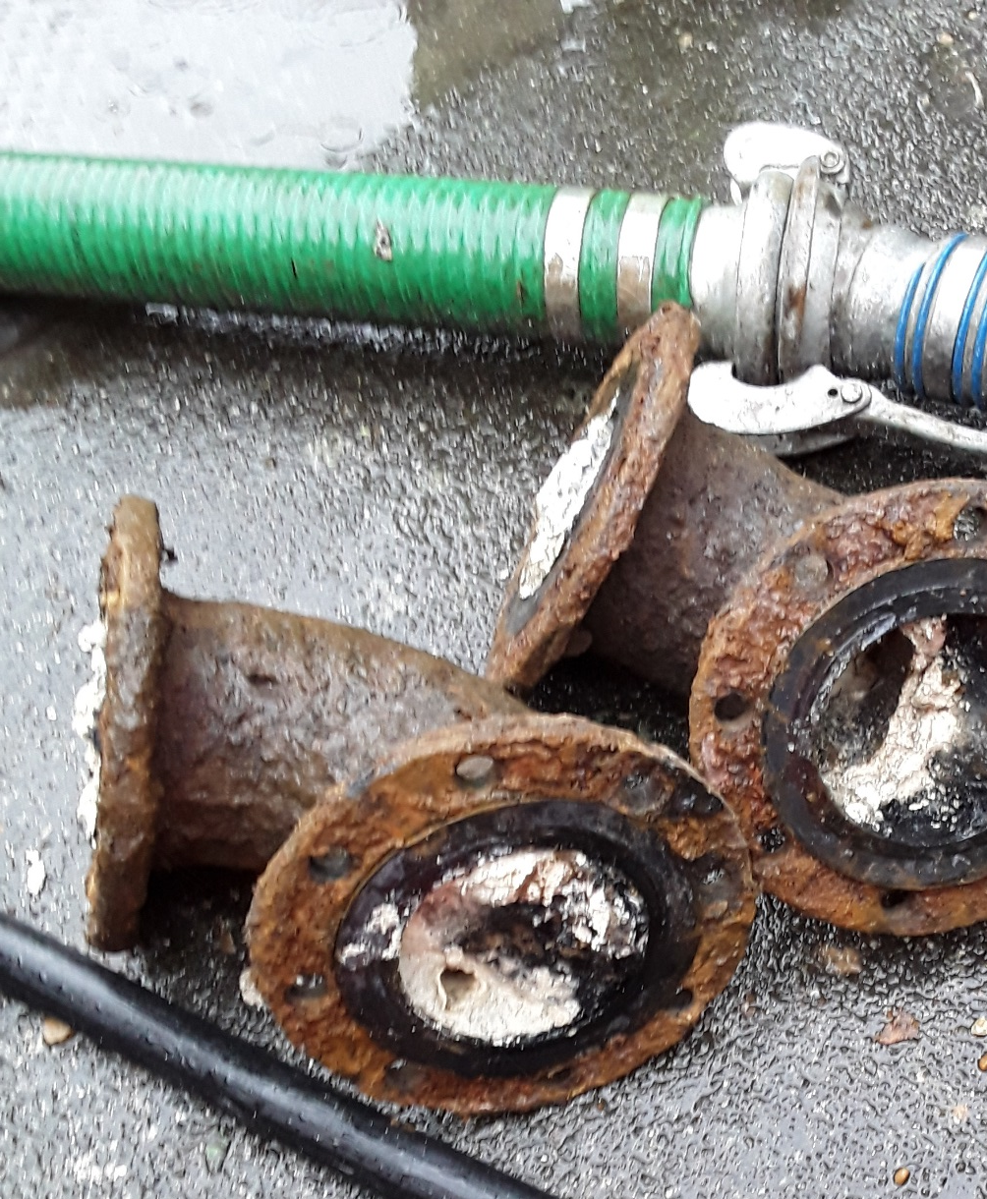

Slide 17
When things go wrong…

Slide 18
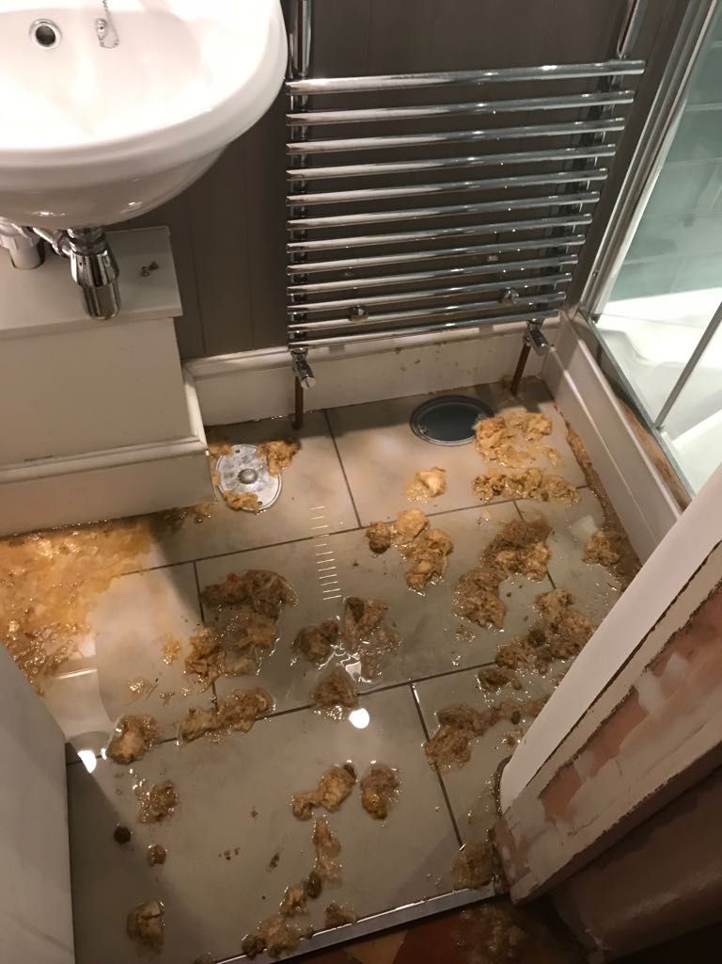
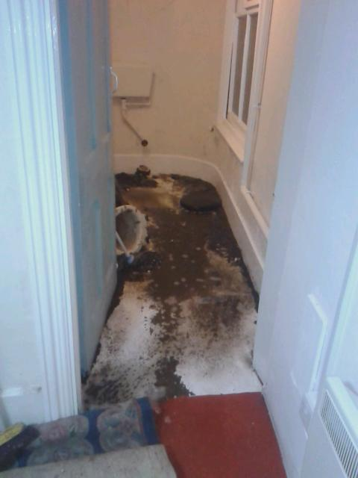

Slide 19
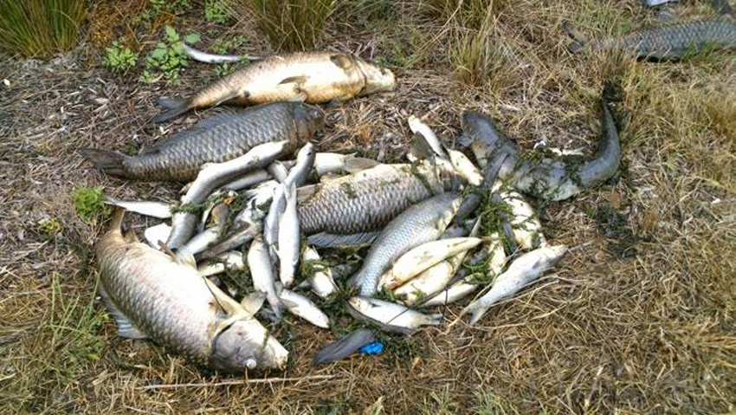

Slide 20
How can we all help ?

Slide 21
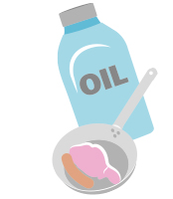
In the Kitchen
Pour excess fat into a container and dispose of it in the bin
Make fat balls for birds by mixing it oats and seeds
Mop up excess FOG from pans and plates with kitchen roll
Use a sink strainer to prevent food being washed down the sink
Never mix detergent with fat and pour down the drain “it make it worse”.
Oils, gravy, yoghurts & milks should go in the bin

Slide 22

In the bathroom
Only flush the 3 P’s – paper, pee & poo
Items such as wipes, sanitary products, nappies and cotton pads or buds should go in the bin
Beware of labels claiming to be “Flushable” or “biodegradable”
Be mindful of shampoo and shower gels containing oil based products
Make sure you have a bin in the bathroom

Slide 23
Waste Water Treatment

Slide 24
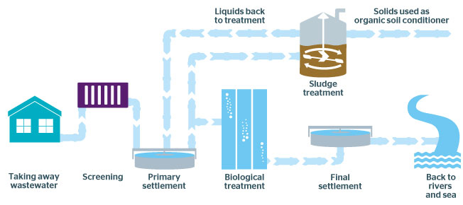

Slide 25
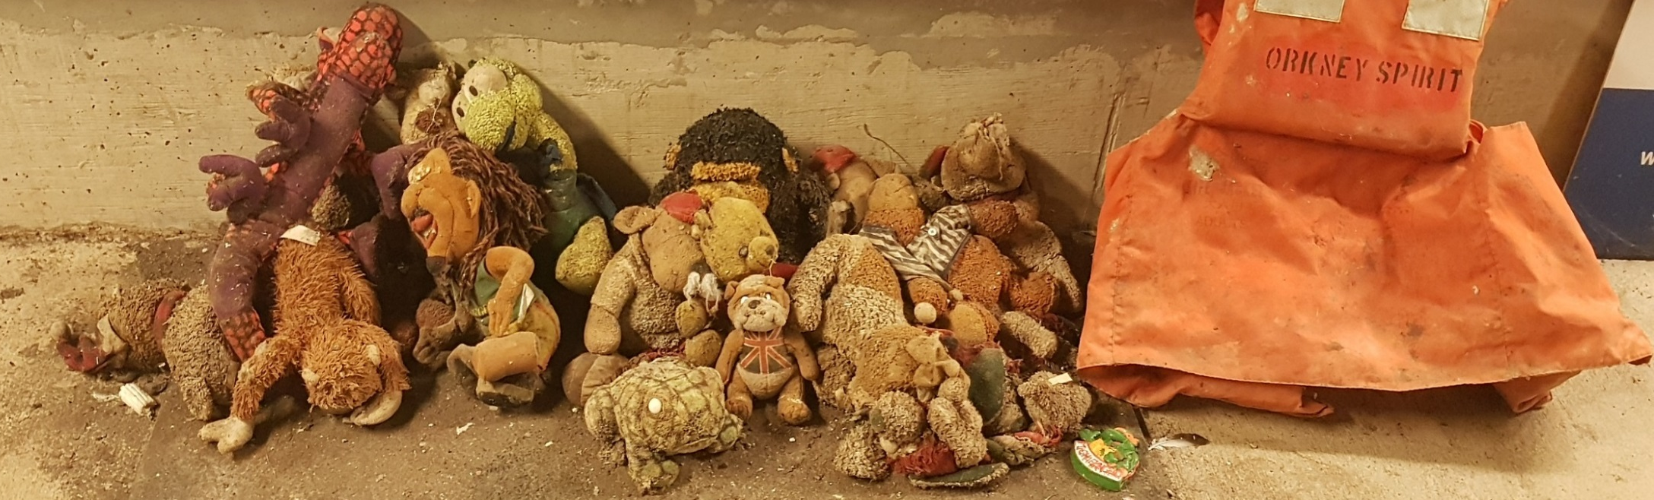
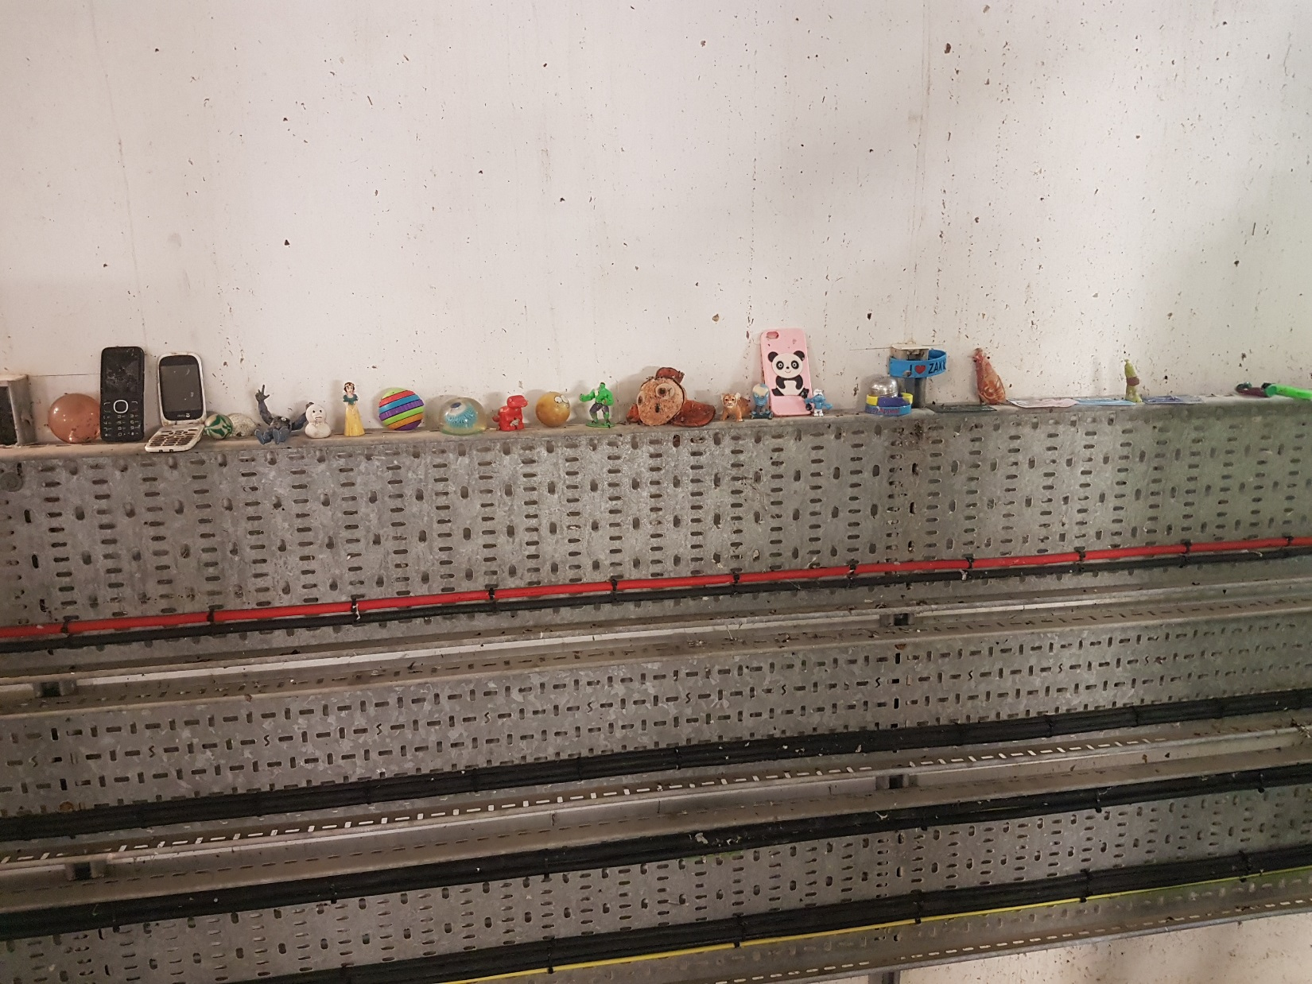
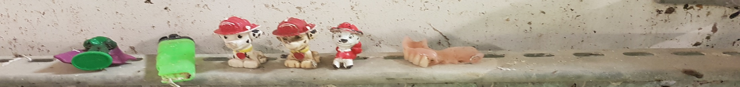

Slide 26
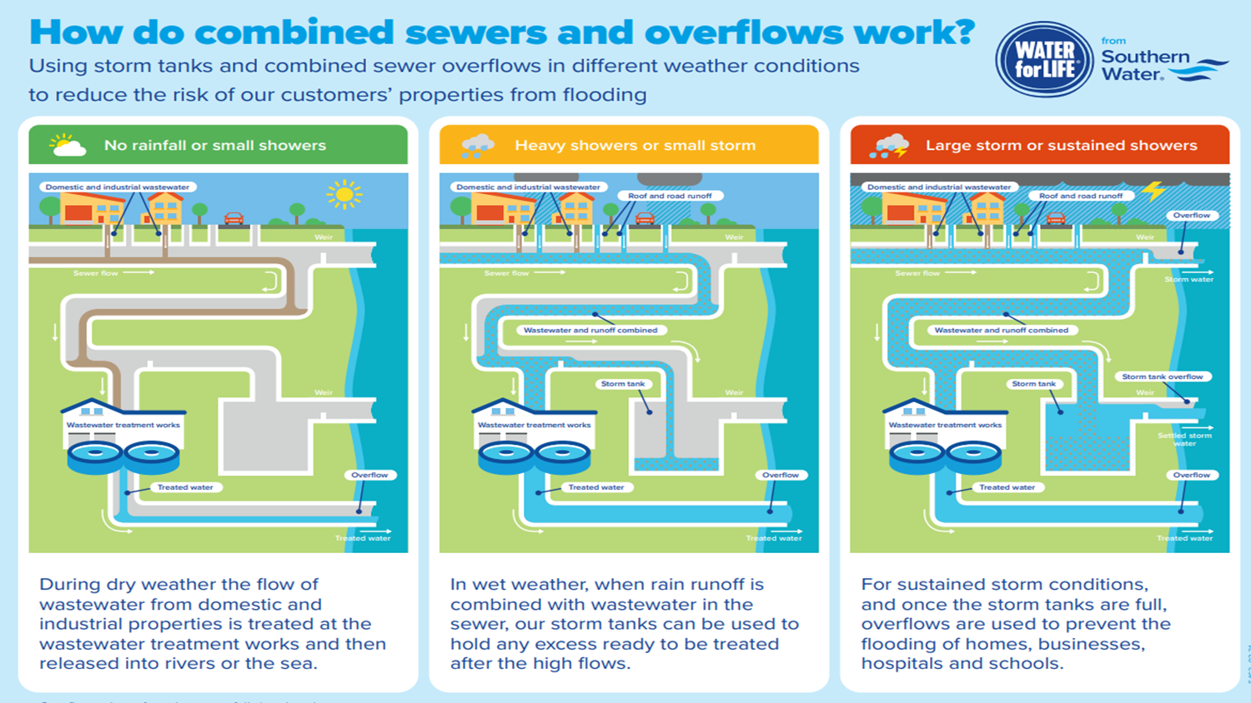

Slide 27
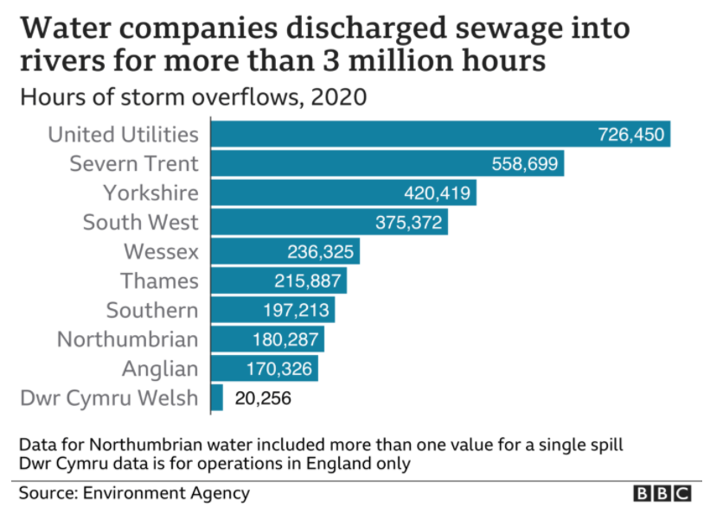
Nationally published data shows Southern Water has nearly all overflows monitored, and our relative performance is one of the best in the industry.
How often are they used?
Notes:
Event Duration Monitoring

Slide 28
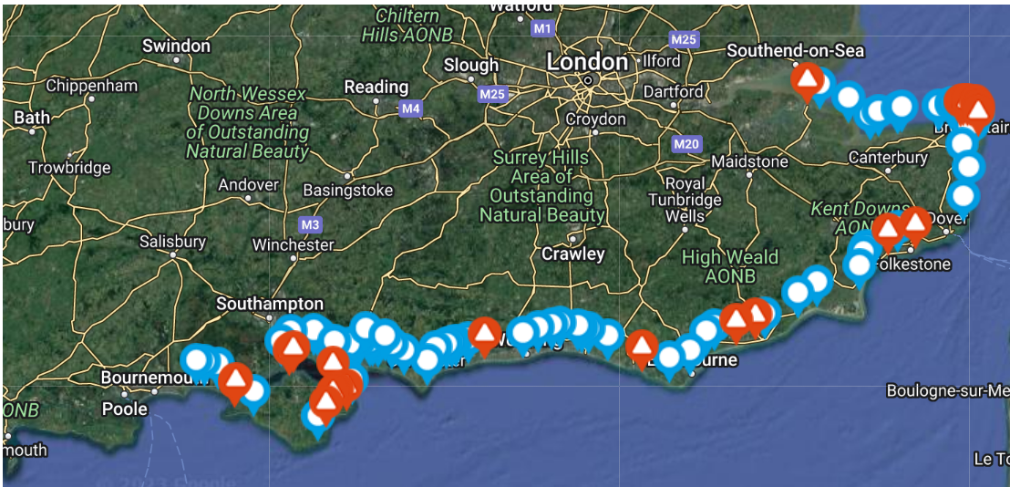
Live bathing water quality Southern Water website
Beachbuoy (southernwater.co.uk)

Slide 29
Changes we’re making

Slide 30
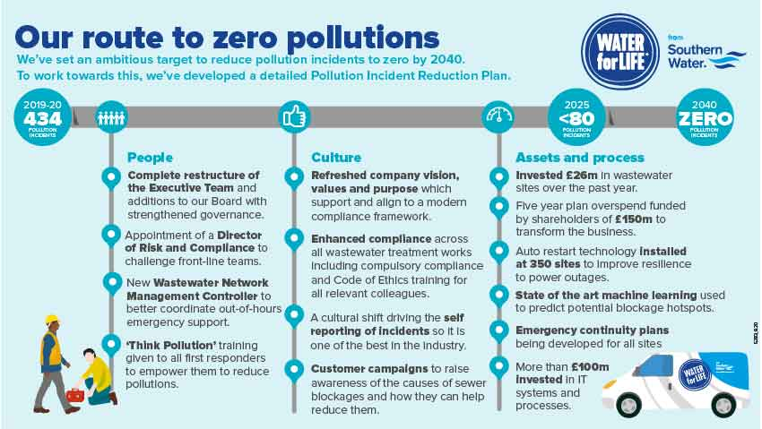

Slide 31
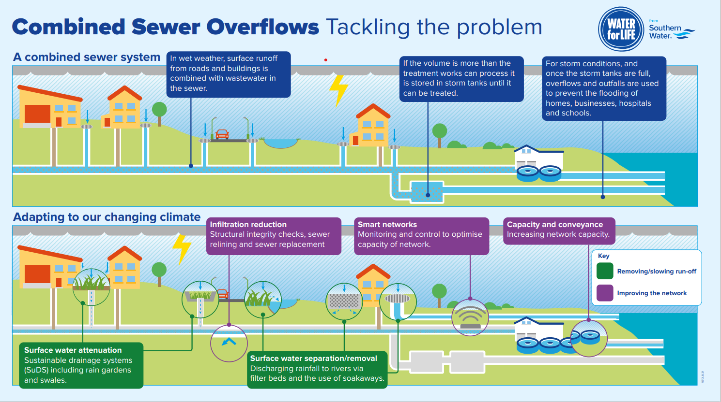

Slide 32
Questions?
Thank you for listening

