Slide 1

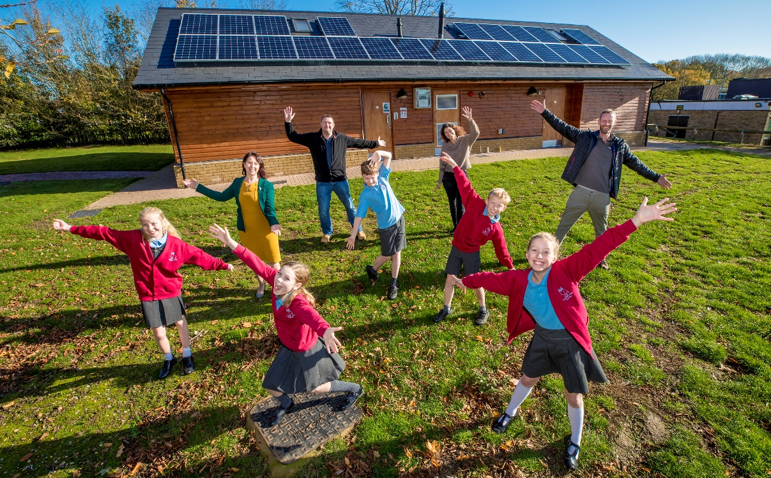
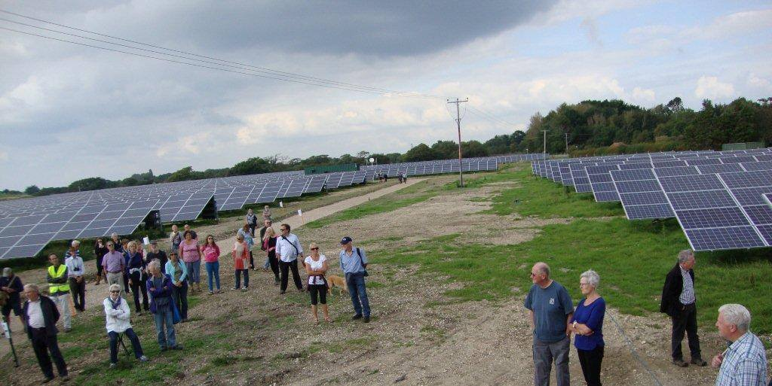
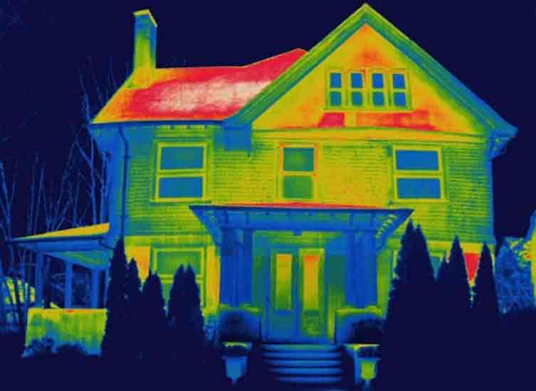
A community energy programme for the New Forest

Slide 2



Agenda
Welcome and introduction
Setting the scene in the New Forest – Roxie King, New Forest District Council
Overview of community energy – Laura Wilson, Community Energy South
Case study of community energy – Cathy Cook, West Solent Solar Coop
New Forest Community Energy Programme and next steps – Laura Wilson, Community Energy South
Q&A
Networking & refreshments

Slide 3
Energy Resilience of the
New Forest
Energy Resilience of the
New Forest
July 2023
July 2023

Slide 4
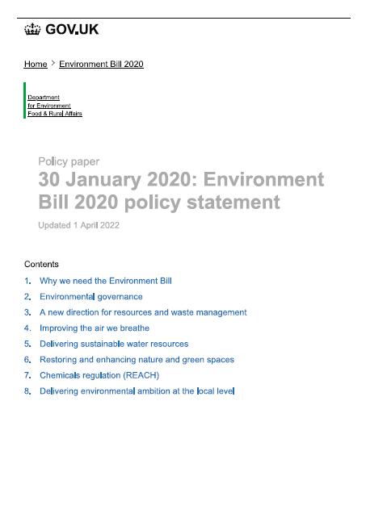

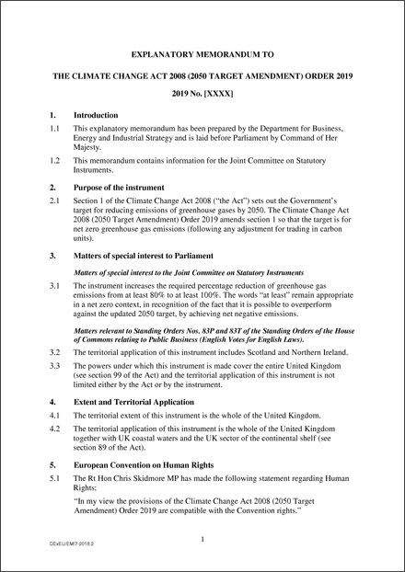


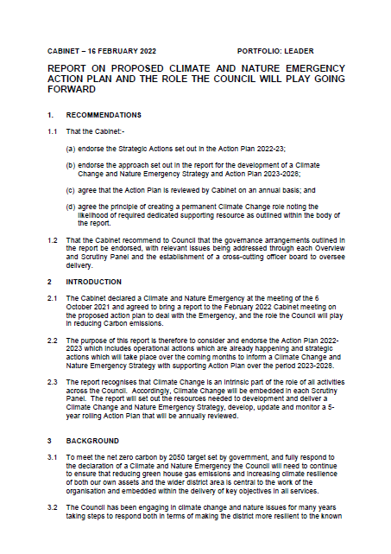
Climate Change in the New Forest
  In the NFDC area, we expect to experience:
  Hotter, drier summers
  Warmer, wetter winters
  More frequent and extreme heatwaves, droughts flooding and coastal erosion
Climate Change and Nature Emergency declared October 2021
​
Annual Report Feb 23
Strategy Summer 23
Local
National

Slide 5
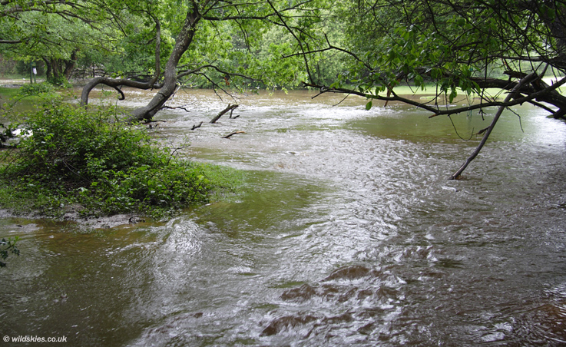
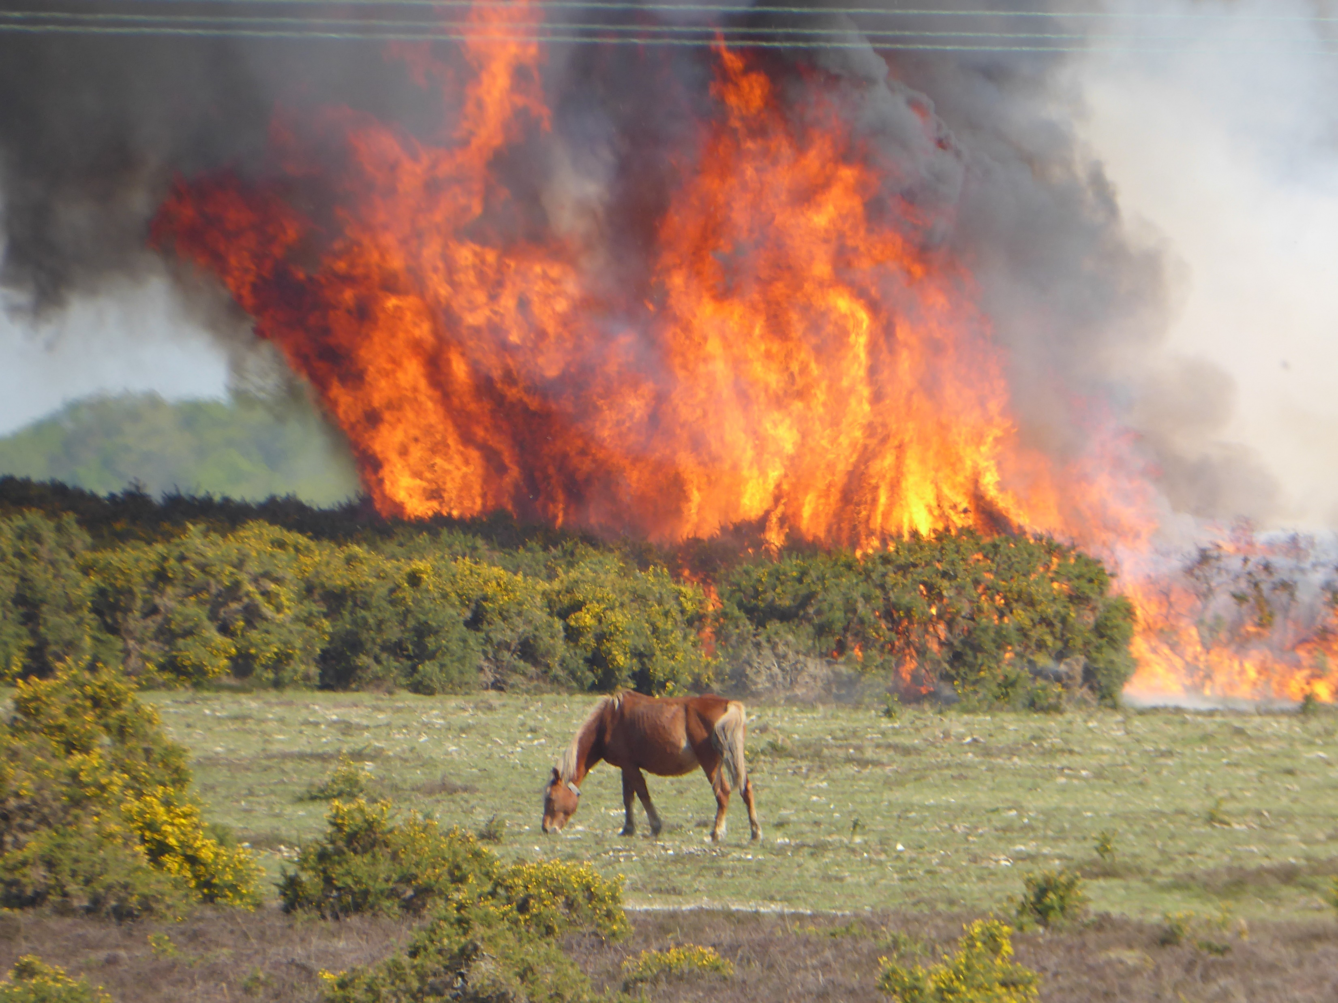
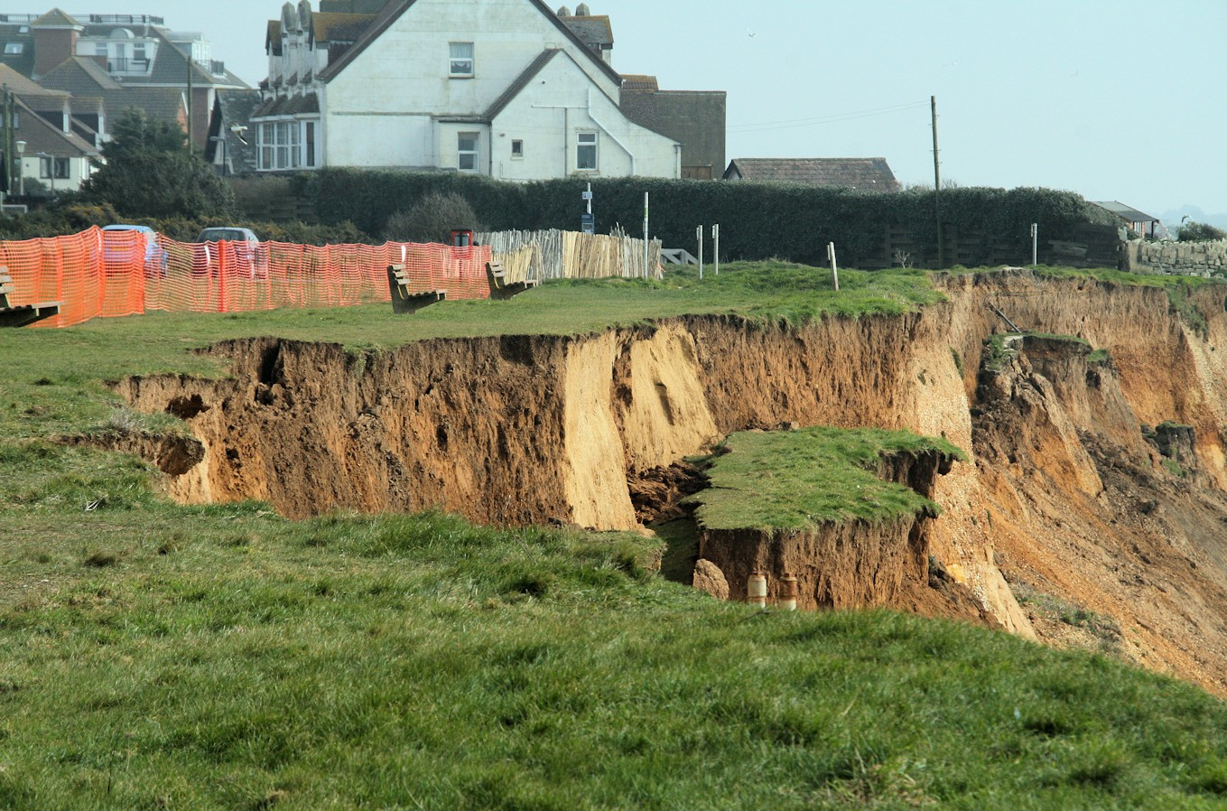
What impacts will this have?
  RESIDENTS / BUSINESSES / VISITORS / ECONOMY
  Health & wellbeing
  Accessibility & transportation
  Housing suitability
  Habitat degradation
  Species loss
  Storm damage
  Service delivery
  Food growing
  Resource availability
  Waste generation & processing
  OPPORTUNITIES & RISKS

Slide 6



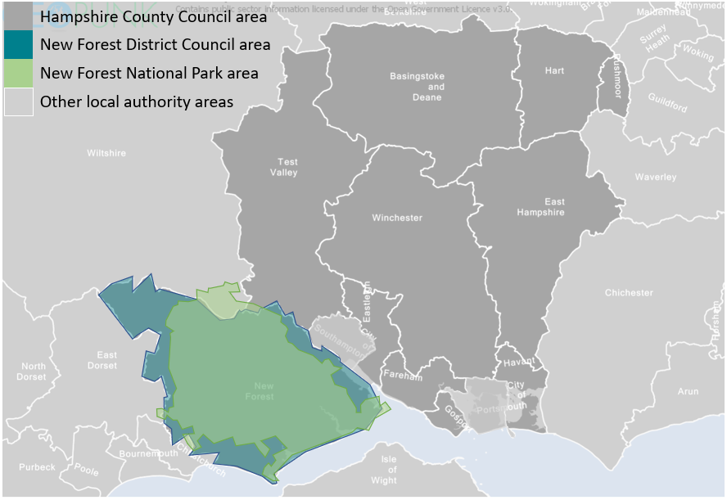


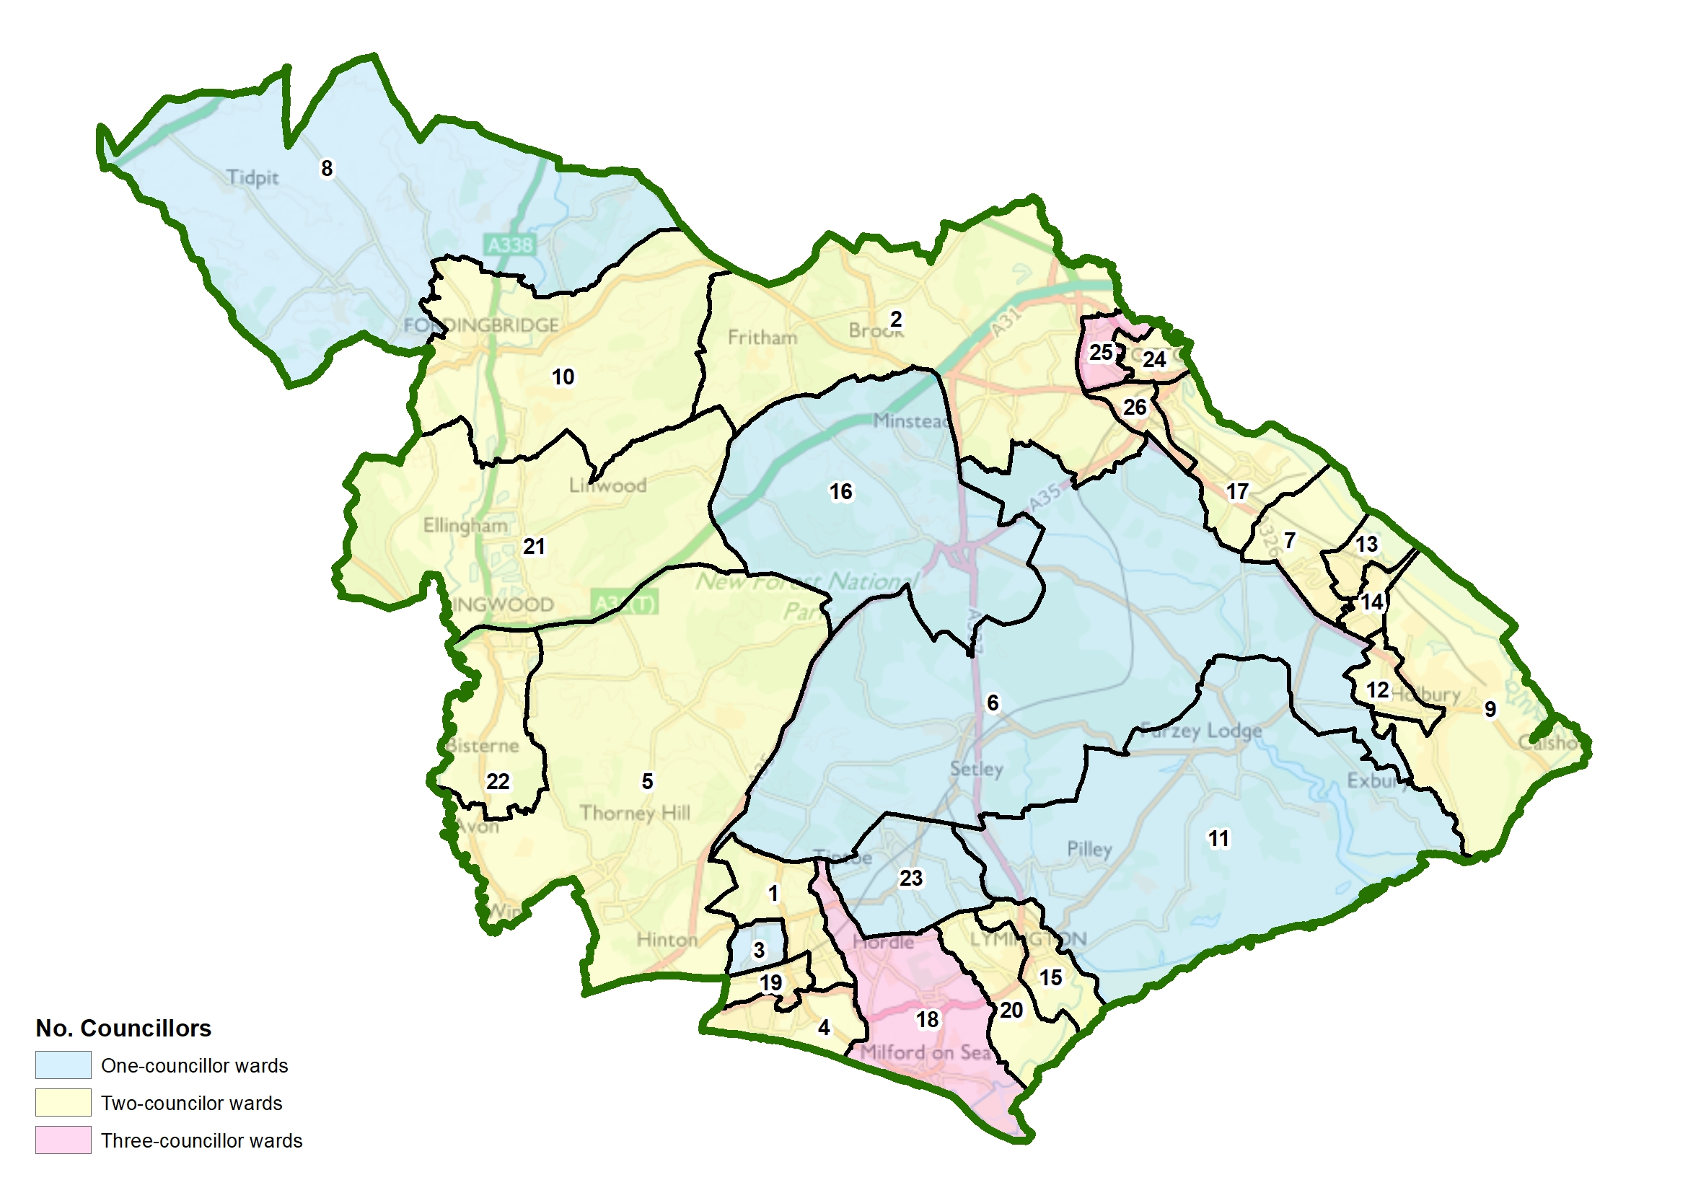





Working with Partners

Slide 7
Climate & Nature Action from 2023
CARBON REDUCTION
INTERNAL PRIORITIES |  |  | EXTERNAL PRIORITIES
Fleet | Gas | Electric | Industry | Road Transport | Homes
Depot electrification EV fleet replacement Service delivery optimisation | Building fabric / insulation BMS systems Boiler replacement | LED lighting in buildings Street lighting Renewable energy | Solent Cluster Industry engagement Carbon capture & storage | LTP4 / LCWIP EV charging network Public transport improvements | Community Energy South Retrofit / Greener Housing Local Plan
BUSINESS AS USUAL IMPROVEMENTS
Sustainable policies, plans, services & procurement |  |  | Net zero infrastructure, investment & engagement
CLIMATE ADAPTATION
INTERNAL PRIORITIES |  |  | EXTERNAL PRIORITIES
Buildings | Assets | Staff | Flooding | Coastal Erosion | Heatwaves
Location risk assessment Temperature adaptation Storm resilience | Natural assets e.g. open space Fixed assets e.g. bins Vehicles e.g. fleet / grey | Climate Champions Emergency preparedness Business continuity | Built infrastructure Natural infrastructure Catchment partnerships | Christchurch Bay / Harbour FCERM Hurst Spit to Lymington FCERM Durlston to Hurst SRM Programme | NHS / Public Health Community Resilience Plans Water conservation
BUSINESS AS USUAL IMPROVEMENTS
Service risk assessment, adaptation plans & comms |  |  | Area risk assessment, adaptation plans & comms
​
NATURE RECOVERY
INTERNAL PRIORITIES |  |  | EXTERNAL PRIORITIES
Biodiversity | Connectivity | Stewardship | Biodiversity | Connectivity | Stewardship
NFDC land studies Habitat protection Habitat creation | Nature corridors / Habitat banking Ecology infrastructure Local partnerships | Local Plan / SPDs / GI strategy Maintenance / upkeep Staff volunteering | Environmental surveys / data Habitat protection Habitat creation | Local Nature Recovery Strategy Connectivity of strategic sites Active travel / accessibility | Environment Act / regulations BNG Credits / Habitat banking Ecology without boundaries
BUSINESS AS USUAL IMPROVEMENTS
Nature Recovery in policies, strategies & decisions |  |  | Nature protection, enhancement & partnerships
PROGRAMME MANAGEMENT
INTERNAL PRIORITIES |  |  | EXTERNAL PRIORITIES
Communications | Governance | Funding | Communications | Data | Partnerships
Newsletters / updates Staff / member training Forest Net resources | CC&NE Steering Group Portfolio Holder Decision making | NFDC internal budget Central Government Private investment | Social / online / print media External webpages Public events | Carbon / Climate / nature data Public Reporting External verification | Hampshire County Council New Forest National Park Professional organisations
BUSINESS AS USUAL IMPROVEMENTS
CC&NE principles embedded in NFDC culture & services |  |  | Residents, businesses, visitors support CC&NE principles

Slide 8
Carbon Reduction Action from 2023
CARBON REDUCTION
INTERNAL PRIORITIES |  |  | EXTERNAL PRIORITIES
Fleet | Gas | Electric | Industry | Road Transport | Homes
Depot electrification EV fleet replacement Service delivery optimisation | Building fabric / insulation BMS systems Boiler replacement | LED lighting in buildings Street lighting Renewable energy | Solent Cluster Industry engagement Carbon capture & storage | LTP4 / LCWIP EV charging network Public transport improvements | Community Energy South Retrofit / Greener Housing Local Plan
BUSINESS AS USUAL IMPROVEMENTS
Sustainable policies, plans, services & procurement |  |  | Net zero infrastructure, investment & engagement
Notes:
Propose that NFDC focusses on 4 programmes, each with 3 priority areas
Align projects to address main emissions sources
Existing action plan to be aligned, developed and prioritised
Ensure that BAU processes design out carbon emissions and waste, and embed value for money, environmental improvements & climate resilience
Guidance for PMs
Collaboration between services
Information for decision makers
Data for monitoring and improvement
Approach consistent with other authorities and aligned to sector guidance

Slide 9
Energy Resilience of the New Forest
Issues
Opportunities
Increasing energy demand
Increasing population
Ageing infrastructure
Restricted capacity / availability
DNO resource constraints
National grid energy mix
Price volatility
Planning restrictions
Local renewables
High solar potential (usable)
High alternative potential (unusable)
Income generation potential
Increased capacity / less grid demand
Community interest and capacity
Community energy resilience

Slide 10
Energy Resilience of the New Forest
Outcomes
Considerations
Community engagement
Reduced personal energy use
Lower energy bills
Lower carbon emissions
Income generation
Leadership
Community asset investment
Suitable locations
Materials cost and availability
Ongoing maintenance
Longevity of schemes (succession)
Industry knowledge and support

Slide 11
Introduction to Community Energy
Laura Wilson, CES

Slide 12

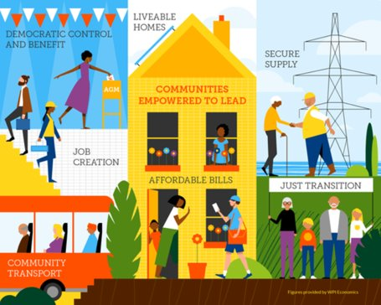
Community Energy South
- a little about us
Community Energy South was set up in 2013 to support the network of community energy groups in the South East of England.
We are a regional hub that encourages the growth of community led projects in renewable energy, energy efficiency and fuel poverty, including community owned renewable energy and grant funded projects.

Slide 13







Our Partnerships with Local Authorities
We team up with LA’s to provide support for the development of community-led low carbon and renewable energy groups and projects throughout the county.
We support the implementation of Net Zero strategies within LA’s.
Our approach is stimulate the growth of the Community Energy sector.
Our emphasis is on enabling local communities to build their own self sustainability capacity to achieve ongoing, ground level emissions reductions.
We act as a support mechanism to establish and support a network of community energy groups through mentoring, training, providing tools and resources.

Slide 14
Community energy projects
Community energy refers to any energy project or scheme that is wholly or partly owned and controlled by the local community and which has wider community impact.
They are led by people, groups and organisations in the communities that the projects are based in.
Community energy has a key role to play in the transition toward a more efficient, low carbon, decentralised energy system.
Community energy groups are usually constituted as Community Benefit Societies, which means that all profits have to be directed towards community benefit.
Community energy groups and projects are funded through a mixture of grants, community finance and philanthropic funding.

Slide 15
Three main categories
Powering Up
Communities developing and owning their own energy projects which save money and reduce carbon emissions: heat networks, renewable energy and low carbon transport
Harnessing community finance
Powering Down
A network of community energy champions who provide trusted and impartial local advice on energy and cost savings and support households struggling with their energy bills.
Enabling community resilience
Energy planning
Communities working together to coordinate and develop local energy / decarbonisation plans that are led by the community and encourage participation and ownership.
Enabling community participation

Slide 16


Community Energy Group
Owns, maintains and manages renewable energy asset
Enters into long term lease with building owner or offtaker
Uses PPA income to pay off investors
Surplus used for community benefit / social impact
Supplies electricity
Pays CEG for electricity utilised
Uses electricity generated onsite
Pays CEG for generated electricity via PPA

Slide 17
Energy Champions
Energy Champions are enthusiastic local volunteers who are involved in outreach and engagement with their local community about all things energy related.
They can provide free and impartial advice on a range of topics such as saving energy and energy efficiency, reducing energy bills, energy grants and retrofit.
Energy Champions provide a good introduction to how a household can reduce its energy consumption and can signpost them onto professional services or support agencies for more in depth support.
Energy champions can delivery advice in a variety of ways including energy cafes (e.g. Ovesco), delivering talks and workshops or even home energy visits (e.g. Energy Alton).

Slide 18

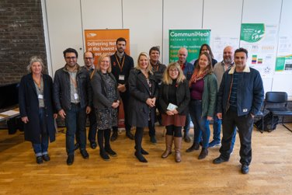
Communipower Kick Start
Kickstart allows you to work with your community to give you an outline community energy plan. It involves:
Developing an understanding of the carbon and energy usage of the community
An overview of how properties are heated within your parish/community and how the properties use their energy
Reviewing the housing archetypes within your community
Scoping and reviewing local heat and energy suppliers
Exploring community transport and EVs
Measuring interest within your community to transition to net zero
Developing an engagement programme

Slide 19
West Solent Solar Coop

Slide 20
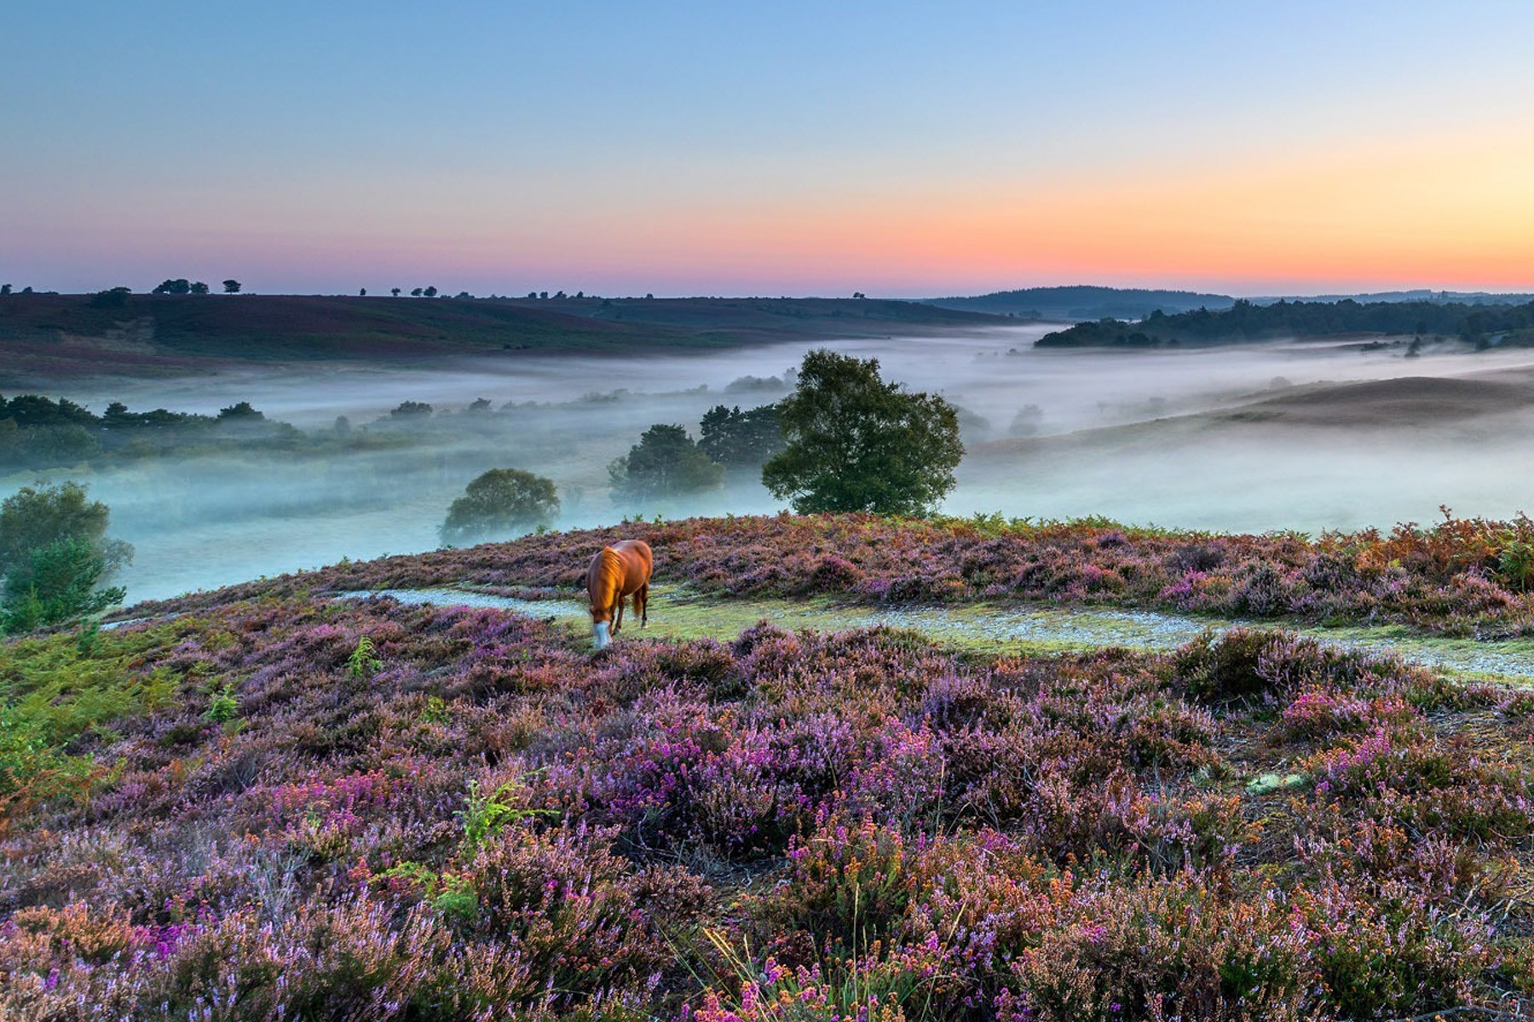
New Forest Community Energy
Community Energy South is working with New Forest District Council to deliver a two year community energy programme. This involves:
Working with communities from across the New Forest to form a new Community Energy group with a good mix of skills and experience.
Working with the group to identify a pipeline of suitable community energy project opportunities in the district.
Supporting and mentoring the group to develop its skills and capacity.
Undertaking an outreach programme to raise awareness of the community energy in the District.
Developing a network of trained energy champions across the District who can provide first step advice to households on how they can reduce their energy consumption and costs and referring them to other agencies.

Slide 21
Next steps
Workshop to explain in more detail:
  Community energy projects
  What’s involved in developing a community energy group – process, skills / experience etc.
  Identifying suitable sites
Develop volunteer network
Form community benefit society with founder members – set vision, aims and objectives, support from Coops UK.
Identify suitable sites and assess them to see whether they are viable community energy projects.
Ongoing community engagement and outreach – spread the word

Slide 22
QUESTIONS
newforest@communityenergysouth.org

