Slide 1

The truth about electric vehicles in 2025
Pub Quiz

Slide 2
About me (Phil Hookham)
I spent 36 years in the oil industry, so I’m not going to criticise anyone for driving a car with an Internal Combustion Engine (ICE)
My past cars include a 5 litre Supercharged Jaguar XKR, A TVR Chimera and three diesel cars, one of which smoked like a bonfire
The above already makes me the biggest hypocrite in the room!
However, I now drive a Tesla Model 3 and realise that there is a lot of deliberate misinformation “Clickbait” in the media that could be holding back the transition to a more sustainable future
I will be talking a little about my Tesla experience but that doesn’t make me a Tesla “fanboy” as I think that Elon Musk should keep out of politics. I don’t want to talk about his politics today.

Slide 3
Introduction
Like much of the rest of the world the UK is going through a difficult transition away from the use of fossil fuels to mitigate climate change
In 2023, road transport accounted for 28% of the UK’s total CO2 emissions and private cars were 59% of that ( so,17% of the CO2 total)
Most of us have a choice regarding where, when and how we travel and if going by car, the type of car we use.
There is lots of fear, uncertainty and doubt about changing to an electric car (but also benefits)

Slide 4
About this evening
The adoption of Electric Vehicles is a highly divisive subject with strong views held on both sides of the argument for and against
Today, let’s calmly listen to each others views/ information and facts
Some “early adopters” had a bad experience with EV’s due to the poor range of their cars, lack of charging infrastructure, heavy depreciation and battery reliability. EV’s had a bad reputation.
Todays EV’s are far superior to the early cars, and the charging infrastructure has been transformed (but with much more to do)
This evening, I will attempt to inform you of the current status and challenge some of the misinformation that you may have heard

Slide 5
Quiz subjects & discussion areas
EV’s are too expensive, and the batteries don’t last long
They don’t have enough range, especially in winter
They take too long to charge & the charging infrastructure is inadequate
EV’s cost more to run than ICE cars
They catch fire and their weight will collapse multistorey car parks
The electricity that they use isn’t green and the grid can’t cope
It’s “greener” to keep driving an old banger than buy an EV
The batteries are an environmental disaster and can’t be recycled

Slide 6

The Quiz
Arrange yourselves around a table, this is will be your team
Each table will have an answer sheet and a pen
There will be 20 questions based on common EV myths, anxieties or concerns
We’ll discuss the answer to each question before moving to the next question. Mark your own answer sheet.
We only have 5 minutes max per question!

Slide 7

Qn 1. What do you think is the average car journey distance in the UK?
A 53.5 miles
B 37.6 miles
C 18.3 miles
D 8.2 miles

Slide 8

It’s D, 8.2 miles (Source Nimblefins Sept 2025)
71% of all car journeys in the UK are less than 5 miles
The average annual mileage in the UK is 7300 miles/yr (140 miles per week).

Slide 9
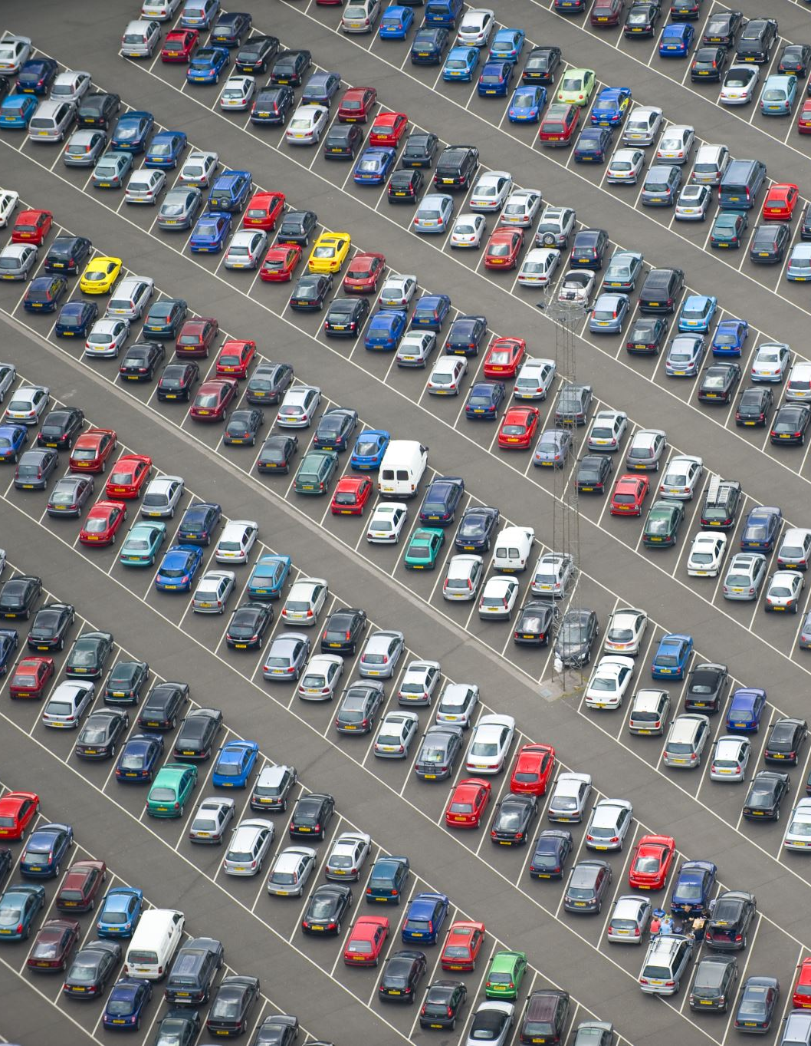
Qn 2. How many electric cars are there in the UK?
There are 28.9 million ICE cars and vans on the UK roads (18.6 million petrol, 10.3 million diesel)
How many electric vehicles are there on UK roads?
  A 670 thousand
  B 1.1 million
  C 1.7 million
  D 2.3 million

Slide 10
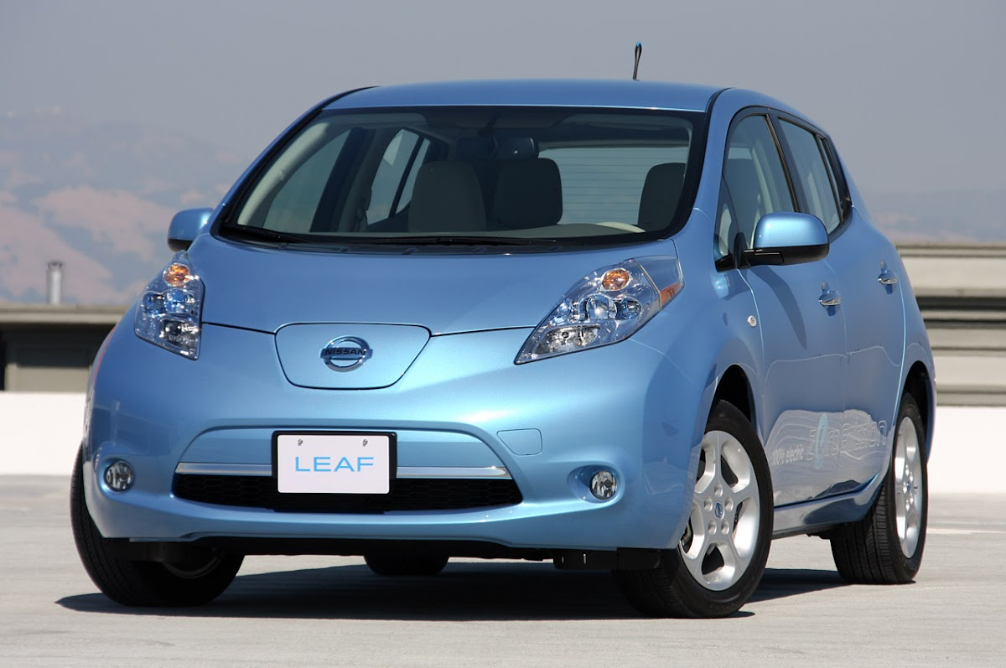
It’s C, 1.7 million
First deliveries of the Nissan Leaf in the UK were in March 2011, 14 years ago
The number of EV’s in the UK has quadrupled since 2021

Slide 11
Qn 3. What percentage of EV owners charge their cars at home?
A 91%
B 86%
C 74%
D 62%

Slide 12
It’s A, 91% of EVs are charged at home
¾’s of the EV’s charged at home use wall chargers
To charge at home the house ideally needs a front drive or garage

Slide 13
Qn 4. What percentage of the UK’s 30.4 million homes have their own front drive or garage?
A 82% (25 million)
B 70% (21 million)
C 63% (19 million)
D 44% (13 million)

Slide 14
It’s B, 70%
21 million homes with a front drive or garage means that there’s lots of potential to increase EV numbers beyond 1.7 million
However,
The numbers mean that 9 million people will have to use public chargers (on street charging or charging hubs)
The VAT on electricity at home is 5%, it’s 20% on a public charger!

Slide 15
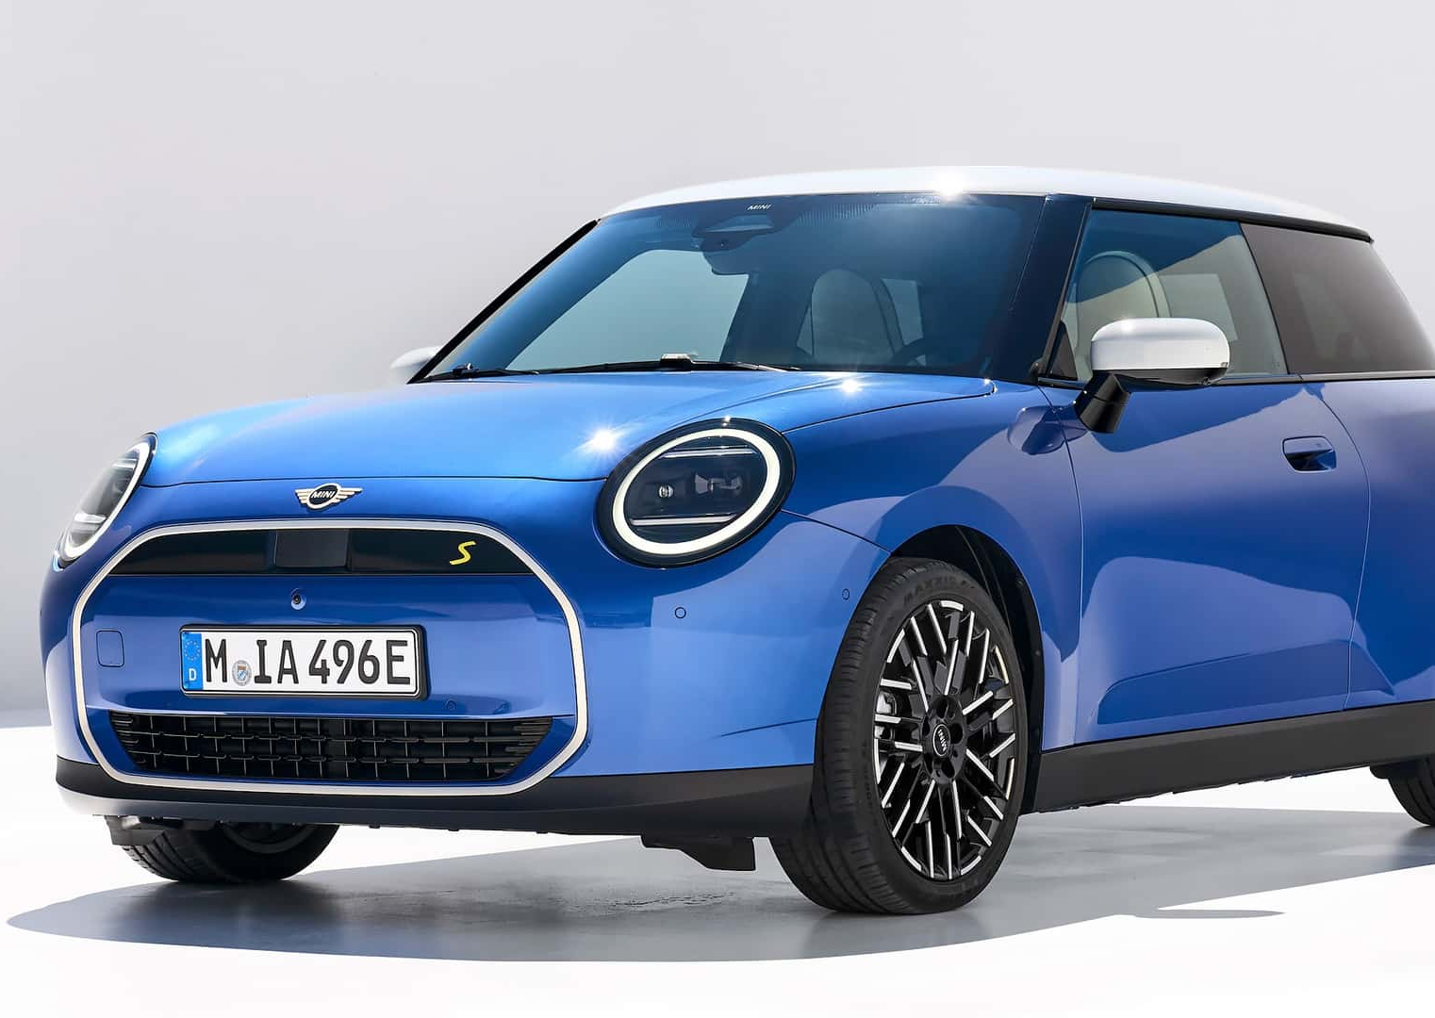
Qn5. Are EV’s too expensive to buy?
Which is/was the most expensive new car to buy on the list below
A A 2020 diesel BMW mini (discontinued in 2020)
B A 2023 plug-in hybrid BMW mini (discontinued in 2023)
C A 2025 petrol BMW mini
D A 2025 fully electric BMW mini

Slide 16
B is the most expensive
Here are the numbers
A 2020 Diesel Mini £25,500
B 2023 Plug-in hybrid Mini £31,300
C 2025 Petrol Mini £26,265 (or £250/m with £4054 deposit)
D 2025 electric Mini £26,905 (or £229/m with £4756 deposit)
But there are better deals out there

Slide 17
A few examples of new EV prices (Oct 2025)
Dacia Spring £14995 £12188*
Leapmotor T03 £15995
BYD surf £18650
Fiat Grand Panda £21035
MG 4 £27245 £17557*
Renault 5 EV £22995 £20828*
Nissan Micra £22995
* Source Auto Express due to year end targets (pre-registered) & Government EV vs ICE rules
Coming in 2026
VW ID2 £20k? Renault Twingo £17k?
MG2 £20k? Kia EV2 £25k ?

Slide 18
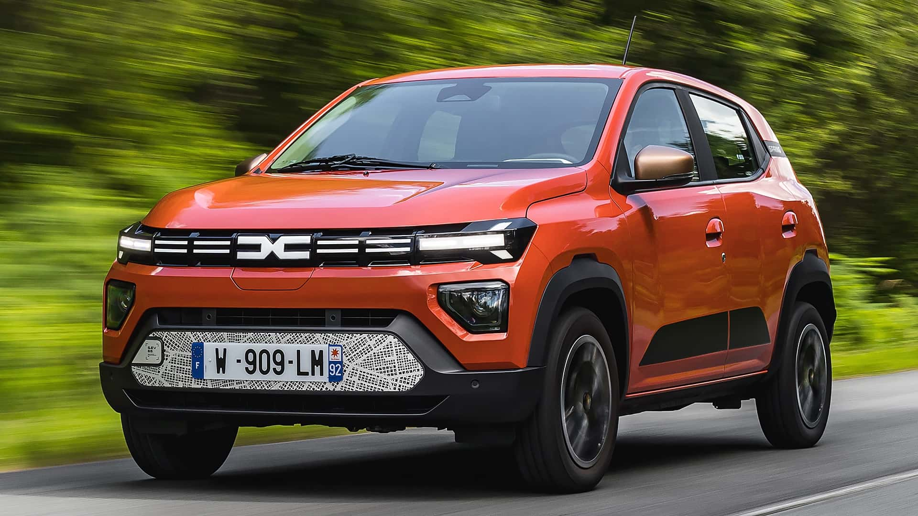
DACIA SPRING
140 miles WLTP
£125/m on a PCP

Slide 19
What about used EV’s ?
£5000 buys a 2015 Renault Zoe with 7930 miles on the clock
£9995 buys a 2023 MG4 with 3720 miles on the clock
£14900 gets you a 2024 Citroen eC4 that’s done 10223 miles
£19949 would buy a 2022 Tesla Model 3 that’s covered 25260 miles
There are currently 28944 EV’s advertised on AutoTrader of which 1391 (5%) cost less than £10k (Data taken on October 3rd , 2025)

Slide 20
Qn 6. In the UK, what % of new car sales are EV’s?
A 62.3% (984,998 EV sales to end Sept 2025?)
B 37.6% (594,478 EV sales to end Sept 2025?)
C 22.1% (349,414 EV sales to end Sept 2025?)
D 15.1% (238,740 EV sales to end Sept 2025?)

Slide 21
It’s C, 22.1% of new car sales are EV’s
That means that almost 80% of new car buyers are choosing to NOT buy an EV
Let’s have a look next at what might be stopping them!

Slide 22
Qn 7. Can EV’s do the manufacturers claimed range?
Four years ago, “What Car” tested 10 EV’s in real world driving conditions to compare their actual range versus claimed WLTP range (Worldwide Harmonised Light Vehicle Test Procedure)
The VW ID3 had a WLTP range of 264 miles. How far did it go in the “What Car” test (which was carried out in summer)?
  A 264 miles (100% of WLTP)
  B 245 miles (93% of WLTP)
  C 226 miles (85% of WLTP)
  D 198 miles (75% of WLTP)

Slide 23
It’s C, 226 miles
On average, the 10 cars tested only delivered 85% of their claimed range but there were large variations
  The Porsche Taycan achieved 97% of its claimed 290-mile WLTP range
  In contrast, the Fiat 500 only got to 140 miles instead of 198 miles
If buying ANY car – do your research
In 2015 I bought a new Euro 4 diesel Renault Clio. It later turned out that its real-world NOx emissions were 12x higher than claimed (part of the VW emissions scandal – they were all lying)

Slide 24
Qn 8.
Do EV batteries only last 8 years?
When it was new my Tesla Model 3 performance had a real-world range of 290 miles. It’s now 6 yrs, 4-month-old and has travelled 49,000 miles. I recently did a battery max’ capacity test, what do you think the summer range is now?
  A 263 miles (92% of new)
  B 244 miles (84% of new)
  C 220 miles (77% of new)
  D 206 miles (72% of new)
The battery chemistry is NCA (Nickel-cobalt-aluminium) which was phased out in 2021 in favour of the more robust LFP (Lithium-iron-phosphate)

Slide 25
It’s B, 244 miles (84%)
It’s true that early EV’s like the Nissan Leaf and Renault Zoe did degrade their batteries and some needed replacement if the capacity fell below 70%. (Cost to replace, £4920 if done by Nissan, cheaper elsewhere).
Modern EV’s have battery temperature control (heating and cooling), use more robust chemistry (LFP), different charging curves, all designed to give a longer life.
A 2016 Tesla Model S has driven 430,000 miles on its original battery. Similarly, a Hyundai Ioniq 5 has driven 360,000 miles.

Slide 26
Qn 9. Do EV’s have enough range for long journeys?
To travel from Hythe to the South of France (612 miles) via the Channel Tunnel in my 6-year-old Tesla Model 3, how many times would I recharge the car? (given that the max range now is 244 miles).
  A 6
  B 5
  C 4
  D 3

Slide 27
It’s 5x, so B is the answer I was looking for.
An EV driver doesn’t usually let the battery fall to 0%, 20% is the normal minimum (leaves 50 miles in the tank)
The battery charging speed tails off rapidly above 80% so that’s the normal maximum to minimise journey times
That means on a long journey only 60% of the battery capacity is being used, in my case that’s enough for about 150 miles.
The latest Tesla Model 3 has a claimed WLTP range of 466 miles. In real world summer driving, around 400 miles is more likely.

Slide 28
Qn 10, How long do EV’s take to charge?
I frequently visit my parents who live 155 miles away and I generally recharge at the Tesla Centre at Bar Hill. How long does it usually take to recharge the car back to 80%?
  A 12 to 15 mins
  B 20 to 22 mins
  C 35 to 41 mins
  D 41 to 55 mins

Slide 29
It’s B, 20 to 22 minutes, but that creates the wrong impression
Here’s approximately how long it takes an EV to add 100 miles of range
Via a 3-pin plug 10 hours
Via a 7-kW AC wall charger 4 hours
Via an 11-kW AC charger 2.5 hours
Via a 50-kW DC charger 45 minutes
Via a 150-KW DC charger 15 minutes
Via a 250-kW DC charger 10 minutes
Some small cars can’t do DC charging
Some bigger cars “max out “ at 50 to 150 kW depending on the spec’
Taking a break every few hours on a long journey is no bad thing – the “splash and dash” technique

Slide 30
Qn 11. Is an EV’s range in winter less than summer?
Winter driving obviously reduces the range by increasing consumption (cabin heating, lights, wipers, more air and tyre resistance). If the max’ summer range is 244 miles, what is my typical winter range in January based on real data?
  A 198 miles (82% of summer range)
  B 165 miles (68% of summer range)
  C 148 miles (61% of summer range)
  D 120 miles (49% of summer range)

Slide 31
It’s B, 165 miles
Parkers research published in June 2025 suggests a drop in range of 1/3rd summer to winter, so my data matches that.
In winter I pre-heat the car using mains electricity to defrost the windows and heat the cabin.
The optimum battery temperature is 25 Degrees C, increasing to 35 Deg C for fast charging. It gets warmed up by waste heat recovered from the motors and inverter or from the battery itself to give faster charging.
The reduced range in winter means that I need to charge more often
The latest EV’s use heat pumps for cabin heating which is 4x more efficient than the “resistance heating” in my car.

Slide 32
Qn 12. Are there enough EV chargers?
In the UK there are 8381 petrol stations serving 28.9 million ICE cars & vans. So, that’s 1 station per 3448 vehicle. Assuming 12 pumps per station that’s 1 pump per 287 vehicles.
How many chargers over 50 kW are there serving the UK’s population of 1.6 million battery EV’s?
  A 5325 (307 cars per charge point)
  B 8258 (198 cars per charge point)
  C 17132 (95 cars per charge point)
  D 30849 (53 cars per charge point)

Slide 33
It’s C, 53% of which are over 150 kW
There are a total of 85163 public chargers in the UK of which 17132 are “fast chargers”. (Source ZapMap Sept 2025)
However;
  There are some “dark” areas in Wales and Northern Scotland
  Long journeys need to be planned
  There is a need for more on-street charging, destination chargers at work, hotels and holiday homes

Slide 34
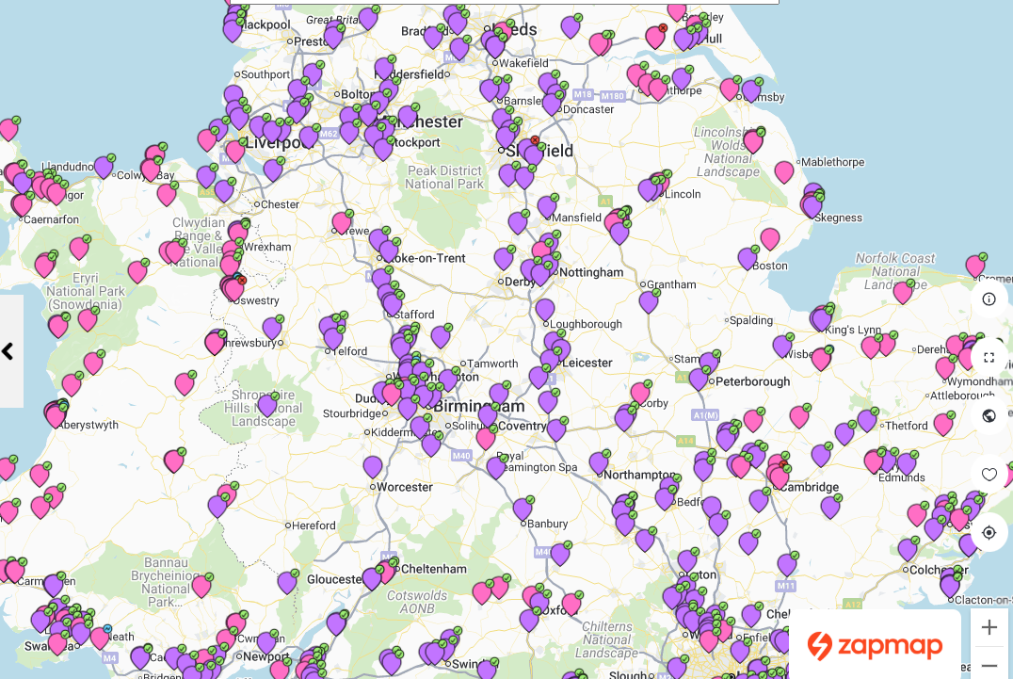
Pink = 50 kW
Purple = 150+ KW
Green tick = chargers available
100 miles

Slide 35
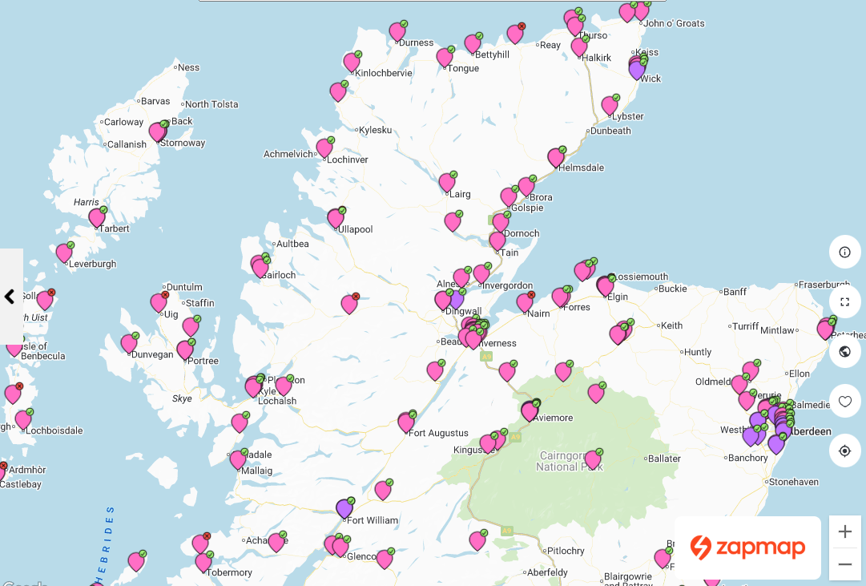
Not so many chargers in Scotland
65 miles

Slide 36
Qn 13. Do EV’s have higher “fuel” costs than ICE cars?
If a petrol car does 50 mpg the fuel cost is roughly 12.4 p/mile (£1.36/litre, Oct 2025)
An EV charged at home on an overnight tariff would cost equivalent to
  A 30 mpg ( 20.7 p/mile)
  B 51 mpg ( 12.4 p/mile)
  C 103 mpg ( 6.2 p/mile)
  D 310 mpg ( 2 p/mile)

Slide 37
The answer is D, 310 mpg. However,
Overnight EV tariff @ 7.9p/kWhr & 4 miles/ kWhr = 310 mpg
At home during the day @ 26.3 p/kWhr = 94 mpg
At the 60 kW Mer charger in Hythe car park @ 78p/ kWhr = 32 mpg
At the 120 kW Ionity charger @ Hardley Industrial estate @ 87p/kWhr = 28 mpg
At the 160 kW Gridserve charger at Winchester = 28 mpg
At a 250 kW Tesla supercharger in the UK (37p/kWhr) = 67 mpg
At a supercharger in France (25p/kWhr) = 99 mpg
Conclusion: If you can’t charge at home, it’s expensive!

Slide 38
Qn 14.
Do EV’s frequently catch fire?
The Swedish Civil Contingencies Agency investigated all car fires in 2022. There were 3400 fires amongst the 4.4 million ICE cars (0.08%)
How many fires (including during charging) were there amongst the 611,000 population of EV’s in Sweden in 2022?
  A 23 (0.004%)
  B 97 (0.015%)
  C 457 (0.07%)
  D 874 (0.14%)

Slide 39
Its A. ICE cars are at least 20x more likely to catch fire
In 2024, in the UK, there were 232 EV fires versus approximately 19,000 ICE vehicle fires (80x more fires than EVs)
My old diesel BMW (and over a million others) was recalled due to the fire risk from the EGR system when the particulate filter does a regen cycle
However, If an EV battery catches fire, it IS more difficult to extinguish because it doesn’t need oxygen to burn. Fire Departments now cover burning EV’s with a special fire blanket and cool it with water jets from underneath.

Slide 40
Qn 15. Are EV’s so heavy that they collapse multistorey car parks (like what happened in New York)
The original Mk1 mini weighed 635 kg, the current BMW petrol mini weighs 1250 kg, the lightest diesel version weighed 1100 kg, the PHEV weighed 1735 kg
How much does the EV version weigh?
A 1052 kg
B 1804 kg
C 1350 kg
D 1480 kg

Slide 41
It’s D, 1480 kg
The collapsed New York multi-story car park was in fact a converted office block.
The operator put more cars into the car park than permitted under their licence. The structure failed because it was overloaded. It had nothing to do with EV’s.
In general, EV’s are slightly heavier than their petrol equivalent but future battery technology is set to make EV batteries much lighter due to changes in design and battery chemistry. For example, solid state batteries will double the battery energy density.

Slide 42

Qn 16. The electricity put into an EV was made from fossil fuels that produced CO2 anyway!
UK electricity is made from wind, solar, nuclear, hydropower, biomass, imports from abroad and GAS (no longer from coal)
In 2024 what percentage of UK electricity annual production was made from gas ?
  A 53%
  B 28%
  C 16%
  D 7%

Slide 43

It’s B, 28% (wind was next at 26%)
The average UK grid carbon intensity in 2024 was 124 gCO2/ kWhr
That means a typical UK EV “produces” about 31 gCO2/ mile
The best new ICE car emits 148 gCO2/mile (Toyota Yaris Hybrid)
Burning 1 UK gallon of petrol produces 10.5 kg CO2, so a car that does 50 mpg produces 210 gCO2/mile (7x an EV).
The grid carbon intensity in France in 2023 was 27 gCO2/ kWhr (nearly 5x better than the UK)
My drive to the South of France and back produced 33 kg’s of CO2 for 2 people
Flying from Bournemouth to Marseille and back would have been about 950 kg’s
But it’s not all about CO2
In the UK an estimated 40000 people per year die prematurely from NOx & PM2.5 emissions, primarily from diesel vehicles.
An EV doesn’t emit any NOx or PM2.5 at the tail pipe

Slide 44
Qn 17. If everyone had an EV, could the UK grid cope?
In the UK the daytime demand for electricity is typically about 33 GW, it peaks at around 6pm. Between midnight and 6 am the demand drops by about 8 to10 GW
If every EV averages 10,000 miles per year, roughly how many additional EV’s could be charged between midnight and 6 am using just the “spare” capacity?
  A 965 thousand
  B 1.6 Million
  C 8.9 Million
  D 28.9 Million

Slide 45
It’s C, 8.9 Million (ish)
Here’s the maths. 10,000/365 = 27 miles/day = 6.8 kWhrs needed
10,000,000,000/6800 = 1.48 Million charged per hour
1.48 x 6 = 8.9 Million charged during the 6-hour time slot
The UK government is targeting 60 GW of electricity from wind alone (high-capacity cables are currently being installed across Norfolk to distribute the power)
The UK Civil Nuclear Roadmap is aiming for 24 GW of nuclear capacity by 2050 & will provide ¼ of UK power

Slide 46
Qn 18. How long does it take for a new EV to repay its production “carbon debit”?
A new Tesla Model 3 made in 2019 produced 10,400 kgs of CO2 during manufacture (nearly 50% of that was in the battery).
A similar sized new petrol car produces about 5,600 kgs
If the petrol car does 50-mpg and they both drive 10,000 miles per year. How long is it before the carbon footprint of the EV is the same as the petrol car?
A 2 years, 8 months
B 3 years, 4 months
C 5 years, 7 months
D 7 years, 9 months

Slide 47
It’s A, 2 yrs & 8 months
Here’s the maths
10400+(10000x31/1000)xZ = 5600+(10000x210/1000)xZ
Z = 2.68 years
The EV will have driven about 27,000 miles.
Arguably, every mile driven in an EV with over 30 k miles on the clock will have a lower carbon footprint than driving an ICE car.
(If the ICE driver only does 5000 miles per year and his car does 60 mpg the break point is 6 yrs, 8 months, both cars will have travelled 33 k miles)

Slide 48
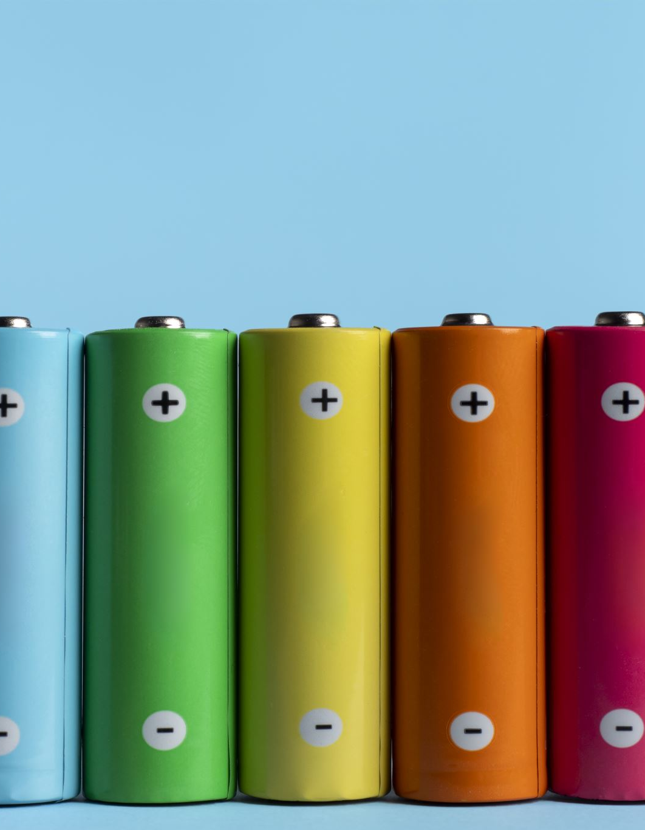
Qn 19. Can an old EV battery be recycled?
When an EV battery falls to 70% of its original capacity it is usually replaced. Some old battery cells can be reused for home or industrial energy storage.
Failed cells are recycled back to their component parts (cobalt, nickel, lithium etc)
How much of a recycled cell is legally required to be recovered in the UK in 2025?
  A 90%
  B 70%
  C 50%
  D 30%

Slide 49
It’s C, 50% in 2025, increasing to 70% in 2030
There are 5 EV battery recycling companies in the UK. Their main problem is that there are not enough old EV batteries coming forward!
The current LFP battery technology is being replaced by sodium batteries which are much cheaper (but slightly bigger) and less harmful to the environment.
The latest solid state “blade” batteries have a higher energy density than “cell” type batteries = longer range
Tesla has recently patented an “Aluminium ion” battery that doesn’t use exotic metals and claims amazing performance (future Tesla model 2)

Slide 50
Qn 20.
Should I buy one?
A Yes, I’ll book a test drive
B Maybe, after I’ve done more research
C I’ll wait until the cars and infrastructure are better
D No, I’m a petrolhead and don’t care about pollution

Slide 51
A, B, or C are correct answers
Let’s remember that in 2025 nearly 80% of new car buyers voted D with their wallet for a multitude of reasons.
Let’s hope that they did it for the right reasons, rather than because they believed the anti-EV “clickbait” lies in the social media.
How many questions did you get right tonight?

