Slide 1
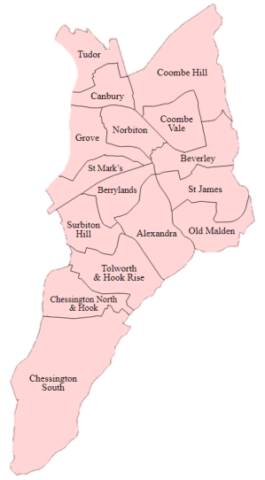
Inspiring love of local places
Kingston Green Infrastructure, Energy and Water Programme

Slide 2
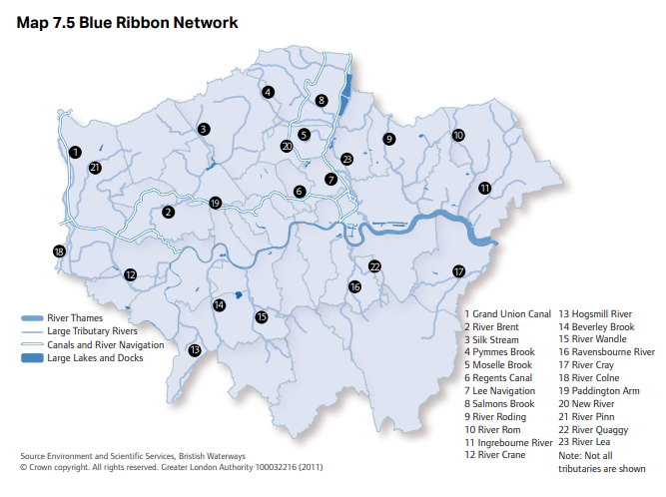
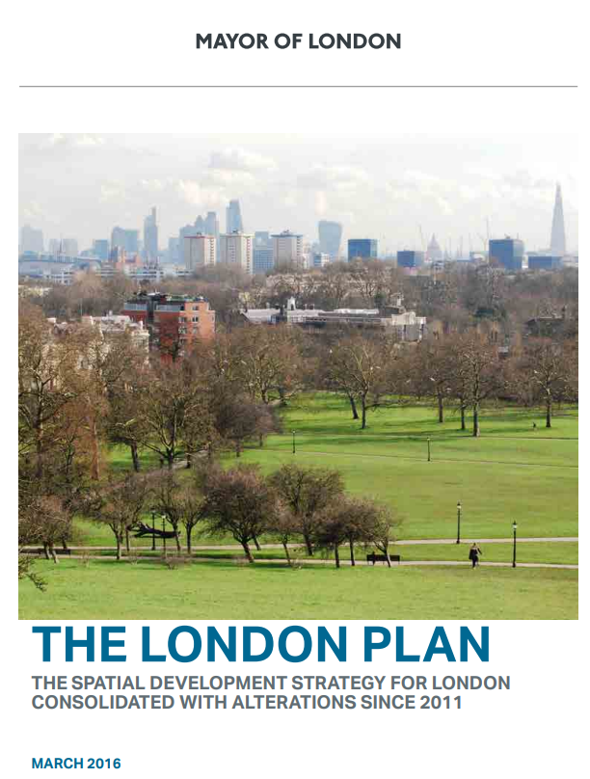
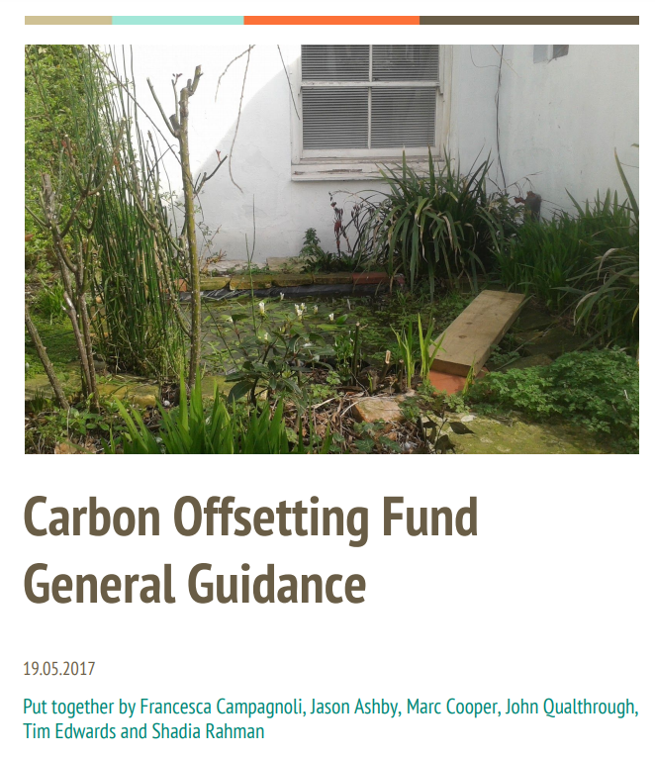
Background
London Plan 2016
Carbon offsetting fund
R B Kingston commission
Environment Trust with South West London Environment Network (SWLEN)
£22.4k, Apr 2018 – Sep 2019, part time staffing

Slide 3
Aims
Engage people living and working in the Borough
Build broad-based support for change
Develop and support environmental projects: four themes
Policy input: decentralised energy

Slide 4
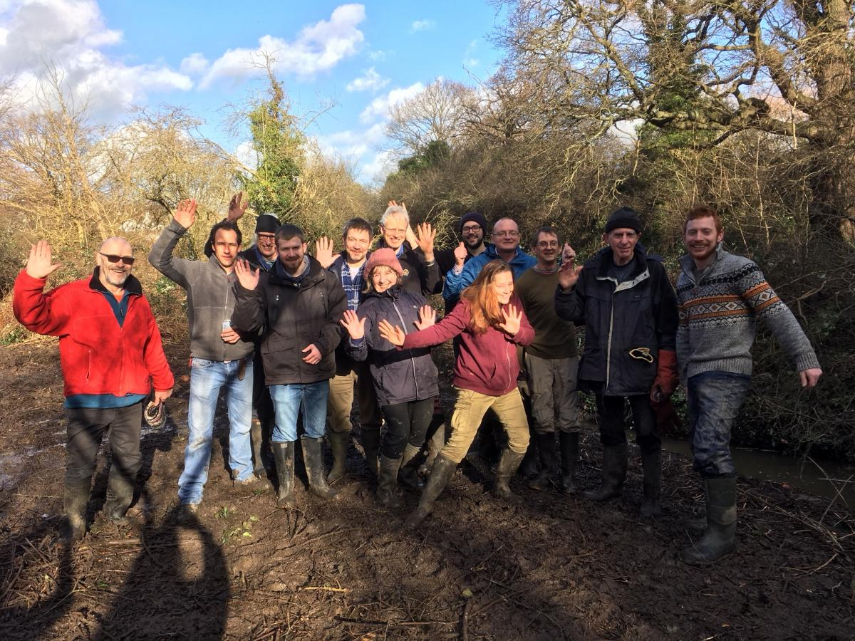
‘Deliverables’
Baseline needs assessment
Four project plans – ‘funding-ready’
Policy input – energy (SWLEN)
Friends’ groups and community networks

Slide 5
Programme themes
Water friendly solutions: green roofs, storm ponds, sustainable urban drainage
Householders: water and energy efficiency
Green infrastructure and biodiversity
Exposure to poor air quality: e.g. cycle ways

Slide 6
Have your say
Questionnaire - for needs assessment
Ideas for projects
Raising awareness more widely

Slide 7
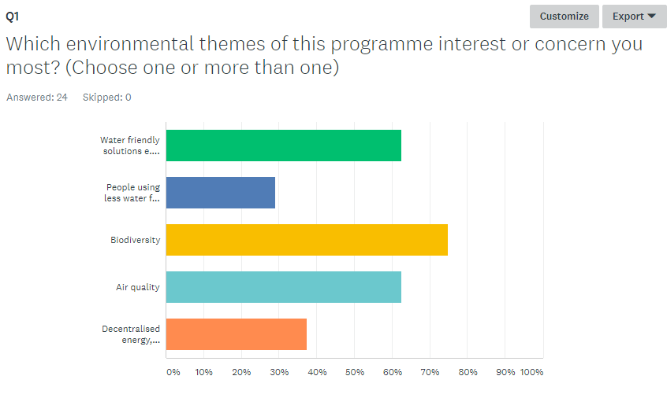
Some survey responses
“A lot more trees and possible re-routing of the one-way system through central Kingston to reduce the huge amount of air pollution present. Also, changing all buses from diesel to hybrid to reduce air pollution. Green walls and roofs to be integrated into the many new buildings being built in Kingston (such as the Old Post Office site & Eden Walk upgrade).”
“Revisiting bus routes which often overlap while other areas are not covered. Encouraging people out of their cars. More school visits re resources and the future.”
“Personal surveys of local observations of various topics wildlife flora pollution etc to make up a local map of the problems.”

Slide 8
Contacts
stephen.james@environmenttrust.co.uk
elliot.newton@environmenttrust.co.uk
Facebook: Environment Trust
Twitter: @ET_Conservation
07860 878462
Thank you!

