Slide 1
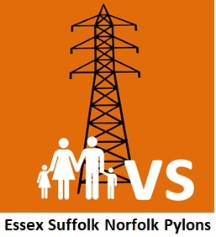
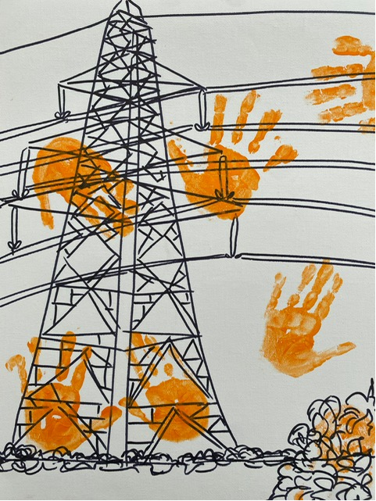
Essex Suffolk Norfolk Pylons
www.pylonseastanglia.co.uk
NOT A DONE DEAL

Slide 3
What are those next stages?
This is the Statutory Consultation. Next step will be the submission of the Development Consent Order, the planning application, to the Planning Inspectorate, next year.
At that point the campaign will be arguing that the DCO should not be accepted – due to failures in the consultation process over the past two years.
A consultation should be held at a ‘formative stage’, i.e before a decision has been made. As you all know, this was not the case!
National Grid decided on pylons down this route a long time ago!
A consultation should also supply enough information to make an informed response. That’s not the case either.
There are lots of gaps, particularly when it comes to costings.
And consultation responses should be given conscientious consideration.
They haven’t been. Much of what we have told National Grid has been ignored.
So we will put all these arguments to the Planning Inspectorate.
And we will be saying that the harms caused by Norwich to Tilbury outweigh the benefits.

Slide 4
Alternatives
If NG’s DCO is accepted then we will also make arguments about the lack of consideration given to alternatives to the pylons.
An integrated offshore grid is CHEAPER and better for the environment than the current piecemeal, or radial, approach.
Underground High Voltage Direct Current, or HVDC, cables instead of Alternating Current as proposed, would be cheaper over the lifetime of the project if built by 2034.
Yet National Grid continues to ignore better alternatives.
We will be saying that the HARMS caused by Norwich to Tilbury outweigh the benefits.

Slide 5
In your own submission, we recommend that you do three things:
Say that you OBJECT and that you endorse the submission of the Essex Suffolk Norfolk Pylons action group.
Say that you have never been presented with alternatives and that the one proposed creates unacceptable harm.
Set out all the HARMS caused by the project in this village. Harms to habitat, heritage, rights of way, businesses. Any harms you can think of!
Finally, think about specific ‘mitigations’, should the project go ahead. That might mean that an ancient oak tree should be avoided, or an access road changed, or an archaeological site bypassed.

Slide 6
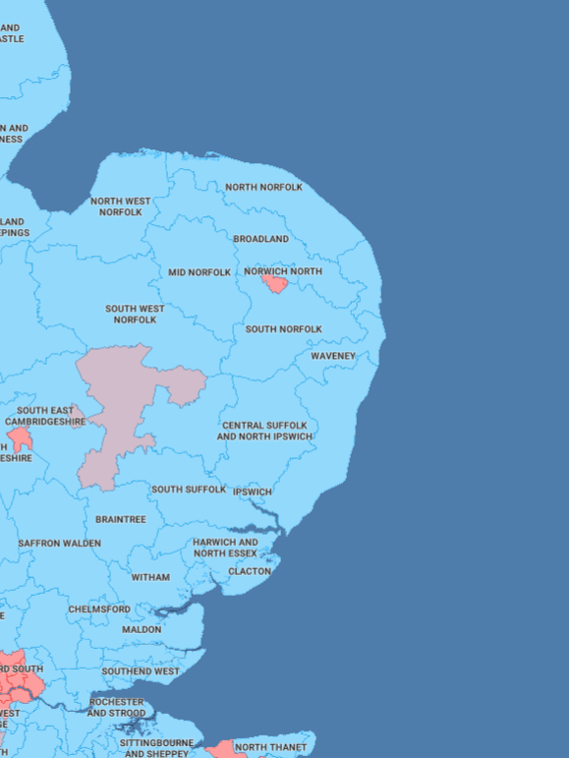
Our submission
Consultation deficiencies
Alternatives
Harm caused by N2T
Offshore grid
N2T ‘offshore’ option
HVDC underground
How YOU can help
Petition
Donate
Actions
Respond
Five Estuaries
& North Falls. Tarchon?
WWW.PYLONSEASTANGLIA.CO.UK

Slide 7
How to respond
Email contact@n-t.nationalgrid.com
« I OBJECT »
Big picture: endorse ESNP submission
HARMS
Harms: habitats, species, heritage, archaeology…
Harms during construction.
3. ‘Mitigation’ & local solutions
See www.pylonseastanglia.co.uk/actions/
“I OBJECT. The Norwich to Tilbury pylons project brings severe harm to the environment, communities, landscapes & heritage of East Anglia. Viable and deliverable alternatives such as an offshore grid and undergrounding of cables have not been presented for consultation.”

Slide 8
Last but not least, it’s Election time. Please ask EVERY candidate who comes to your door to sign our Great Grid Election Pledges. And if you can, please do donate to Essex Suffolk Norfolk Pylons via their website: www.pylonseastanglia.co.uk
Thank you.

Slide 9


Slide 10


