Slide 1



Community Engagement Great Waltham
View in Power BI
Last data refresh:
02/10/2025 15:25:15 UTC
Downloaded at:
02/10/2025 15:26:21 UTC

Slide 2
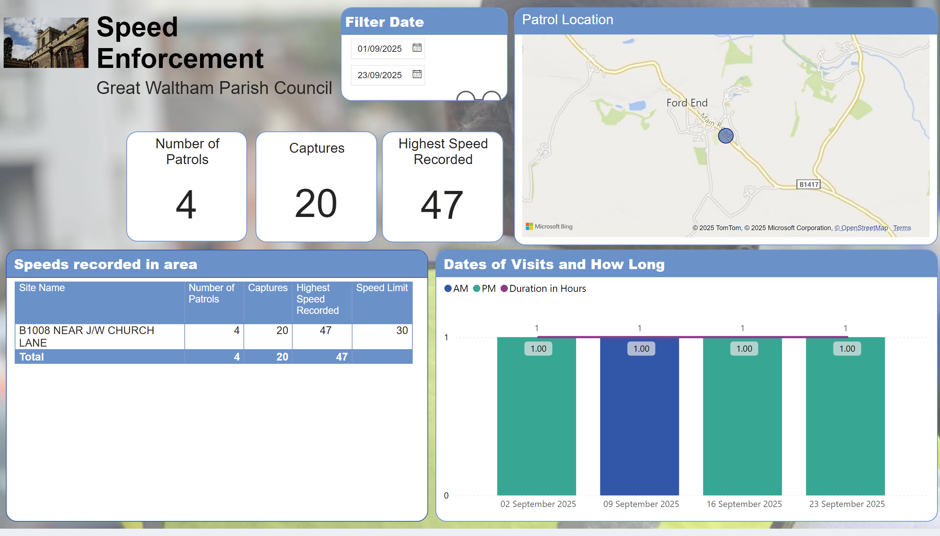
Speed Enforcement-Overview
Notes:
textbox
No alt text provided
Patrol Location
No alt text provided
textbox
No alt text provided
Speeds recorded in area
No alt text provided
Number of Patrols
No alt text provided
Filter Date
No alt text provided
image
No alt text provided
Captures
No alt text provided
Highest Speed Recorded
No alt text provided
Dates of Visits and How Long
No alt text provided

Slide 3
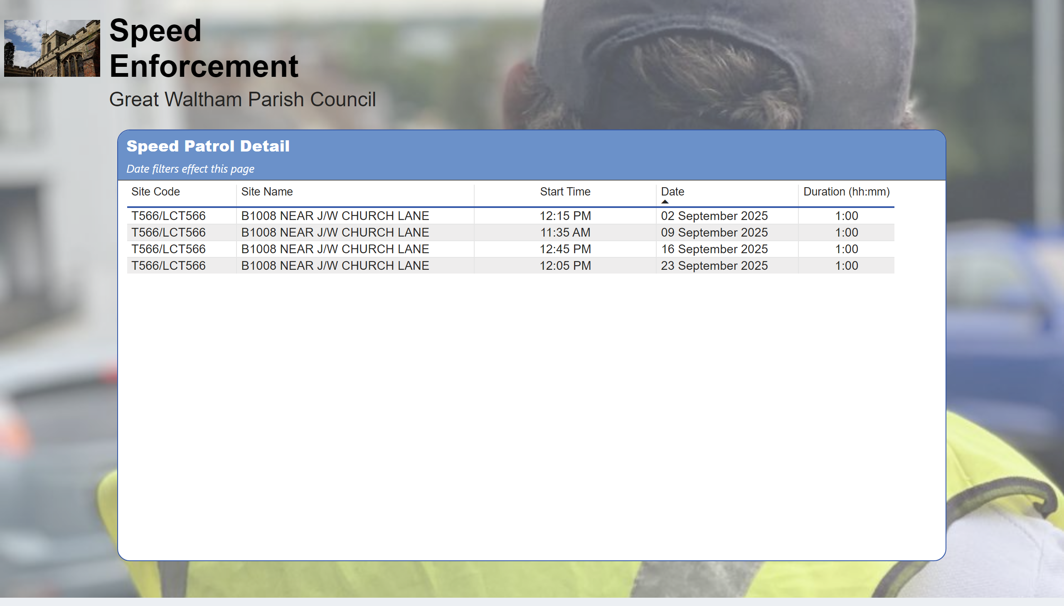
Speed Enforcement-Detail
Notes:
slicer
No alt text provided
image
No alt text provided
textbox
No alt text provided
textbox
No alt text provided
Speed Patrol Detail
No alt text provided

