Slide 1
PSS Live – Screen Shots

Slide 2
Benefits of the Online System
View status of any playground instantly
Clear tracking of issues raised during inspections
Highly customisable
Stores Inspections for 21 years
Inspectors can use smart phone or tablet to enter data
Store photographs of assets
Paperless Inspections
Assign the work
Set budgets
Hold supplier information

Slide 3
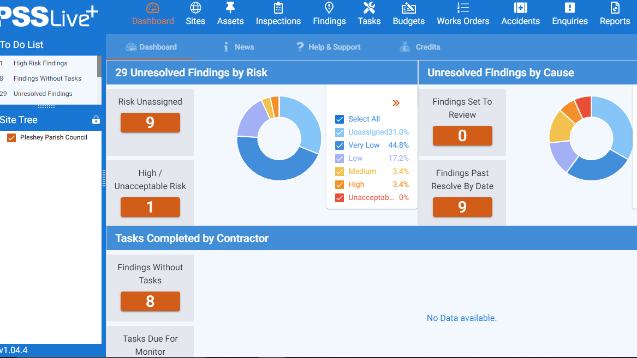

Slide 4
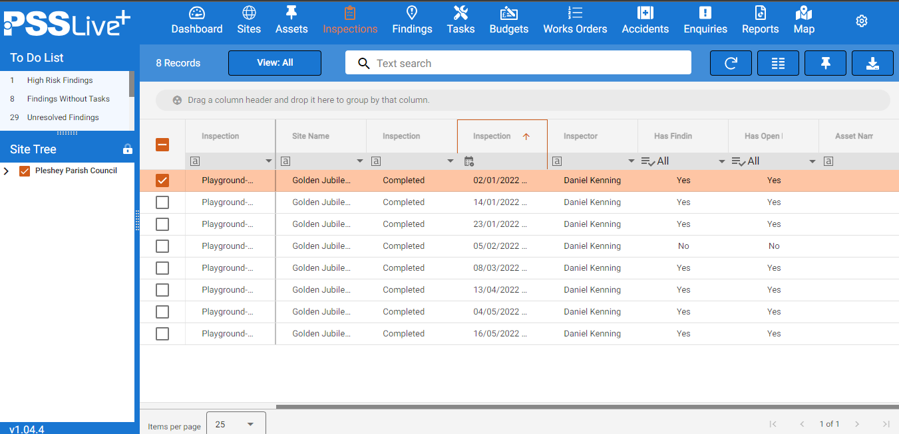

Slide 5
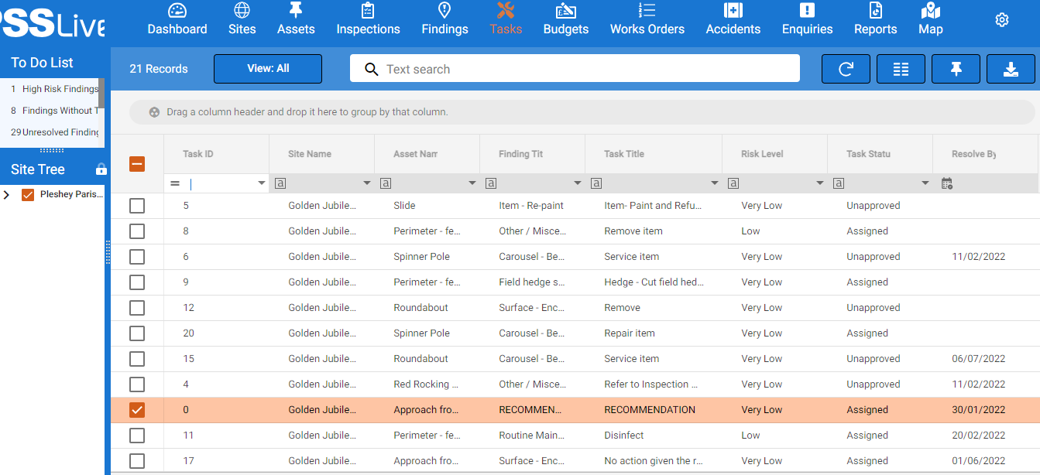

Slide 6
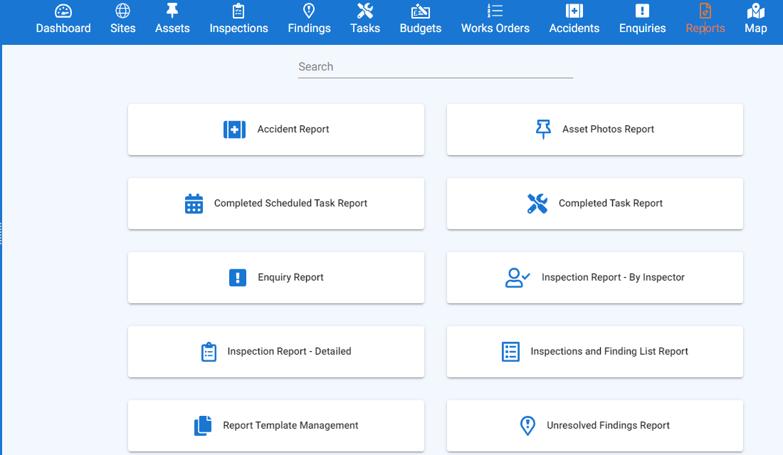

Slide 7
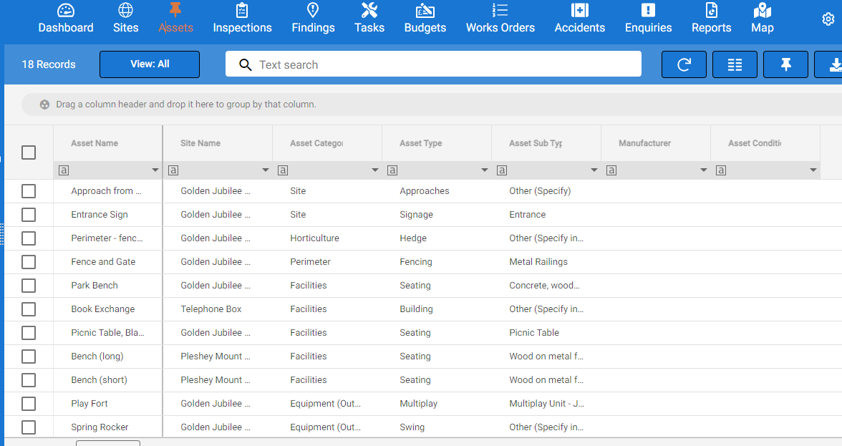

Slide 8
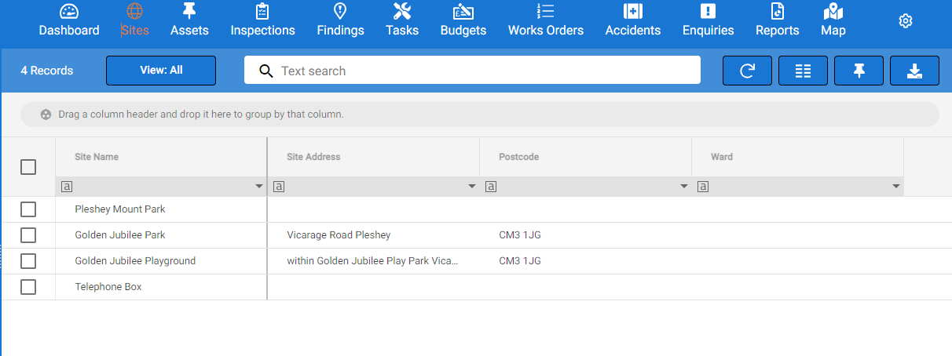

Slide 9
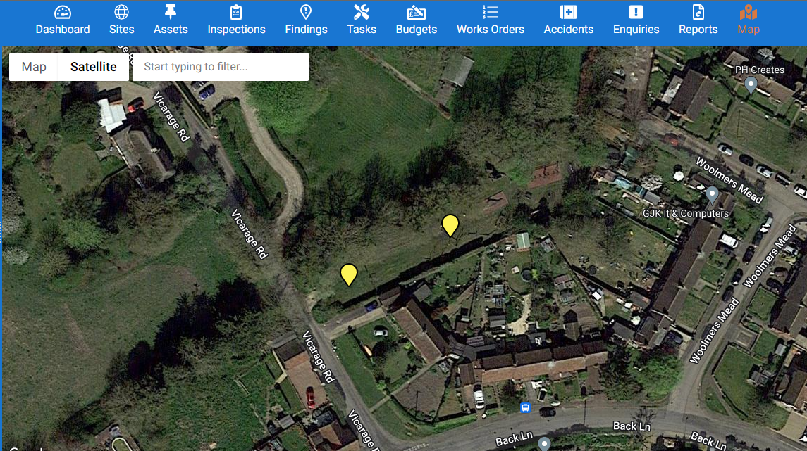

Slide 10
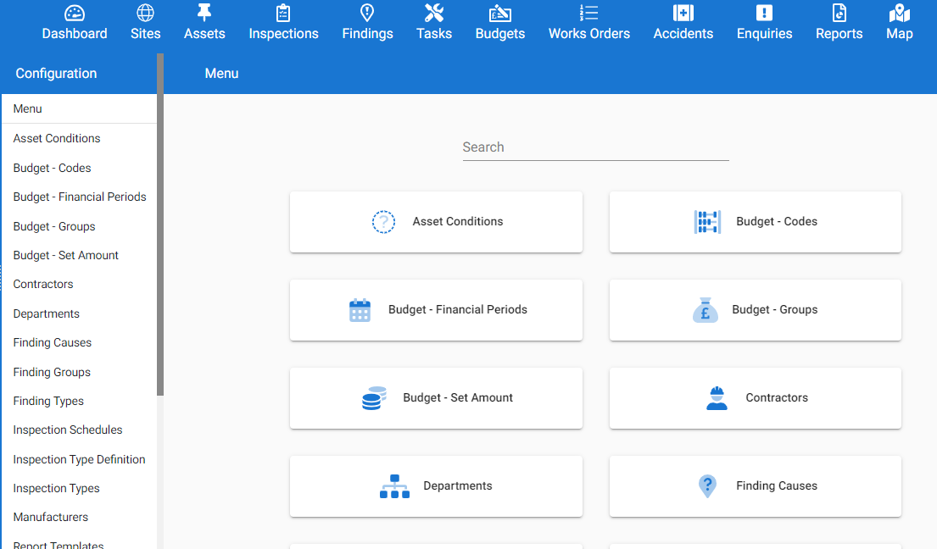

Slide 11
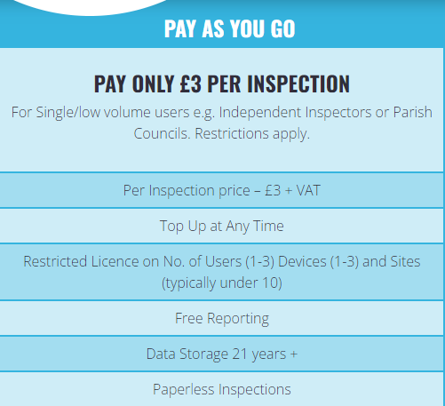

Slide 12
Potential Cost
Cost £3 per inspection
50 weeks per year
£150 per year per Inspector / Site (Clarity needed )
Range of £450 - £300 plus VAT

