Slide 2
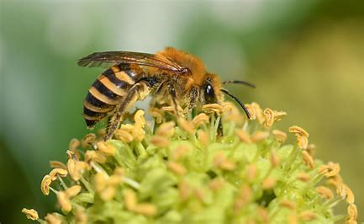
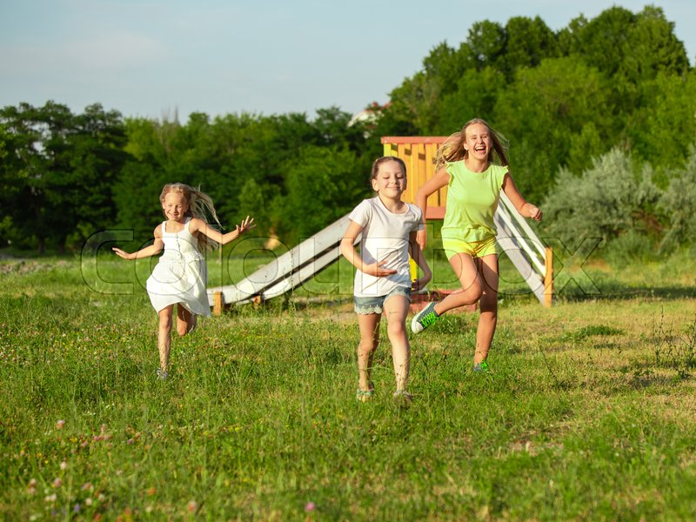
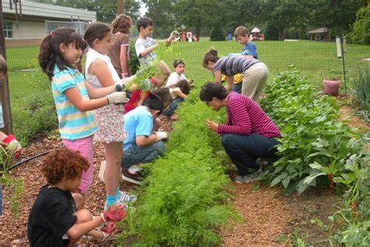
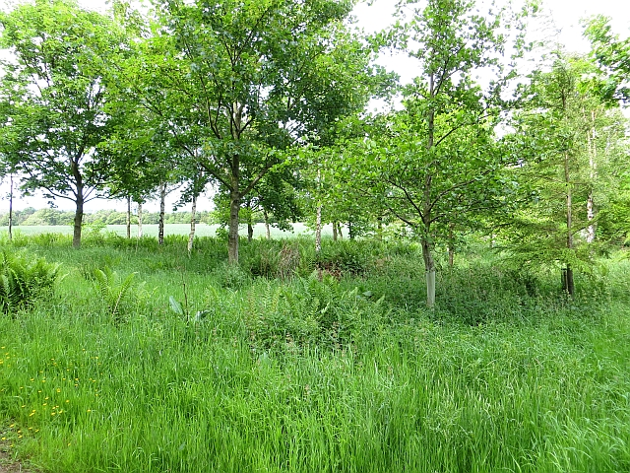
What could it become, what do you think ?
A green open space for families and a nice place to play with your friends
A place that is good the environment, birds, bees, insects and wildlife
A place to understand how things grow and how nature, people and the environment can work together

Slide 3
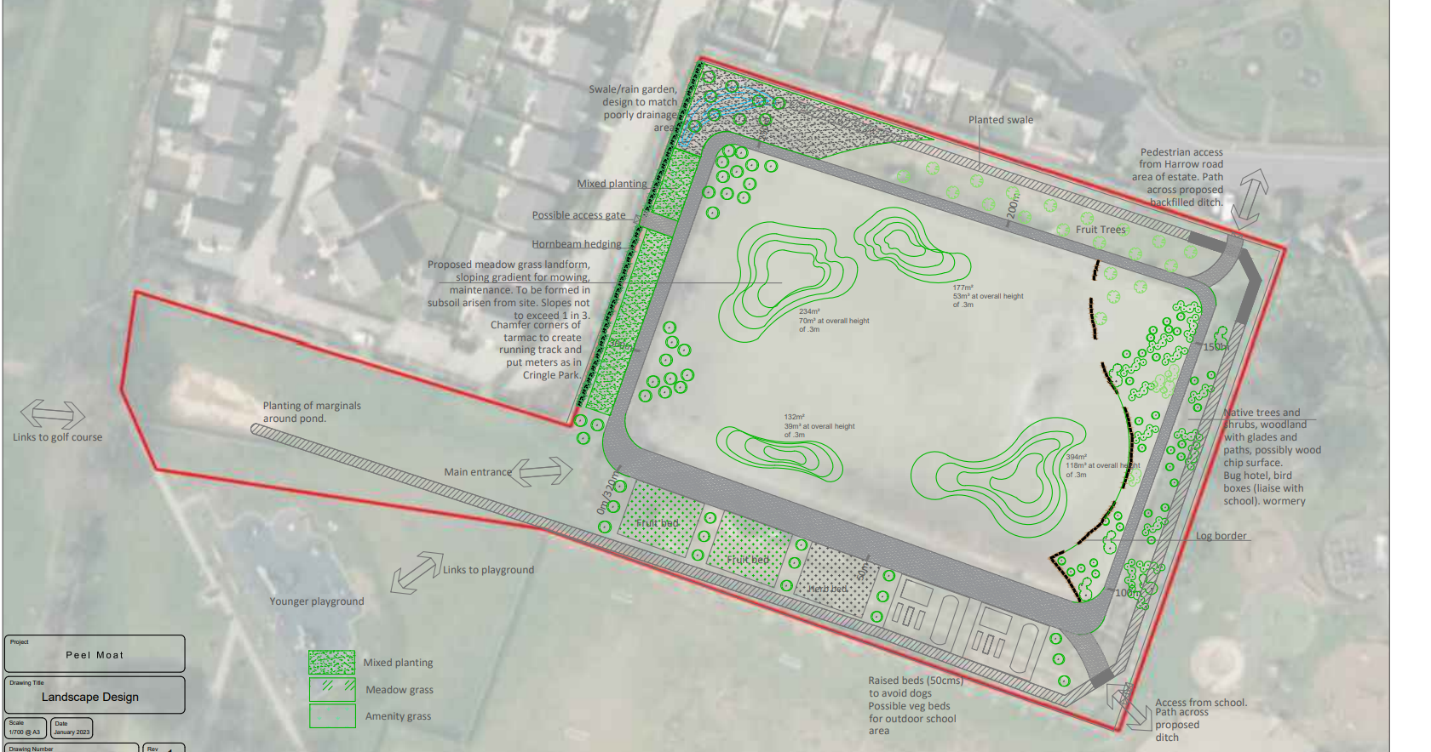

Slide 4
We need some help from you
Help us design a logo or badge for the website, posters and signs
What could that include and what might it say?
A fun place for families and children ?
Good for insects birds and the environment ?
In the future help with planting and gardening

