Slide 1
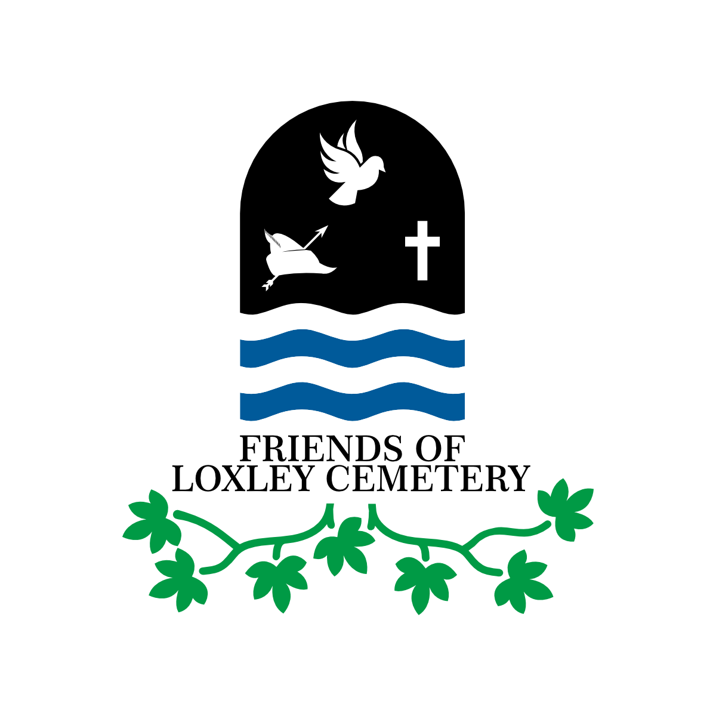

Slide 2
HISTORY OF LOXLEY CHAPEL
1787 - 2025
Mike Ford, Chair, Friends of Loxley Cemetery
e-voice.org.uk/friendsofloxleycemetery/
loxley.chair@gmail.com
loxley.secretary@yahoo.com

Slide 3
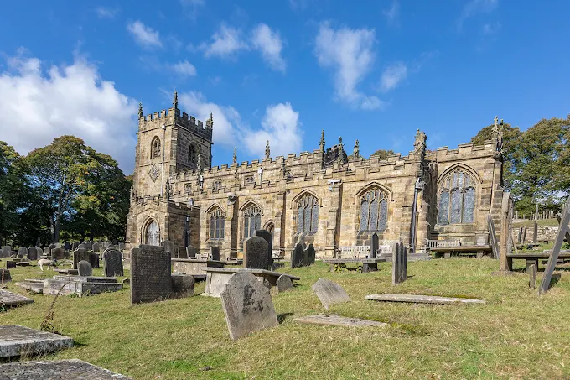
In the Beginning
St Nicholas’ Church at High Bradfield was built in the early 1100’s, approximately 900 years ago. It was originally a Norman church, built after the conquest in 1066. It is a Grade 1 listed building, one of only 4 within Sheffield’s boundaries.
However, as with any long-standing institution, there have been problems along the way. In the 1780’s a new Curate (John Webster), was appointed to replace the existing, and popular, Benjamin Greaves. An additional problem was that Mr Webster came from St Swithin’s at Holmesfield, some 16 miles away and had no connection with the Bradfield area. Therefore, a rift developed and some of the congregation opted to raise funds to build a new church, some 5 miles further down the valley, in Loxley, and install Mr Greaves as its Curate. This new building was given the name Loxley Chapel.
Despite extensive research we have been unable to locate details of the sale of the land that Loxley Chapel stands on, the original architects involved and the builder(s) commissioned to carry out the works. Notwithstanding, we know that the Chapel was declared open for services in 1787.

Slide 4
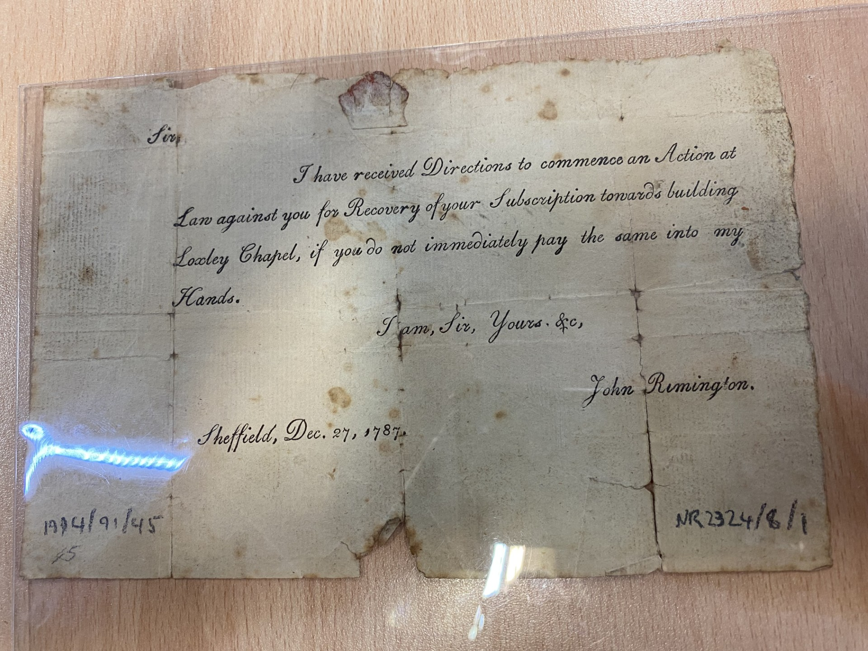
Early Life
The Chapel could seat up to 1000 people. Its first Curate was Benjamin Greaves, who arrived from St Nicholas church at High Bradfield. It is thought that he had a peripatetic role in the early days as the Manse building on Loxley Road, which housed later members of the clergy, was not built until 1855.
It would appear that the Chapel was built using public subscriptions. Problems with this method of funding were evident from the start. An earlier history of the Chapel claimed that the building was refused consecration due to the fact that the sum raised (£1,000), was inadequate to include an ‘east window’ in the structure. Apparently, this is one of the criteria which the CofE required to enable consecration of their religious buildings. Consecration being the declaration that the building/person/area is sacred under Christianity. Another, less charitable interpretation for refusal, was that Mr Greaves was too popular a Curate, resulting in a lessening of parishioners at the Mother Church. Evidence of funding problems also exist in an ‘Action at Law’ which was issued to a reluctant subscriber on the 27 December 1787.
Benjamin Greaves was to leave Loxley for the position of Vicar at St Martin’s Church in Stoney Middleton in 1796.

Slide 5
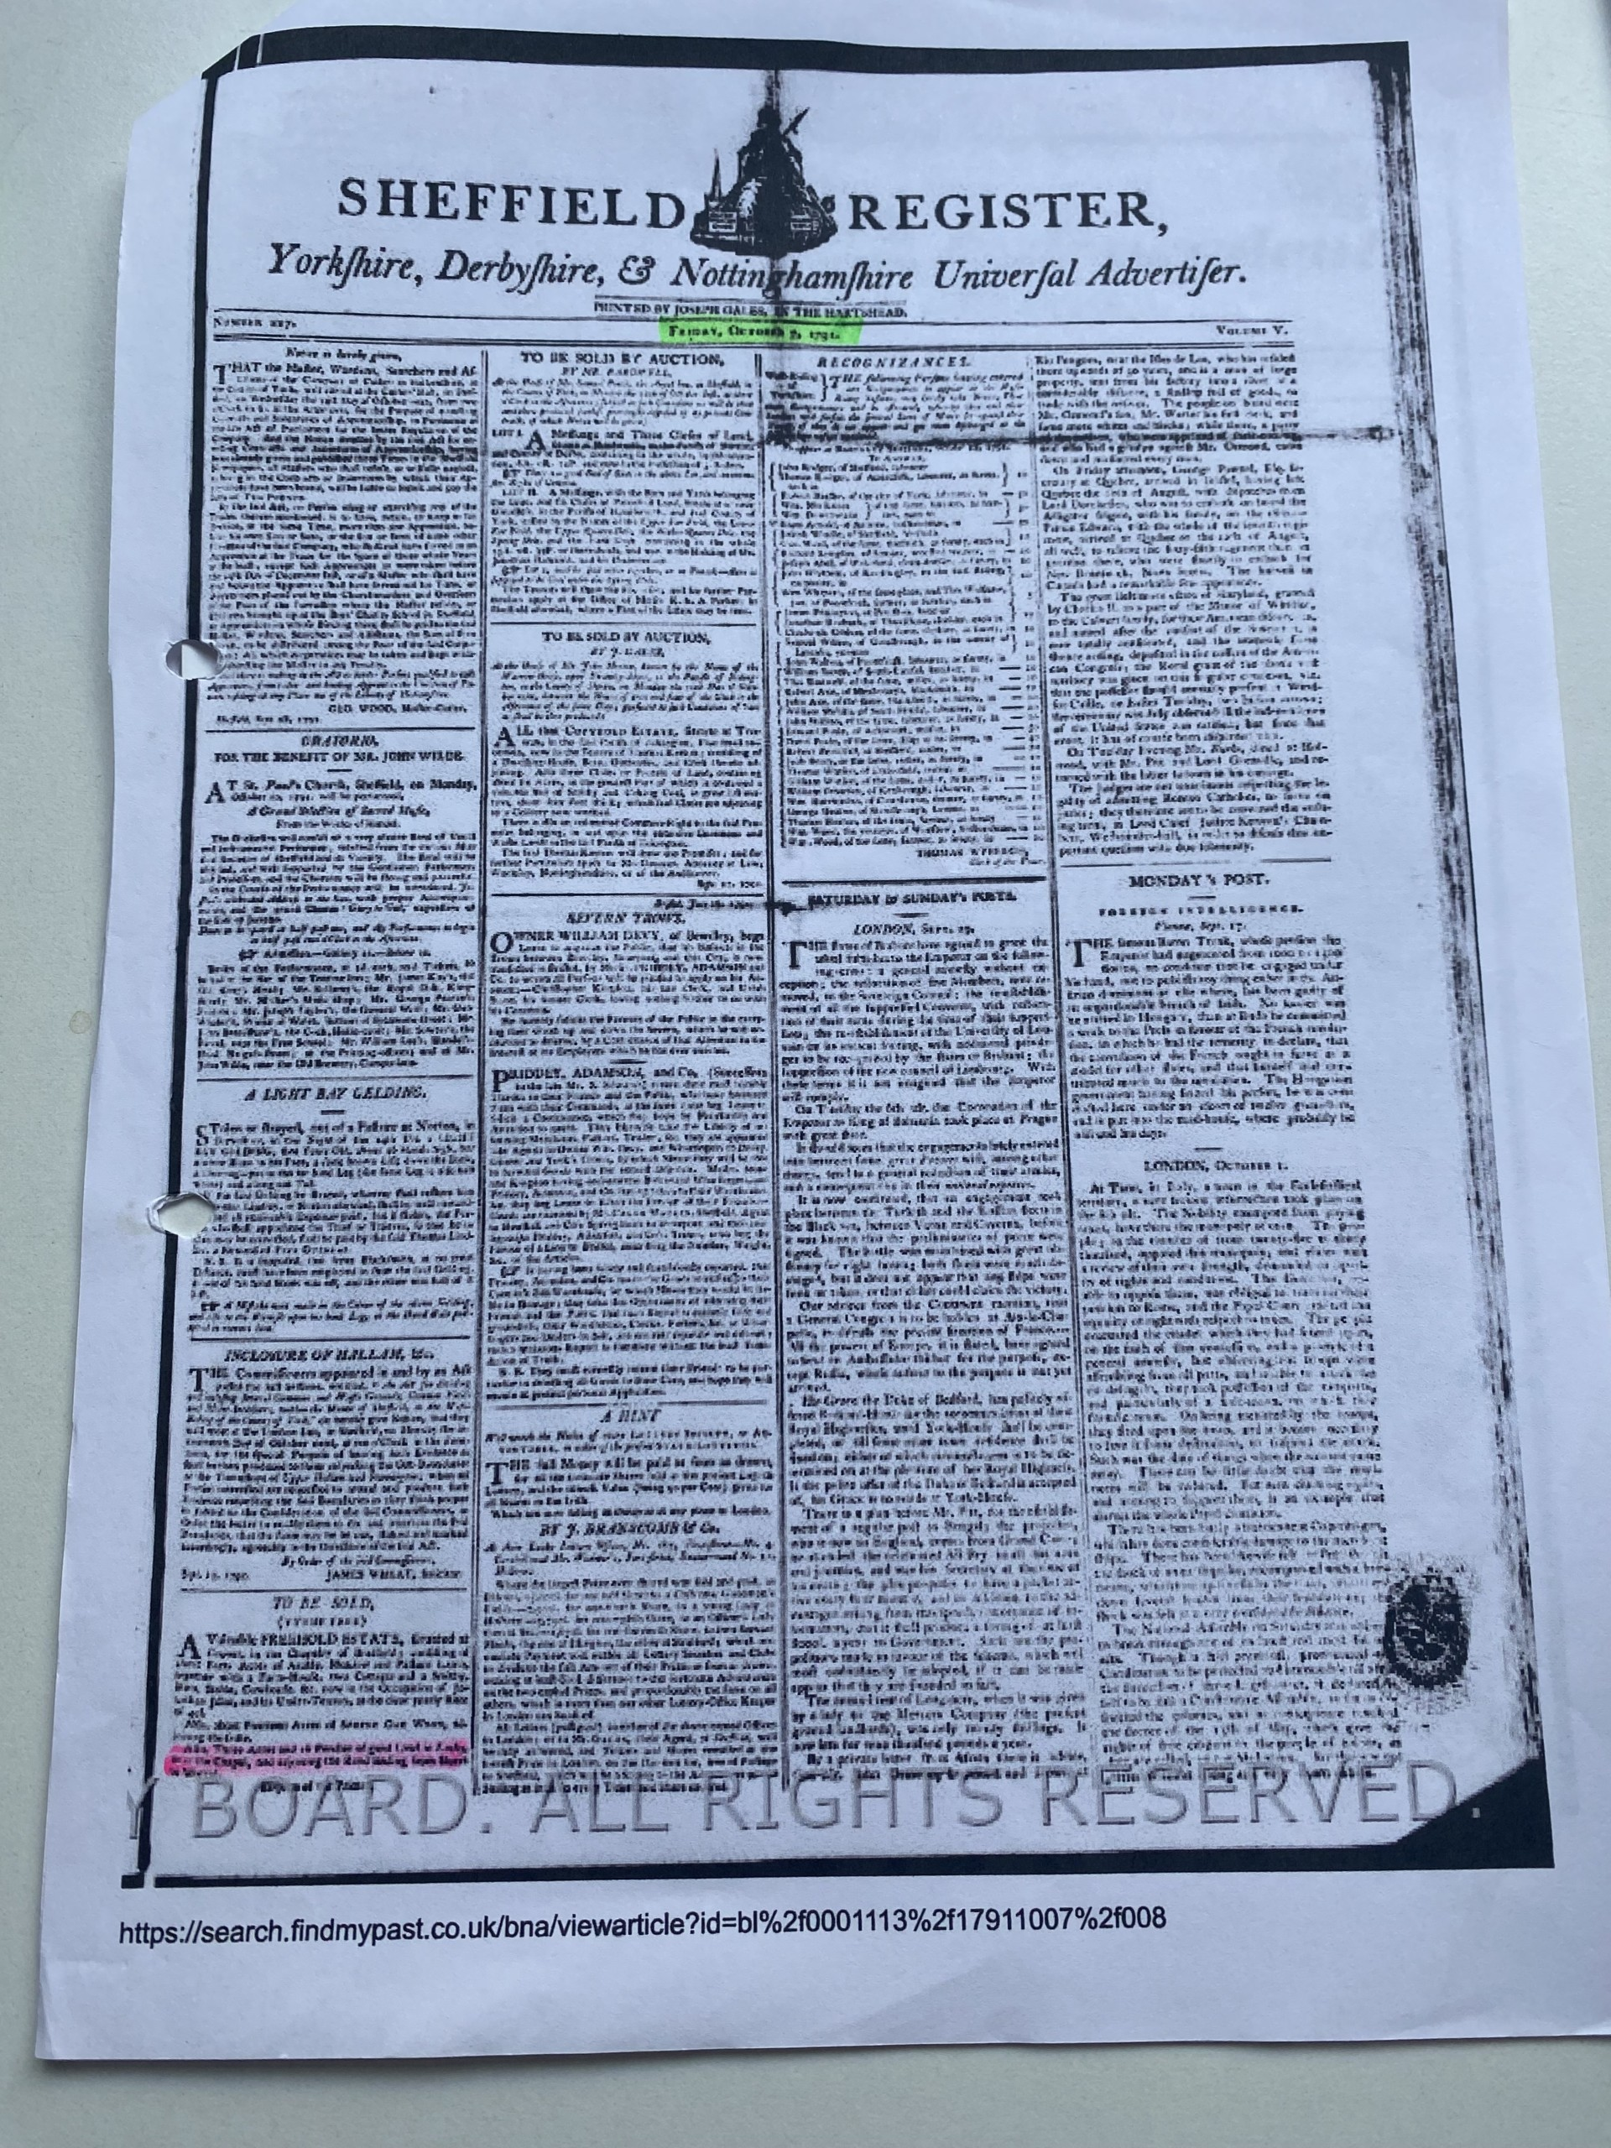
Early Burials
It would appear that there was insufficient space to carry out burials, as additional land was bought, via Public Auction, in 1791 and the first burial did not take place until 1806.
Several burials took place in the Chapel and these were commemorated on plaques fixed to the floor and walls of the chapel. Unfortunately, these are now either inaccessible, or lost.
The lack of an act of consecration meant that all subsequent burials/interments were carried out in un-consecrated ground.

Slide 6
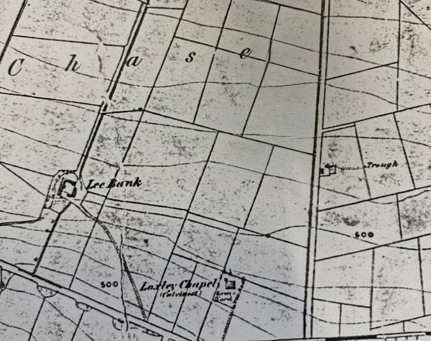
Second Life
The lack of consecration meant that the long term future of the building was thrown into doubt. In addition, it would appear that Benjamin Greaves was obliged to borrow the sum of 300 guineas from his brother (George Greaves of London), to complete the furnishing of the Chapel with pews and pulpit etc. The Chapel was used as security against this loan. Unfortunately, the loan was not repaid on time, and the Chapel reverted to George.
George then rented the Chapel to the Sheffield Independent Church from 1798. The Independents were a branch of the Protestant Church in England, which favoured a more traditional approach to Christianity. They were self-governing at local level. The initial rent was £36 pa for 7 years, £30 pa for the next 7 and on a yearly basis thereafter.
The Chapel was known as the Loxley Congregational Chapel. It was identified as a Calvinist Chapel on an early map of the area, in 1850. This was probably the Cartographers interpretation as there is no history of it belonging to the Calvinist Movement.

Slide 7
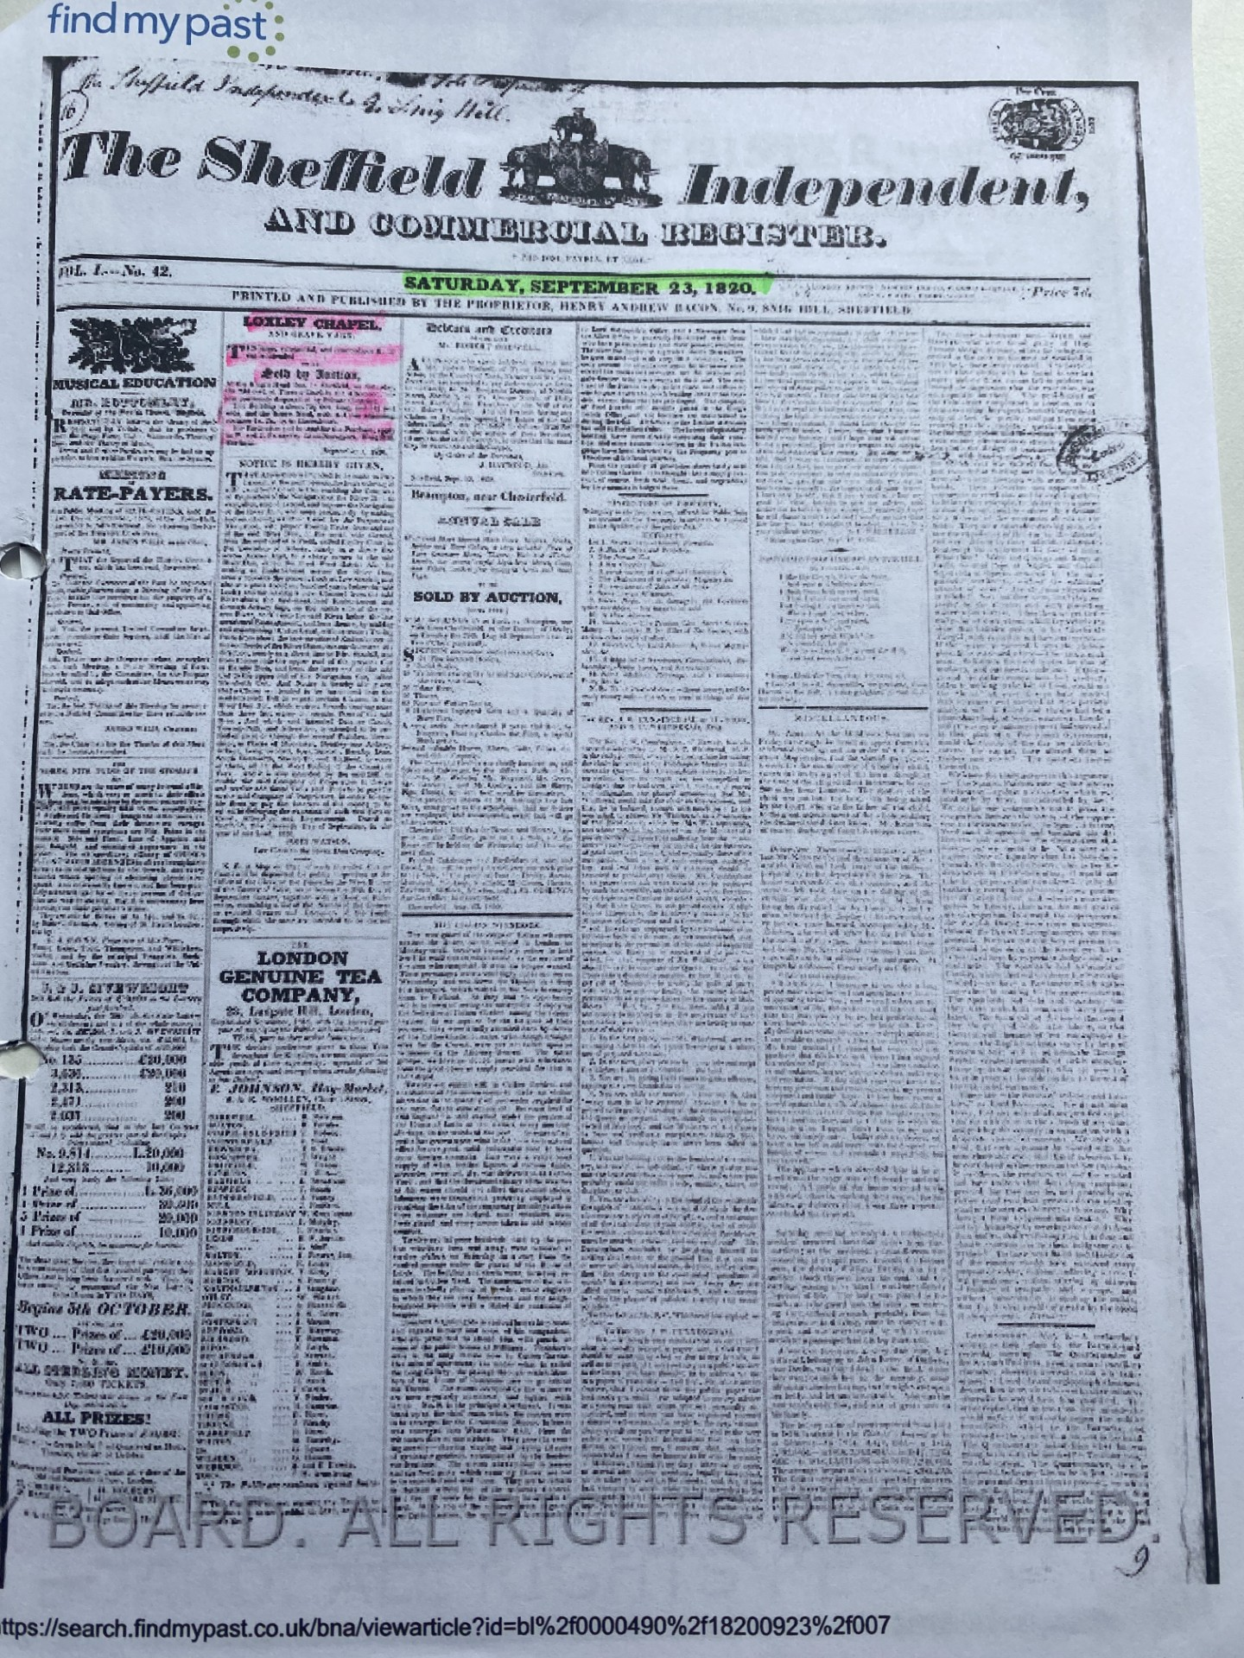
Third Life
In 1820, George Greaves became insolvent & the Chapel was put up for Public Auction. The advertisement read:
  ‘Loxley Chapel & Graveyard.
  This large, substantial & commodious building is intended to be sold by Auction.
  Building is 75 1/2 feet long & 51 1/4 feet wide’.
Unfortunately, the lot didn’t sell at auction, but members of the congregation bought it, by private contract for £315, thereafter. The new owners, together with other members of the congregation, opted to put the building into the hands of 13 Trustees, who stated that:
‘It would be a place of worship for ever for the use of this body of Protestant Dissenters, called Independents’.
The Trustees made revisions to the building, by taking 5 rows of pews from the east end, by the insertion of a new gallery on the north side and by the carrying out a complete repair of the whole building. The Chapel was renamed ‘The Loxley Independent Church’.

Slide 8
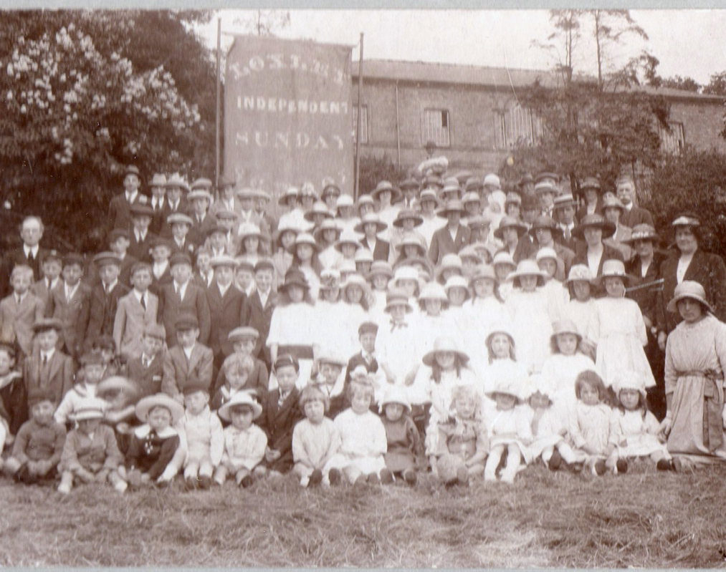
Good Times
In 1802 the Independents appointed a new Pastor, Daniel Dunkerley, under whom it thrived. The Religious Census of 1851 stated that congregations, on a Sunday afternoon, averaged 200. In 1855 a new Schoolroom and Ministers House (The Manse) was built at the bottom of the drive onto Loxley Road.
So, not only was the Loxley Independent Church well attended but it had strong links to the local community. Despite its non-conformist status Baptisms, Marriages and Deaths were recorded in the registers held there. For example, Henry Tingle, who was the Chief Officer of the ill-fated Titanic, was baptised there in 1872.
In addition, there are several graves and monuments to the victims of the Great Sheffield Flood of 1864, in the areas surrounding the building.

Slide 9
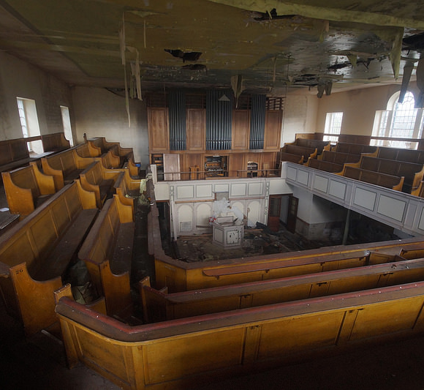
Fourth Incarnation
However, by the 1970’s congregations had dwindled and the decision was taken to sell the building and adjacent cemetery.
The new tenants were the United Reformed Church (URC), which was formed in 1972 following the union of the Congregational Church and the Presbyterian Church of England. The building was re-christened ‘The Loxley United Reformed Church’. The URC is a Protestant order which seeks closer ties with other church/movement organisations. It created its first ordained female Minister in 1917 and was the first Christian organisation to carry out same-sex marriages in 2016.
However, their tenure at Loxley was short lived and in 1993 the URC movement closed the building.

Slide 10
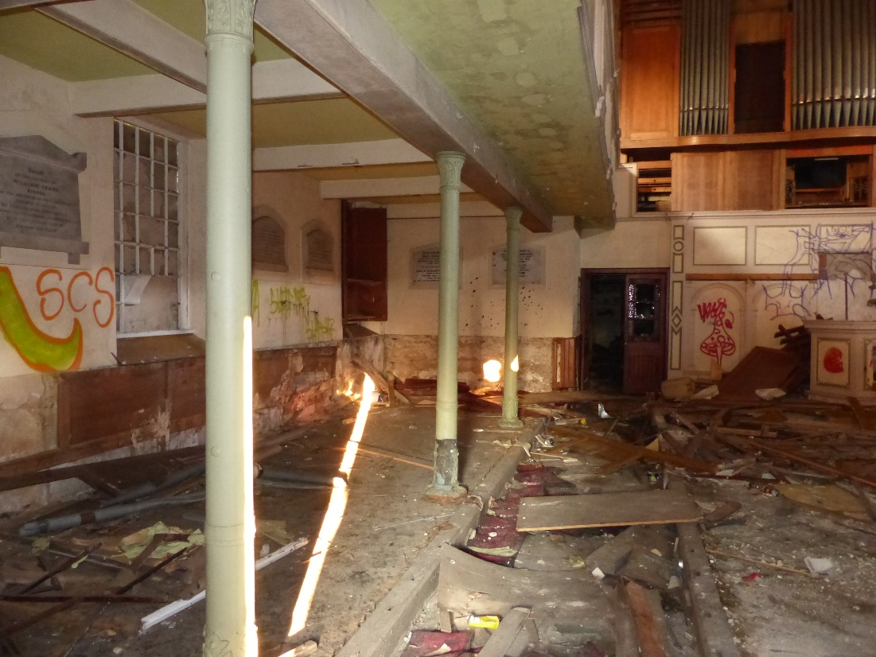
Vandalism
Following closure, the building and attendant graveyard was purchased by Hague Farming of Bradfield. The new landlords sought to secure the building, but to no avail.
Photographs, courtesy of the Daily Mail in an article published on the 26 March 2015, show extensive vandalism to the interior.
This culminated in a fire on the 17 August 2016, which destroyed the roof, upper galleries and all furnishings and fittings. The cause of the fire was unknown. 3 fire engines attended in the early hours and it took 2/3 hours to control the blaze, but by then all that was left was a shell.
A report prepared by Historic England on the 8 September 2016, gave recommendations concerning immediate measures to safeguard the remaining structure of the Grade 11* building. It is thought that these have been carried out, but nil else since. Heras fencing erected to prevent access to the building has since been removed.

Slide 11
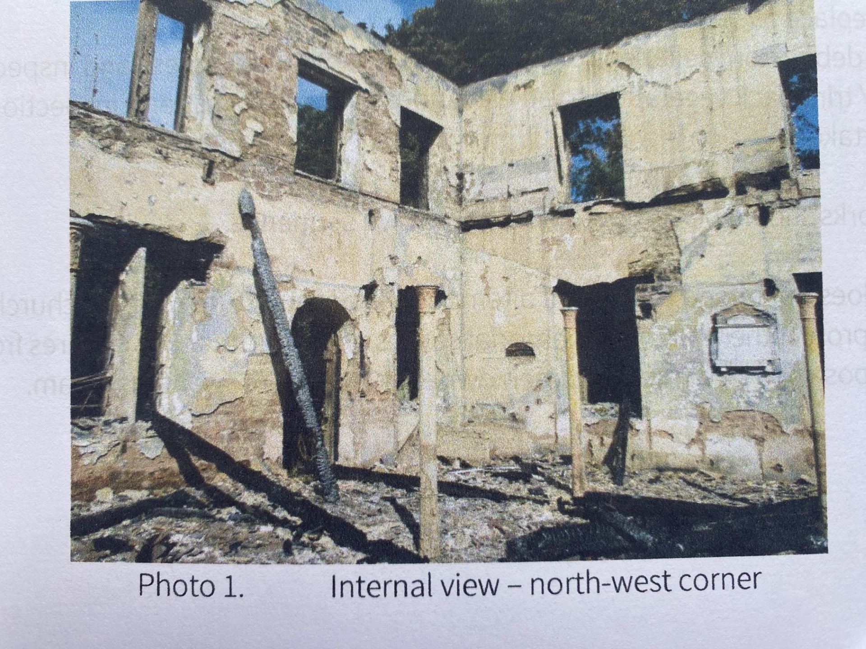
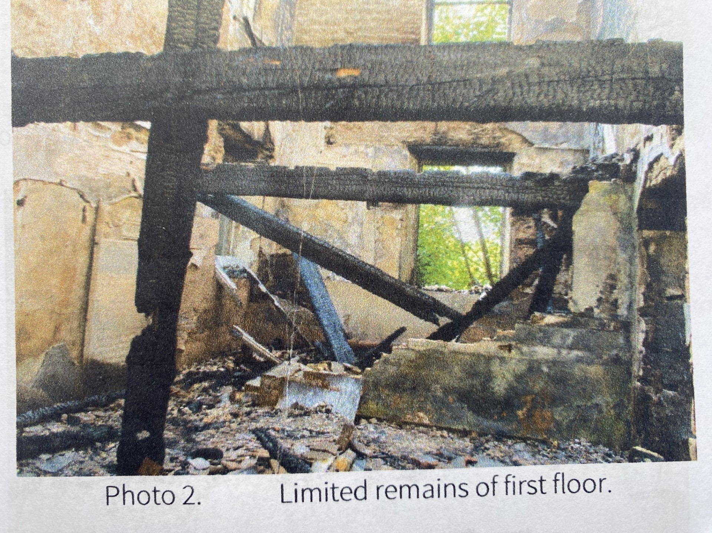
Catastrophic Fire

Slide 12
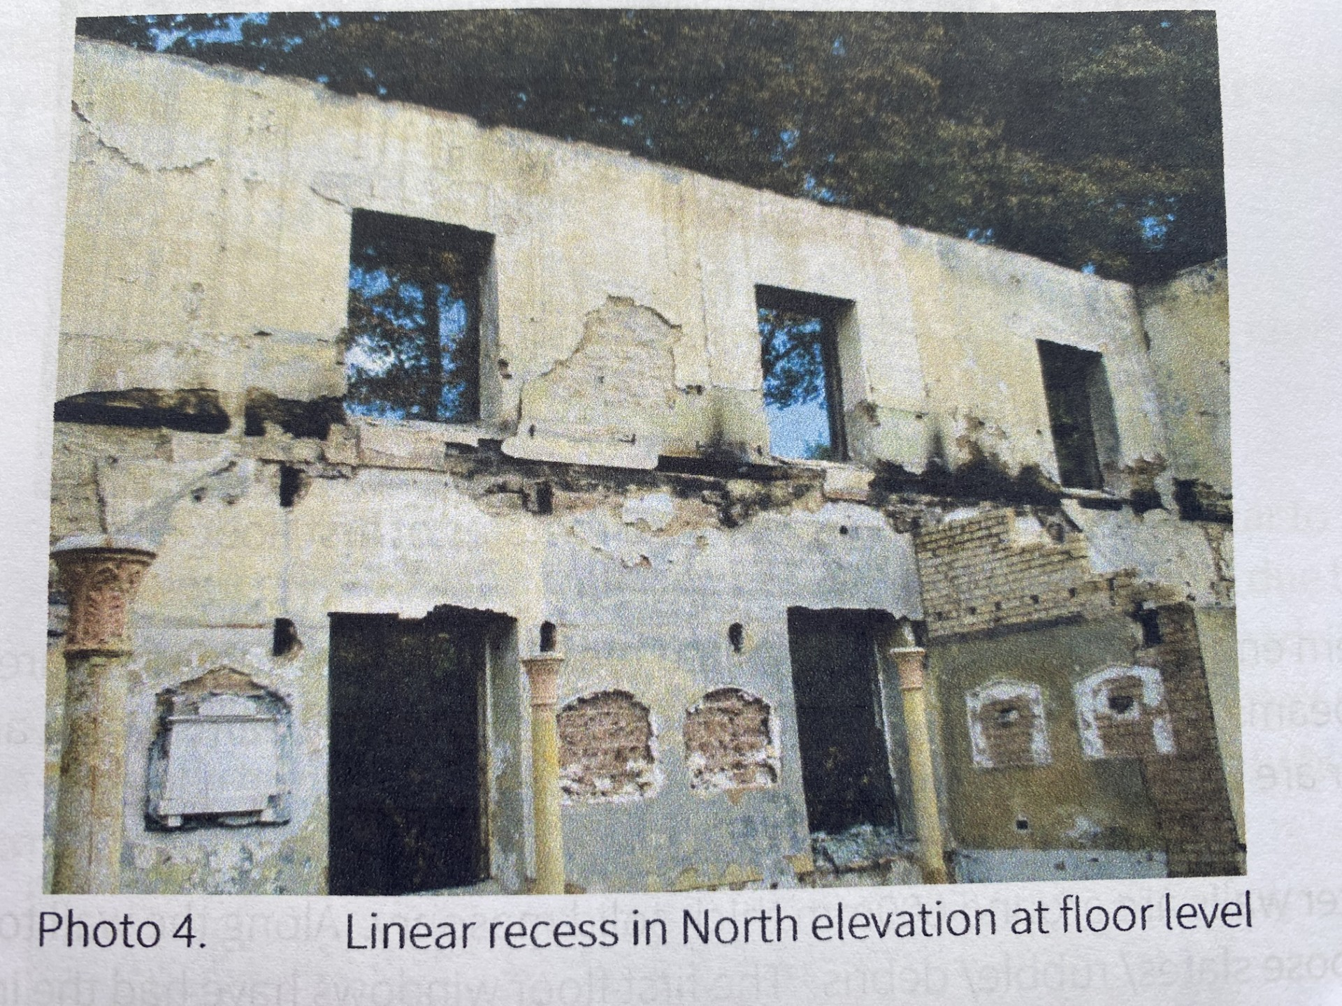
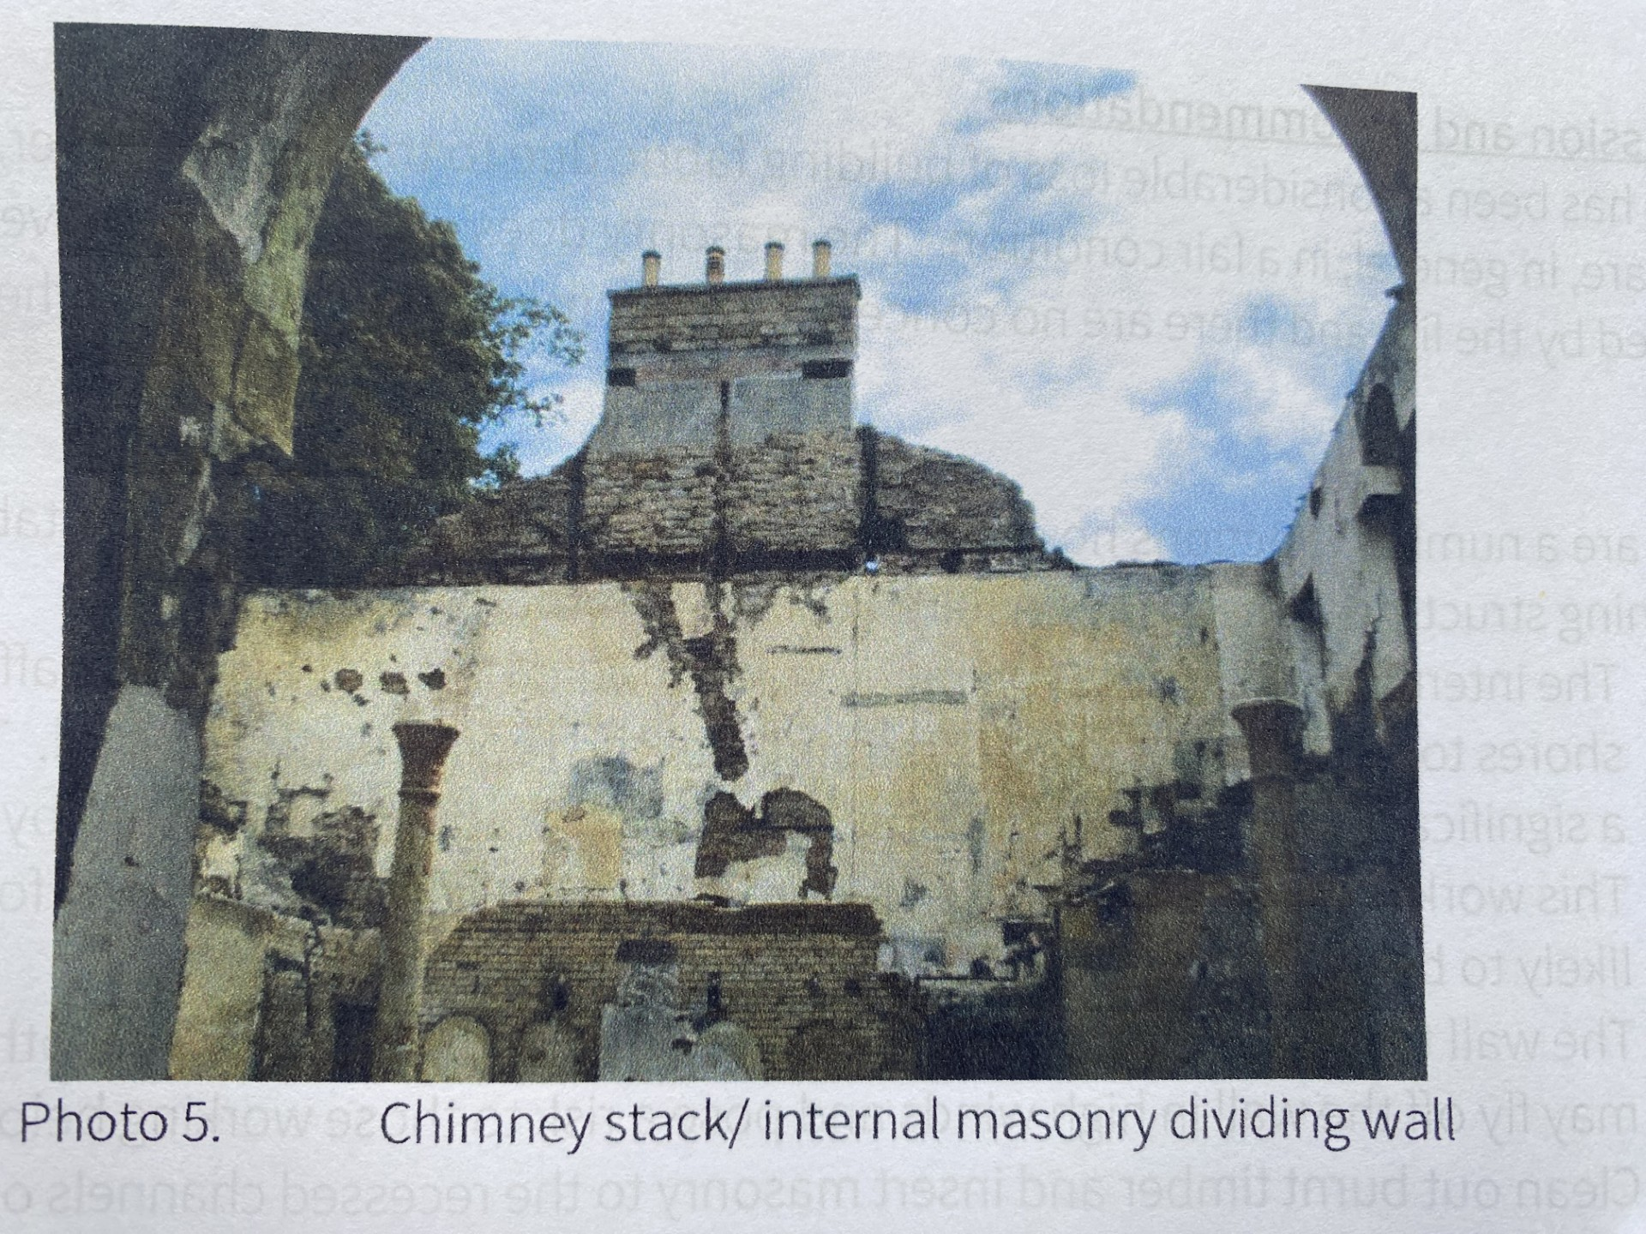
Catastrophic Fire

Slide 13
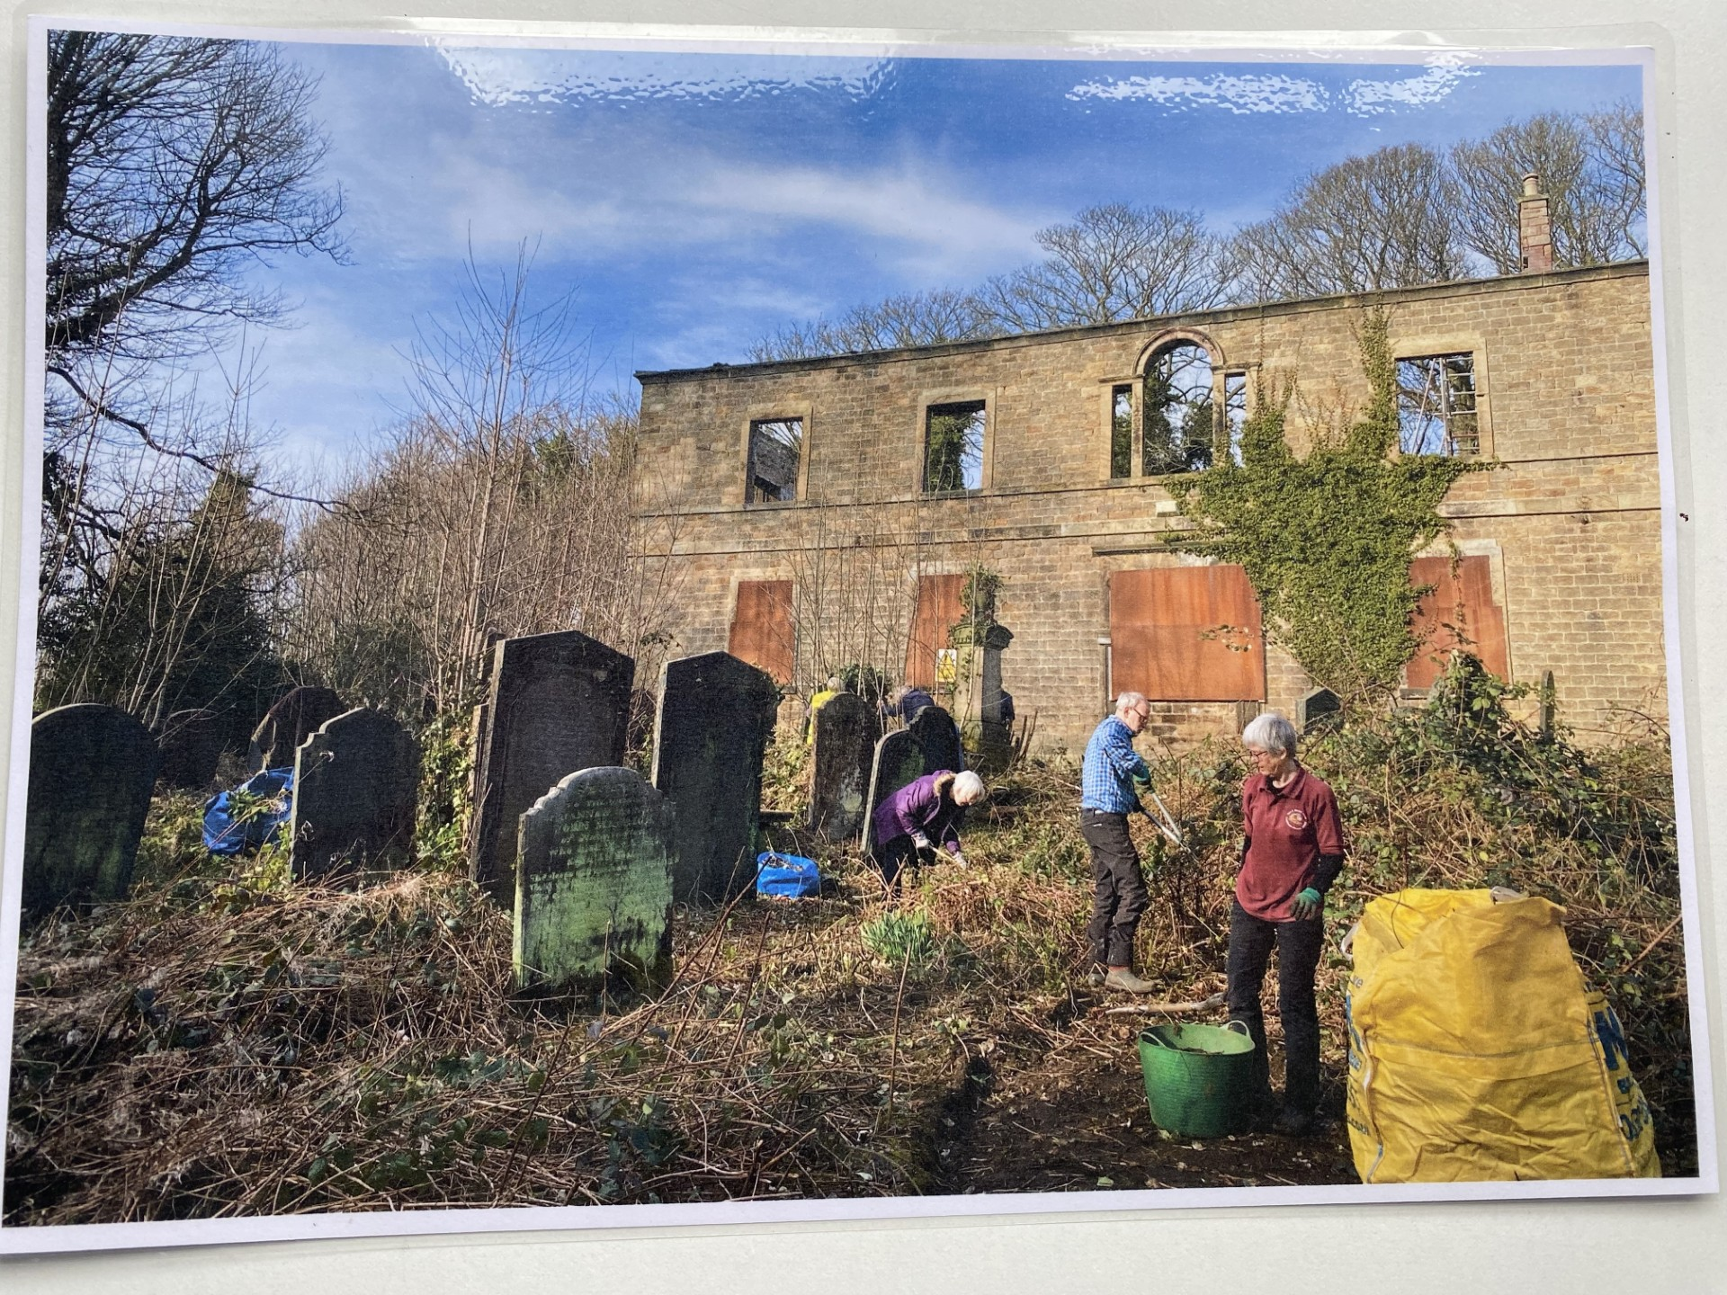
Current Situation
In October 2016 the current owner of the Chapel and graveyard (Mr Ali), acquired the site. In 2020, the Title has been transferred to a local company within the group, called Loxley Chapel Ltd.
Mr Ali has been supportive of the Friends of Loxley Chapel Group (FoLC) since their formation in the autumn of 2019. In turn, the FoLC have offered support in any measures considered necessary to bring the Chapel back into life.
The Chapel is now in its 238th year and it is 9 years since the fire took place. The temporary works are showing signs of distress and the building has lost coping stones from the west elevation and all its window glazing. In addition, self seeded trees are growing within the ruins.

Slide 14
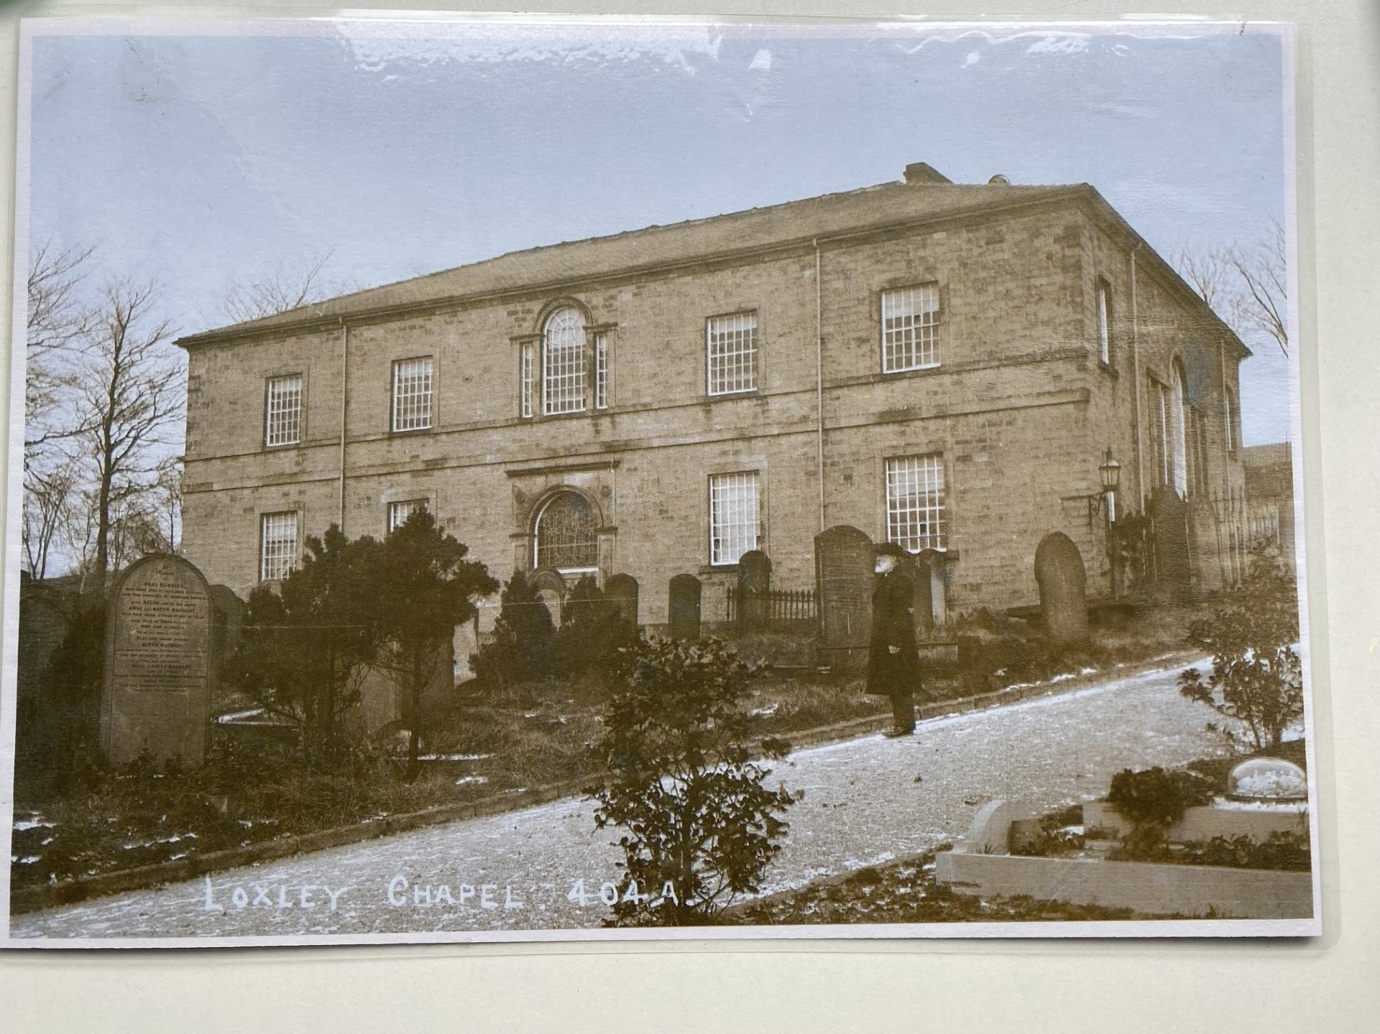
The Future
It is understood that the current owner has undertaken investigative and design works to remodel the existing Chapel and give it a sustainable new life. However, the FoLC are unaware of the progress of same and there has certainly been a lack of action on the building itself since our formation.
The Chapel is currently out-of-bounds to the general public and FoLC members. Drone surveys carried out in January 2022 and February 2023 are available on-line to give an indication of the extent of the destruction wrought and the deterioration of the building’s fabric since. The building remains on the SCC Heritage at Risk Register.
It can only be hoped that the Chapel will rise, Phoenix like, from the ashes and have another 200+ years of life.

Slide 15
Endnotes
1. Loxley Church Book (p. 1), Sheffield Archives (Doc # NR2324/6/1/1).
2. Loxley (Wanderings in a Curious Valley) (p. 98), Peter Machan (2021).
3. Sheffield Independent newspaper (29 May 1914).
4. ‘Action at Law’, dated 27 December 1787. Sheffield Archives (Doc# NR2324/8/1).
5. Loxley (Wanderings in a Curious Valley) (p. 98), Peter Machan (2021).
6. Sheffield Register newspaper (7 Oct 1791).
7. Index of Burials Taken From Grave Registers, Sheffield Indexers (2010).
8. Loxley Church Book (p. 1), Sheffield Archives (Doc # NR2324/6/1/1).
9. . Loxley Church Book (p. 2), Sheffield Archives (Doc # NR2324/6/1/1).
10. Sheffield Independent Newspaper (23 Sep 1820).
11. Loxley Church Book (p. 2), Sheffield Archives (Doc # NR2324/6/1/1)..
12. Loxley (Wanderings in a Curious Valley) (p. 98), Peter Machan (2021) .
13. e-voice.org.uk/friendsofloxleycemetery (Baptism Records).
14. Daily Mail Newspaper (26 March 2014).
15. ‘Eerie pictures show smashed windows & torn bibles in church that was abandoned more than two decades ago – and creepy overgrown graveyard where victims of Sheffield Flood are buried’.
16. Customer Incident Report by South Yorkshire Fire & Rescue (Incident Report Ref 1644009472).
17. Historic England Civil & Structural Engineering Team Internal Memo (8 Sep 2016).
18. FoLC Constitution, Aims & Objectives, (item d).
19. You Tube videos (https://www.you tube.com/watch?v=2c4xxztb3zw&t=5s).
20. List Entry ref. 1314565, Condition - Very bad.

