Slide 1
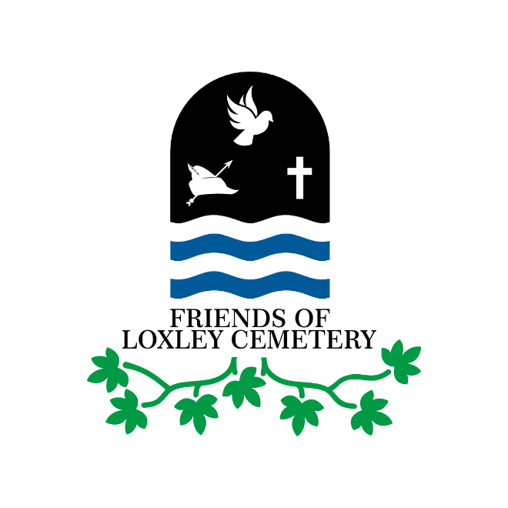
History of Loxley Cemetery
Mike Ford
Friends of Loxley Cemetery Annual General Meeting Wednesday 1 September 2021

Slide 2
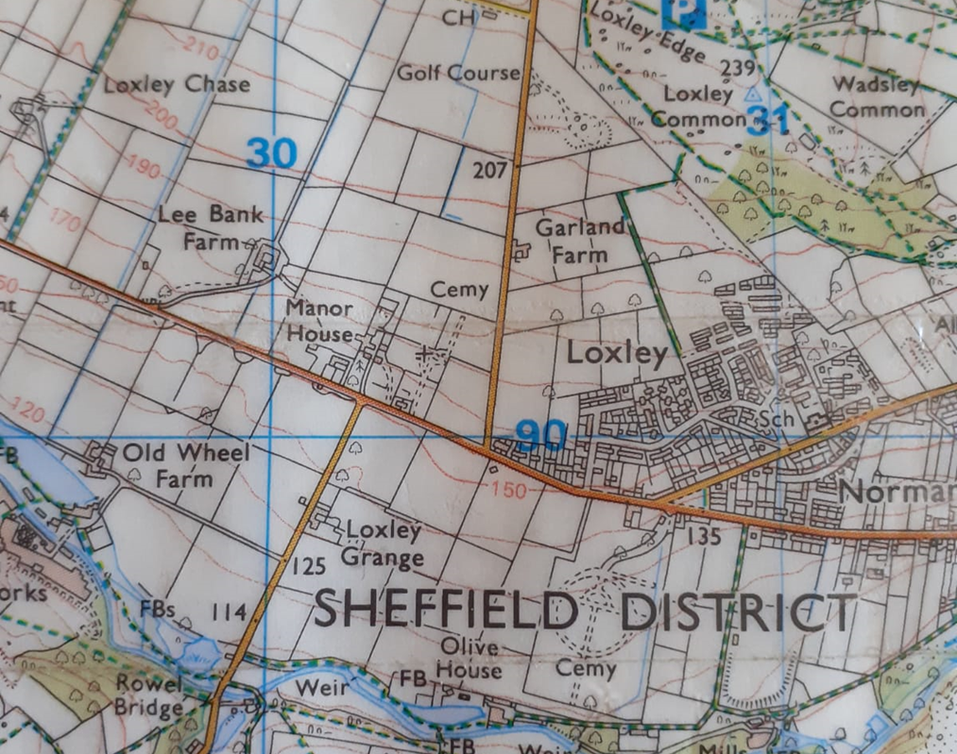
Location of Loxley Cemetery, Sheffield.
Loxley Cemetery is accessible from both Loxley Road & Long Lane, Loxley.
It sits behind the current Loxley Nurseries at the junction of both roads & is approximately 10 acres in overall size.
The cemetery includes the remains of a chapel which is known locally as ‘Loxley Congregational Chapel’ to distinguish it from another chapel further down Loxley Road (Loxley Methodist Chapel), which has now been converted into apartments.

Slide 3
Origins.
Loxley Congregational Chapel (LGC), is in the diocese of Bradfield, with the Parish Church being St Nicholas at High Bradfield (see plate opposite).
There has been a church at the site of St Nicholas for over 900 years & the present building is thought to be 500 years old.
LCC was built as a ‘Chapel of Ease’ by the diocese, at a cost of £1,000 in 1787, to provide easier access to parishioners in the Loxley, Storrs, Worral & Wisewood areas.
It’s use as a Chapel of Ease was short lived, as it was being rented to Protestant Dissenters by 1798, & they bought the chapel in 1821, changing its name to ‘The Loxley Independent Church’.
The chapel changed its name for the third & final time to the LGC in the 1970’s when it became part of the ‘United Reformed Church’ which was formed in 1972.

Slide 4
Origins (continued).
The original footprint of the LGC & access to same from Loxley Road did not provide much space for burials.
The situation was improved by the acquisition of “3 acres & 16 perches of good land in Loxley, near the Chapel & adjoining the road leading from Storrs to Worral”, which was advertised locally in 1791 (sources: Sheffield Register, 7 October 1791, 29 July 1791 & 19 August 1791).
The first recorded burial was of Mr Elias Crapper in 1806 (source: Index of Burials taken from Grave Registers, Sheffield Indexers, 2010).
Over 5,000 burials have been thus recorded, but this does not include those still being interred in the part of the churchyard which is currently in use to this day.
The graveyard is thought to be unique in the Sheffield area, as it is privately owned & permission to carry out internments has to be obtained from the Landlord (Mr Mohammed Jameel Ali) .

Slide 5
Evidence - Sheffield Register (7 Oct 1791) & Sheffield Independent (23 Sep 1820)

Slide 6
Evidence (continued).

Slide 7
Previous Lives.
As stated previously, the LCC has had at least 3 different lives in its history.
In 1820, having been declared surplus to requirements by the C of E diocese, it was offered for sale.
An advert in one of the local newspapers read “This large substantial & commodious building is intended to be sold by auction. The building 751/2 feet long & 511/4 feet wide” (source: Sheffield Independent, 23 September 1820).
The purchasers were the Protestant Dissenters who had been renting the property since 1798. They named the building & grounds ‘The Loxley Independent Church’.
There followed a period of growth, with congregations numbering 200 by the middle of the century (source: Religious Census of 1851).

Slide 8
Previous Lives (continued)
Following the formation of the ‘United Reformed Church’ (URC) in London in 1972, the LCC became one of its first churches.
The URC is a union of Presbyterians & Congregationalists in England, Scotland & Wales, with links around the world. It is probably best known for the blessing of same-sex marriages in 2012 & the hosting of actual marriages in 2016.
Unfortunately, LCC did not get the chance to hold one of these marriages as it was closed in 1994 & was then destroyed by fire in August 2016.
The circumstances surrounding the cause of this fire have never been fully explained & the building today consists of a shell, which has been declared structurally unsafe.
The site subsequently changed hands between private Landlords 2016 for £86,000 (source: Sheffield Star, 9 May 2019).

Slide 9
The Future.
The current Landlord of the LCC & surrounding graveyard has put forward plans to convert the LCC into a visitor centre & hostel for ramblers & bikers attempting the nearby Pennine Way.
The Landlord is also keen to build a Respite Centre for up to 6 children on adjacent unused land (source: Sheffield Star, 9 May 2019).
However, at the time of writing, there is a lack of evidence of the commencement of any of these works.
The Upper Chapel is Grade 2* listed & has been placed on Sheffield City Councils (SCC) ‘At Risk Register’. The intention was that the building would be ‘saved’ by 2020. For one reason or another this commitment has yet to be delivered. Meanwhile, the property continues to receive attention from vandals.

Slide 10
Friends Group.
On acquisition, the current Landlord has embraced the creation of the ‘Friends of Loxley Cemetery’ (FoLC) group.
Formed in October 2019, the FoLC has been stymied by the recent pandemic but is now preparing to undertake its main aims, which are:
“(a) Maintain the physical upkeep of Loxley Cemetery so as to ensure, where reasonably practicable, safe access for visitors to all areas.
(b) Maintain the aesthetics & environmental integrity of the Cemetery in keeping with the Loxley Valley.
(c) Create & maintain records of social & historical interest connected to Loxley Cemetery, thus providing a unique research resource.
(d) Work with the owner of the site to restore Loxley Church [LCC] & to preserve the memorials within the building” (source: FoLC Constitution, Aims & Objectives).

Slide 11
Friends Group (continued).
At the time of writing, works have already commenced on site by volunteers aligned to the FoLC.
A formal start is hoped for this coming July, subject to government lifting current restrictions on the 21 June 2021.
Membership of the FoLC is £5 pa, payable in January each year. There are currently 50 members, who all receive Quarterly Newsletters and the benefit of insurance cover when undertaking works. They also receive a grave finding & photography service.
A website is currently being constructed & a grant application is being prepared to assist with the structuring of the group.
Membership is world wide & all-inclusive, with many of the members having family members interred in the Cemetery.

Slide 12
Friends Group (continued).

