Slide 1
Friends of Loxley Cemetery Chair’s Report, AGM October 2021- September 2022
Mike Ford
Chair, Friends of Loxley Cemetery
Wednesday 26 October 2022

Slide 2
Brief History
The Friends of Loxley Cemetery Group (FoLC) was formed at a meeting, which was open to members of the public, at the Wisewood Inn, Loxley Road on the 18 September 2019.
The FoLC Constitution was agreed and endorsed by members of the Management Committee (MC) on the 9 October 2019. There are 8 MC members and 3 Officers (Chair, Secretary & Treasurer).
Initial MC meetings were held until the onset of the Covid pandemic in March 2020. Plans to commence works on the clearance of the Cemetery in the spring of that year were put on hold.
Notwithstanding, by the end of the first year we had 57 subscribing members.
Works began in earnest in the summer of 2021.
By the time of our first Annual General Meeting (AGM) on the 1 September 2021, membership stood at 63.

Slide 3
Remembrance Day
On Thursday the 11 November 2021, we held a Remembrance Day event in the cemetery. The event was attended by Year 5 pupils from Loxley Primary School, with their teacher, Dan Eaton, in attendance. The party was also accompanied by the Reverend Dan Brown of Wadsley Church.
Under direction from their teacher, and with assistance provided by our Malcolm Nunn & Ron Clayton, the pupils had undertaken research on all the War Graves visited on their tour. They then provided a set of cardboard wreaths with a brief biography of the occupants of the graves (see pic).
The event was graced with good weather and was reported in the Sheffield Star.
We will be repeating the event, with a different set of pupils, this year.

Slide 4
Heritage Fair 29-30 January 2022
Following a years absence, the Sheffield Heritage Fair returned to the Millennium Galleries on Arundel Gate at the end of January.
FoLC had a stand which was manned by a rota of volunteers over the 2 day period (see pic). I understand that almost 1500 people visited the Fair over the 2 day period.
There was certainly a lot of interest in our stall and we gained new members as a result.
We also signed-up with Joined-Up Sheffield, which is an ‘umbrella’ group for similar groups in the area & also committed to the Heritage Open Days event which is a national programme held every September.

Slide 5
Dockroyd Graveyard Visit
On the 17 February 2022, following an invitation received from the Chairman of the Dockroyd Graveyard Trust, a group of Management Committee members visited this Wesleyan Methodist graveyard which is in the village of Oakworth, near Keighley in West Yorkshire.
The graveyard has similarities with Loxley in that it was previously in private hands, was overgrown & was mostly neglected before the Trust began its work in 2019. Although much smaller than Loxley, the Trust have worked miracles in transforming the graveyard with only a small band of volunteers. It was also interesting to learn of their formation of a Trust to safeguard the graveyard for the future.

Slide 6
Open Day
On 2 May 2022, we held our first ‘Open Day’ event. It was a great success, with over 200 visitors attending. Tours of our Flood & War Graves were given by Verity Brack & Malcolm Nunn. We attracted over 20 new members at this event and it showed that there was a serious interest in the cemetery & what we were trying to achieve as a group.
During the event, we provided a free ‘Find A Grave’ service, which proved very popular. During the same, it was apparent that providing locations of graves in the older parts of the cemetery (around the Chapel), was much easier than those located on the newer Long Lane section. This was primarily due to the fact that an electronic database had been set-up by ‘Sheffield Indexers’ for the old part of the cemetery, whereas records for the newer part consisted of handwritten records containing details of over 5,000 interments. We therefore set up a team to produce an electronic log and that process is ongoing on a weekly basis.
Again, we were fortunate to have the Sheffield Star produce an article on our Open Day event.

Slide 7
Family History Fair
Following an invitation from the Sheffield & District Family History Society, FoLC took a stall at the annual Family History Fair, which was held at the Crowne Plaza Royal Victoria Hotel on the 14 May 2022.
The event was well attended and I was able to meet representatives from other cemetery groups and similar organisations in the genealogical world.

Slide 8
Heritage Open Days
This brings us up to the present. The Heritage Open Days were held on the 13th & 17th September 2022, as part of the national campaign to open up heritage attractions across the country. The cemetery was one of 130 sites listed in the Sheffield area.
Again, we were blessed with good weather on both days. The Flood & War Grave Tours were held on both days and attracted over 20 & 10 attendees respectively on each day.
Contact was made with delegates from the Commonwealth & War Graves Commission (CWGC) & our application for entrance signs from this organisation has been re-visited as a result.
The free ‘Find A Grave’ service was re-introduced and, with the help of the partially complete electronic log for the Long Lane section of the cemetery, all enquiries were successfully sourced.
Although late in the year, membership applications were distributed and a reasonable amount in donations received.

Slide 9
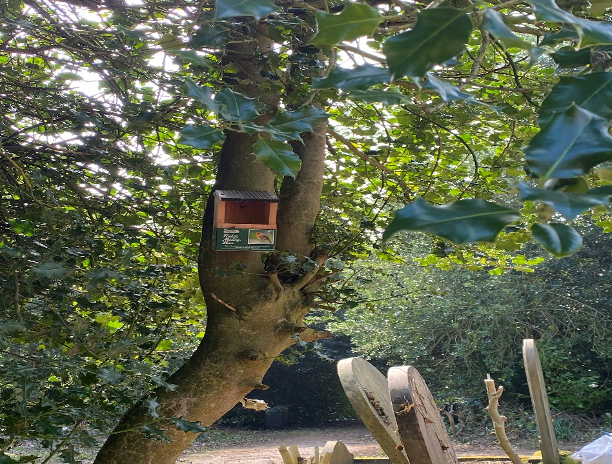
Wildlife
The cemetery is full of wildlife. As well as the normal mix of ‘garden’ birds, we have a brace of pheasants, a resident owl & a curlew has been heard in the vicinity. Sheffield Hallam University have also been carrying out monitoring of ‘night life’.
In the Spring, volunteers erected a couple of nest boxes (see pic), & have installed bird feeders, as well as supplying wild bird food and water.

Slide 10
Clearance Works
I can’t finish this address without mentioning the work undertaken by our volunteers. I think we can all agree that the works carried out by them, in clearing the undergrowth after decades of neglect has been nothing short of miraculous.
Commencing in the summer of 2021, initially on a Tuesday morning on a bi-weekly basis and later transferring to Saturday afternoons, each session has not been more than 3 hours at most. The lack of electricity and running water has not deterred our band of hardy souls who have turned out in all weathers.
The results are staggering. The Long Lane section (see photo) was an area of willow herb, brambles & long grass, with ‘weed trees’ popping up everywhere. The scene now is a transformation with willow herb & brambles mostly eradicated, grasses cut back to a manageable height & weed trees removed back to their stumps.
A separate group of volunteers have made serious inroads into the areas of older cemetery around the Chapel. Here the work is even more labour intensive & the results obtained are equally stunning.
This has all been achieved by a group which has never numbered more than 20 strong and is often less than half that.

Slide 11
Clearance Works (Continued)

Slide 12
Notice Boards (courtesy of Bradfield Parish Council)

Slide 13
Rustic Furniture (by the Pratts); the Chapel in 2017

