Slide 1
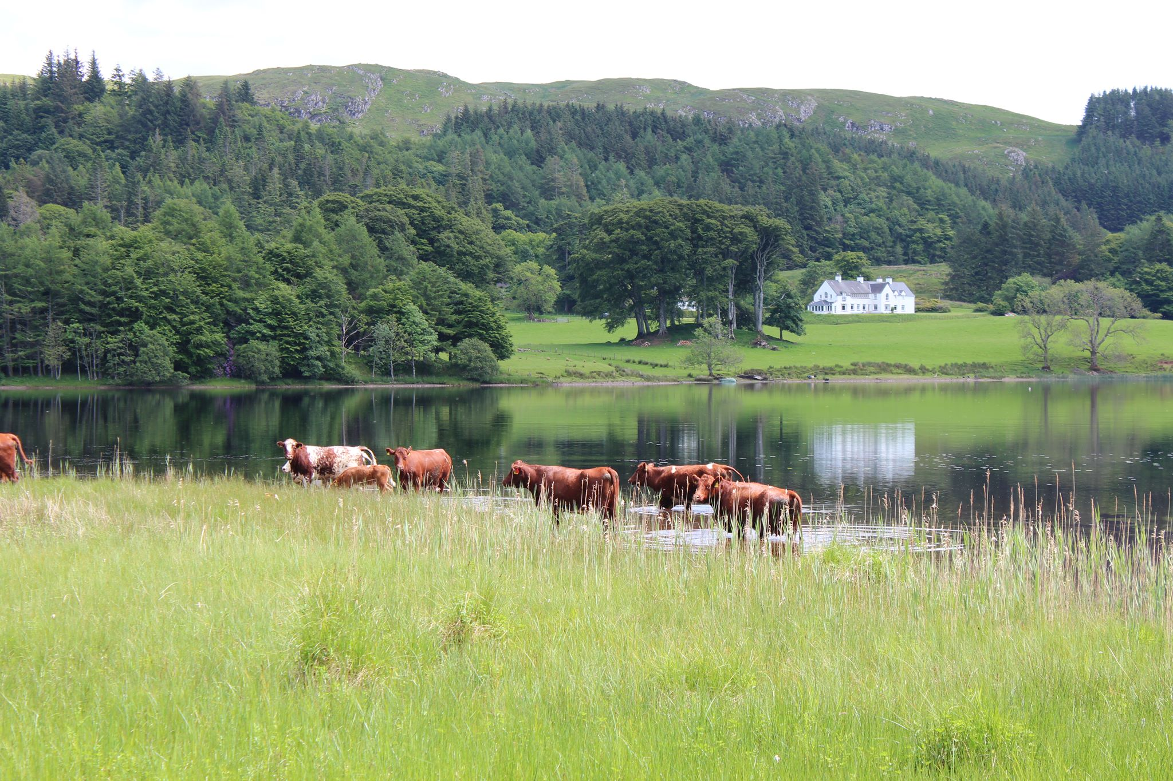
Ford Local Place Plan and
Community Action Plan
V.1

Slide 2
Contents
Chapter | Contents | Page Number
1 | Introduction and Context
2 | Local Place Plan Proposals
3 | Statements
4 | Community Action Plan Initiatives and Proposals
5 | Appendices

Slide 3
Endorsements
Ford Village Hall Committee
“Ford Village Hall Committee in 2024 undertook a major public consultation with the residents of Ford Village. This work aimed to create a new Community Action Plan for the village and village hall for the next three years. As this Local Place Plan contains the Ford CAP, we feel we can give it our full unqualified support.”
Dunadd Community Council
“Dunadd Community Council…”
Dunadd Community Enterprise
“……”
Acknowledgements
Ford Village Hall Committee would like to thank the residents of Ford and the surrounding areas for taking the time to provide comments and support to this plan. FVHC would also like to thank Dunadd Community Council for their support in taking this plan forward.
If you would like to know more about the content of this plan, how it was developed, or would like to find out how the proposals could be taken forward, please contact Ford Village Hall Committee at fordvillagehallargyll@gmail.com
All mapping reproduced from Ordnance Survey data (Crown Copyright) under DCC’s PSGA license using Community Maps Scotland (Parish Online) software.
Photographs in this document are reproduced with permission from Steve Walker and Aileen Gillies.

Slide 4
Acronyms
Acronym | Meaning
FVHC | Ford Village Hall Committee
DCC | Dunadd Community Council
CAP | Community Action Plan
ABC | Argyll and Bute Council
LPP | Local Place Plan
DCE | Dunadd Community Enterprise
SLF | Scottish Land Fund
FS | Foundation Scotland
NPF4 | National Planning Framework 4
NTS2 | National Transport Strategy 2

Slide 5
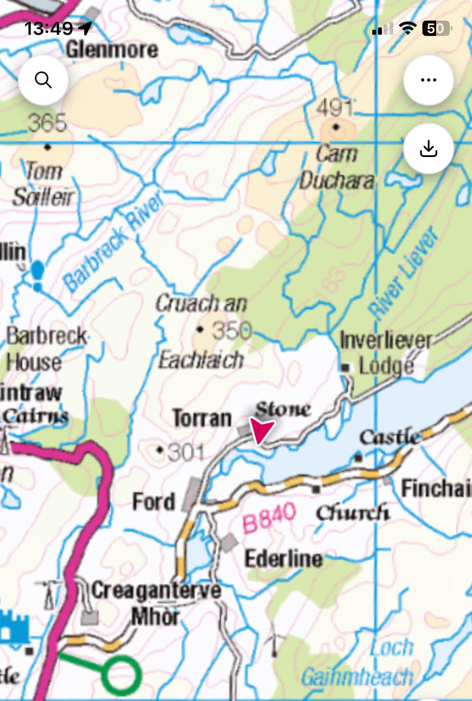
Chapter 1: Introduction and Context
About Ford:
Ford, Àth na Crà, is a small village at the southern end of Loch Awe in Argyll, Scotland. The village originated as a stopping point on the drove route to Inveraray. Many prehistoric structures survive within the village boundary and are all easily accessible or can be seen from the public road. Opposite the guest house, in the village centre, stands a prehistoric burial mound known in Gaelic as Cnoc an Ath. Several standing stones are scattered around the area, the three most notable ones being the one in the field next to the guest house, the one opposite Glennan Farm, and the largest one at Torran Farm. A crannog is also present in Loch Ederline and is visible from the road.

Slide 6
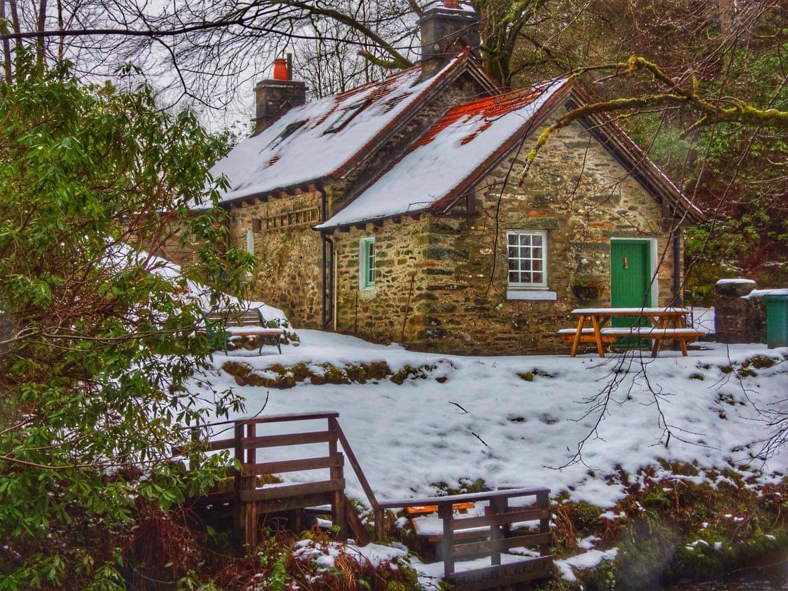
The village and its hinterlands stretch from the centre with the junction with the B840 west out along Loch Awe to the Inverliever River, east along the Loch to Finchairn. It encompasses the Ederline Estate, homes out towards Kilmichael Glen, and farms almost to the junction with the A83. 100 or so people live centrally within the village, with about the same living in the outer reaches. The village, since the 1980s, has seen a huge change in terms of demographics. There are currently only two people still living in Ford who were born there. During this period, the village lost its school, Hotel and bar, shop, post office, and most recently its church. It is rated in the lowest decile for access to services in the SIMD survey of Argyll and Bute. The village hall is the only remaining community asset in Ford.

Slide 7
Purpose and Scope of the Local Place Plan & Community Action Plan
Ford Village Hall Committee has prepared this Local Place Plan, which sets out the main issues for the community, along with potential ways in which these issues could be addressed.
Ford is an active community, with voluntary and community groups which contribute to the life of the area. FVHC and Dunadd Community Council want to ensure that the people who live in the area continue to have a say in the future development of the community, in the local rural environment, and the look and feel of our public spaces. and have a say in the way support services are delivered in the community, including to our most vulnerable groups.
Ford Priorities
The priority areas for our community, as laid out in this LPP and CAP, are as follows:
A village hall, which is a warm and welcoming space for the village and wider community.
A community that has access to services and events which help to overcome Ford’s rural isolation.
A well-connected community, outward and forward looking and with strong internal cohesion.
A community with the infrastructure to face the future and to provide for the needs of our community.
A community where the quality of life is excellent and where people are welcomed.
A community that has access to the countryside and its associated fauna and flora.
A green community that protects and sensitively develops our natural assets

Slide 8
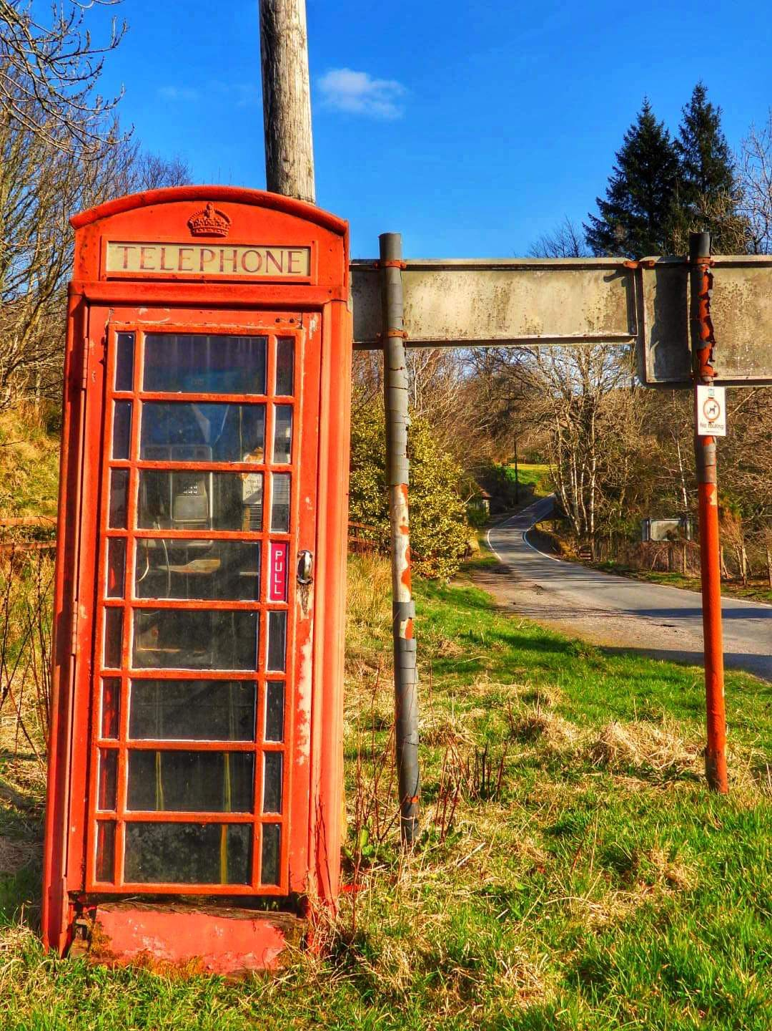
The Structure of the Report
More about these priority areas can be read in Chapter 4, where we outline the projects that are underway or planned to deliver the Ford CAP.
Additionally, in Chapter 2, we have detailed proposals regarding the use and development of land and buildings controlled by the planning system that we are submitting to the planning authority for assessment for inclusion in LDP3.
Chapter 3 is a technical chapter required by the regulations governing Local Place Plans that explains how we have taken regard of the existing Local Development Plan (LDP2)., National Planning Framework 4 (NPF4) and the Locality Plan that has been developed for our area. This section details the reasoning and justification for our proposals in terms of planning policy.

Slide 9
Boundary of the Local Place Plan
The Boundary of this Local Place plan is the same as the boundary of Ford Village, as shown in black below. Boundary of
Dunadd Community Council is shown in blue. Dunadd Community Council lies within the Argyll and Bute Council region.
This is considered to be the Locality Plan covering our area, for the purposes of the Community Empowerment Act (2015). The LPP proposals in this document must take into account this document.

Slide 10
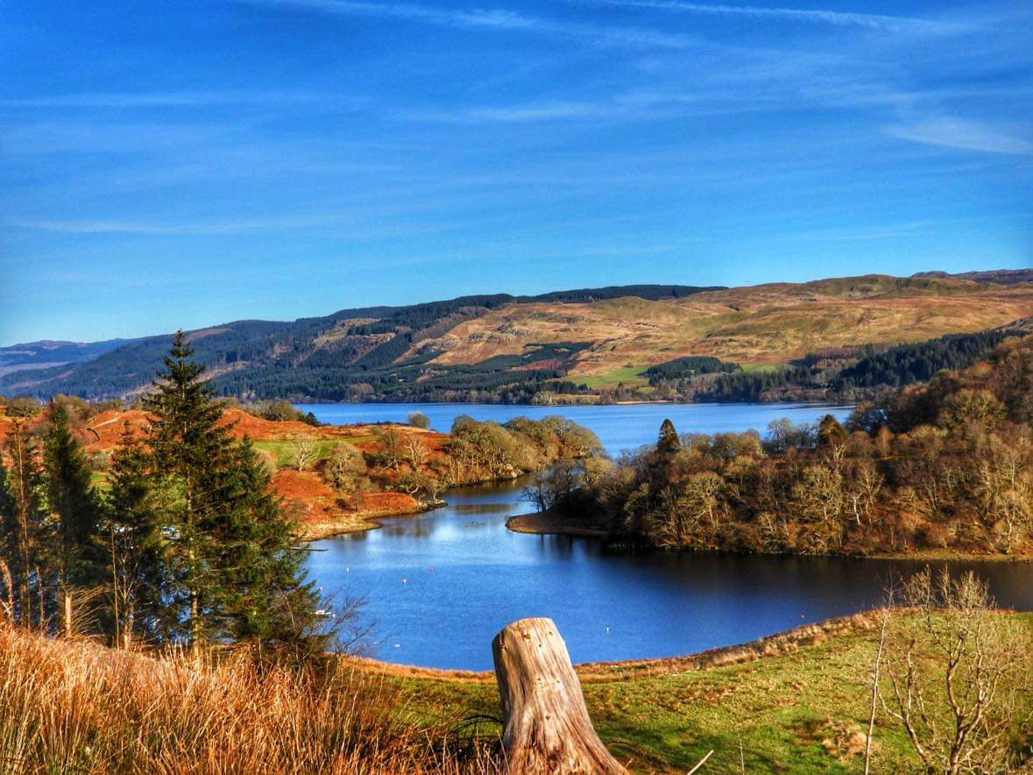
Planning Context
Argyll and Bute Council is currently developing the Local Development Plan (LDP3), due to be adopted from 2027 and in force for 10 years. We have actively consulted with the residents of Ford. We are submitting the five proposals in this Local Place Plan to the planning authority for assessment and inclusion as statutory policies in LDP3. We want to be fully involved in the developments planned for our community and support the economic health of our area. We would like Argyll and Bute Planning Service to support the proposals in this plan and include each proposal in the forthcoming Local Development Plan as policies with statutory weight in the planning system.
The key stakeholders in making this Local Place Plan a reality are:
Ford Village Hall Committee
Dunadd Community Council
Dunadd Community Enterprise
Ford Community Wood Project
Heart Of Argyll Wildlife Organisation
Foundation Scotland

Slide 11
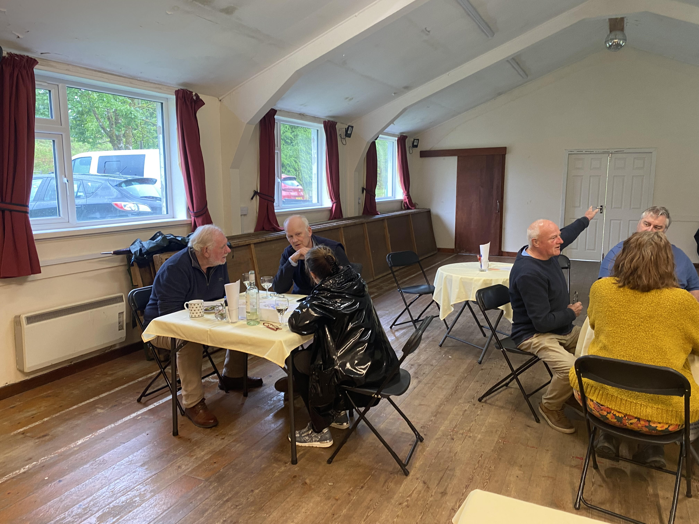
Our Approach
CAP 2024-7 and LPP: How did we consult?
A website was created for the village and its hall: https://e-voice.org.uk/fordvillageargyll/. Information about the CAP was placed on the site, including a link to an online survey. We had 60 online responses.
Paper versions of this survey were hand-delivered to every household in the wider Ford locality. This included homes in Inverliever, Kilmichael Glen, and Ederline. We received 13 paper returns.
The website also had a discussion area for locals to add their views on key questions.
Three public meetings were held in the Hall during May 2024.
During 2024, we continued to assess the evidence gathered, looking at the main areas of concern. One member of the Ford Village Hall Committee has engaged with Planning Aid Scotland, attending an online training session hosted by Paul Ede from “Place at the Table” to help develop this Local Place Plan. Having assessed the information gathered previously and sorted it into the main focus areas for the CAP and this report, we then consulted further with the local community regarding a proposed community wood in the winter and spring of 2024/5. We aim to present the plan to the Council in April and for our Local Place Plan to be part of the Local Development Plan in due course.

Slide 12
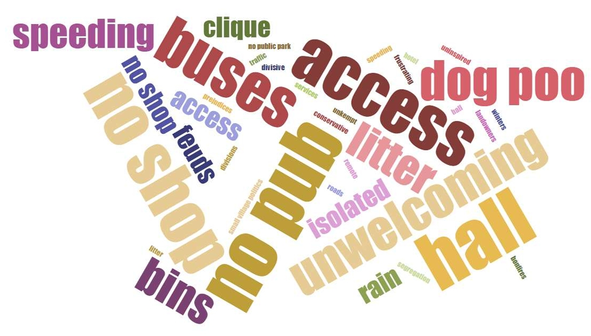
What was said by the community
The community was asked to submit single words/phrases that summed up both the positive and negative about living in Ford village. These can be seen below. This work provided the foundation for the development of the Ford CAP and LPP.
How to get involved
If you would like to know more about the content of this plan, how it was developed, or would like to find out how the proposals could be taken forward, please contact Ford Village Hall Committee at fordvillagehallargyll@gmail.com

Slide 13
Next steps?
We are obliged to run a statutory consultation period for a minimum of 28 days. During this period, we must send copies of the draft plan to our local councillors and all surrounding community councils, inviting them to make representations about the plan. We will also go beyond the statutory requirements and consult with the wider community again through the use of social media. The Information Notice period will run from midnight on 7th April to midnight on 5th May 2025.
Representing everyone’s views – The Information Notice Period
The Information Notice period is a statutory requirement for a minimum 28-day period where local councillors and community councils adjacent to the boundary of the Local Place Plan have a chance to make representations about the draft LPP.
All comments submitted, whether as a councillor, citizen, or community group during this period, will be read and assessed by the FVHC. They will then decide how best to modify the draft proposals before final submission. Any comments received that disagree with or seek to amend the proposals in the Local Place Plan will be reviewed against previous feedback from members of the community and a decision taken on how best to proceed. We regret we are not able to take suggestions for new proposals at this time. Regardless of any changes FVHC makes to any draft proposals, all comments and responses submitted during the statutory Information Notice period (including any comments that disagree or object to the proposals) will be submitted alongside this plan. Following a further check-in with the planning authority, we will then aim to submit our completed LPP by June 2025.

Slide 14
Chapter 2: Local Place Plan Proposals
LPP No: | Proposal | Linked CAP
1 | Ford Community Wood | Theme 3, iii; Theme 3, i and ii; Theme 4, ii;
2 | Ford Play Park | Theme 2, ii;
3 | Honesty Shop on the grounds of Ford Hall | Theme 4, i; Theme 1, ii, iv;
4 | Ford Historic Information Notice Boards | Theme 1, iv; Theme 2, ii; Theme 4, ii;
5 | New Community Hall for Ford Village | To be developed
Status of the development proposal | Description
Concept | This development remains at the discussion stage.
Initial discussions | Initial discussions are taking place.
Planned | This development is in its planning stage.
In process | This development has already started,

Slide 15
Introduction
This section of the report lays out a series of Local Place Plan (LPP) proposals for Ford Village for the next 10 years. An LPP is a community-led plan for the future of a place. It establishes our spatial vision for our area for the next season. The plan contains ideas for land use, buildings, and development and feeds into the council’s next Local Development Plan (LDP3). It is a new way for communities to influence development in their area. The plan has been prepared by local people to lay out a vision for Ford Village, shaped by input from the whole community. The plan articulates a community position seeking to shape how development happens in the area, and how the use of land and buildings should be enabled or regulated. The goal is to offer workable solutions to make the Ford Village area function well, improve the well-being of its populace, and make it an even more enjoyable place to live. The plan was developed between July 2024 and April 2025. At the heart of this document are 5 proposals for the Ford Village area within the Dunadd Community Ward. These are presented for assessment by Argyll and Bute Council Planning Authority for inclusion in Local Development Plan 3.
Reasoning and Justification for each proposal
In the following chapter, we have also provided policy reasoning for each proposal. This is designed to comply with the validation requirement to provide statements justifying proposals against the existing Local Development Plan (2018) and National Planning Framework 4 (NPF4). For readers from the community, going through this appendix is optional.
Corporate ownership
In addition to being assessed for inclusion in the next Local Development Plan, these proposals may also require action or ownership by departments other than Argyll and Bute Planning Authority. As part of a holistic spatial vision for our area, we consider such elements to form a critical and integrated part of delivering benefit for the wellbeing of our community. We would therefore invite the Planning Authority to ensure that proposals which also require action from other council departments are communicated at the corporate level (as appropriate). This will enable these proposals to be integrated into inter-departmental planning for our area.
Feedback justifying inclusion/exclusion of our proposals in the LDP Proposal Plan
We look forward to receiving written feedback, explanation, and justification from Argyll and Bute Planning Authority at the appropriate point in the Development Plan Scheme. We will be keen at that point to understand why these proposals and/or priorities have or haven’t been accepted as proposals integrated into the Proposed Plan for LDP3.

Slide 16
Overview Maps for LPP Proposals

Slide 17
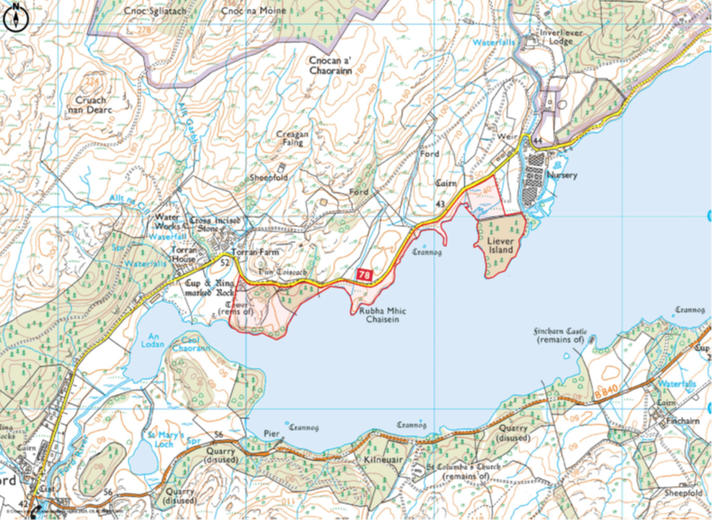
1: Ford Community Wood
Proposal | To purchase land from Torran Fishing Hostel that is currently up for sale (March 2025) to create a community-owned asset. This asset would be a community wood.
Vision for the proposal | The community would like to purchase a 58-acre area of amenity land on the shores of Loch Awe. This project could provide local waterside amenities, together with managed space for nature and income-generating activities. It therefore has the potential to increase community access to the shores of Loch Awe, so increasing local people’s wellbeing and sustainably delivering environmental benefits.
Detail | The community would like to use the site to improve local access to the loch and native woodland, whilst increasing biodiversity and enhancing the natural environment. There is currently very little in place regarding pathways, access to the shore, and parking facilities. They envisage creating walking paths, including accessible paths, a picnic and swimming area on the shore of the Loch, access and storage for small boats and paddle craft, and a wildlife hide. Natural habitats would be improved by replanting the rare temperate rainforest woodland, and providing floating bird nesting platforms and nesting boxes.
Status | Stage 2 application to the Scottish Land Fund

Slide 18
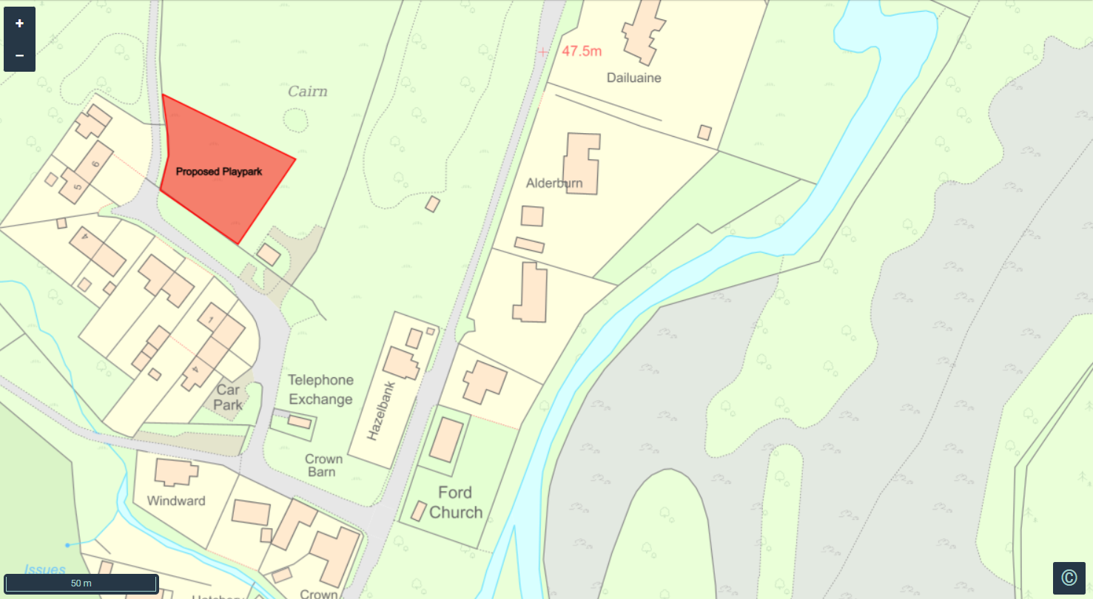
2: Ford Play Park
Proposal | To purchase play equipment and create a children’s play area within the village.
Vision for the proposal | The village would like to seek funds to build a playground for children on land in the centre of the village, which is currently owned by the Ford Village Hall.
Detail | The demographics of the village have changed rapidly in the last 3-5 years. There are now more families in the village and 20 children of primary school age living within the boundaries of Ford Village. The nearest playground for the children of Ford Village is a car journey away in Dalavich, Bridgend, or Lochgilphead.
Status | Initial discussions.

Slide 19
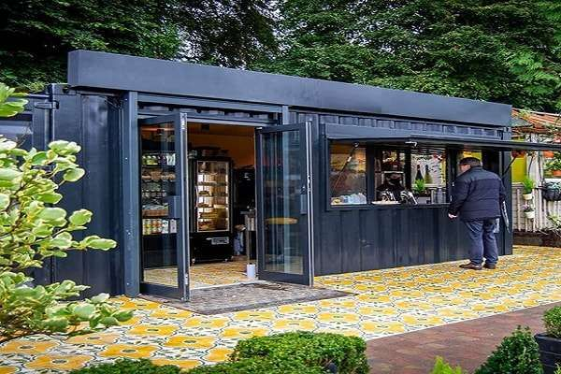
3: Honesty Shop at Ford Village Hall
Proposal | To create an honesty shop on the grounds of Ford Village Hall.
Vision for the proposal | The village hall committee would like to build an honesty shop on their grounds. The shop would sell basic nonperishable goods through an honesty system supported by volunteers managed by the FVHC.
Detail | Ford Village has a population of 100+ and is visited by many tourists during the summer season. The nearest shop is in Dalavich, 10 miles away, or Lochgilphead. This creates unnecessary hardship and car journeys for local people and visitors to shop for basic produce. The FVHC would like to place a “shipping crate” style shop on the land adjacent to the hall to provide basic groceries, tinned goods, and refrigerated produce. This would be an honesty shop and not routinely staffed. However, the shop could be expanded into a summer coffee shop for visitors and an outdoor storage area for the Hall.
Status | Initial discussions.

Slide 20
4: Ford History and Heritage Trail
Proposal | To create a historical walking trail around Ford. To purchase and install historic information boards within the boundaries of the village.
Vision for the proposal | The village would like to seek funds to install historical information boards, which will highlight the wealth of history in Ford, stretching back to the Bronze Age. These boards will be linked along a walking trail.
Detail | Ford Village and its environment have a large number of prehistoric and modern sites of historical interest. These include many standing stones, Bronze Age burial cists, the site of a Bronze Age hoard, several crannogs, and the remains of almost forgotten settlements. The Ford Historical and Heritage group, aided by the FVHC, would like to create a walking trail within the village and its surroundings which links these historically important sites together and is illustrated by historical information boards. The trail would be signposted and supported by a physical and online guide.
Status | Initial discussions.

Slide 21
5: A New Community Hall for Ford Village
Proposal | To build a new community hall for Ford Village on land owned by the current village hall committee.
Vision for the proposal | The FVHC would like to build a new hall on land purchased by the FVHC through funding from the SLF for that purpose.
Detail | The current village hall at Ford was built in the 1960s. It is currently undergoing a modernisation and decarbonisation project (subject to funding) to extend its current life span by a decade. However, there was a plan which had community backing and funding from the National Lottery several years ago, which stalled due to opposition from a local business. That business is now closing, and the FVHC would still like to seek funding in the long term to build a replacement hall for the village and wider Lochside area on the land originally purchased from Scottish Forestry for that purpose in the centre of the village.
Status | Concept.

Slide 22
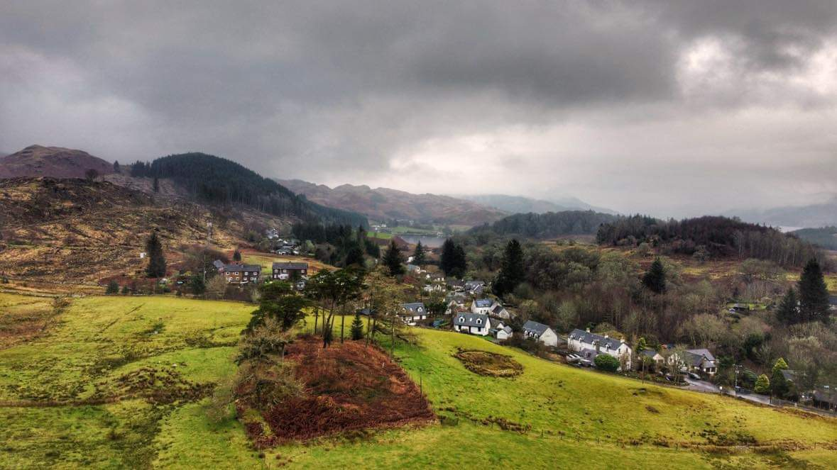
Chapter 3: Statements
STATEMENT OF REGARD OF LPP PROPOSALS TO NATIONAL PLANNING FRAMEWORK 4, AND THE ARGYLL AND BUTE LOCAL DEVELOPMENT PLAN 2 (2019) (including extent of non-alignment if relevant)
Includes planning commentary, statement of the LPP lead from FVHC position, and further reasoning as needed on a proposal-by-proposal basis.

Slide 23
1 | Ford Community Wood
Proposal | To purchase land from Torran Fishing Hostel that is currently up for sale (March 2025) to create a community-owned asset. This asset would be a community wood.
Constraints | Funding needs to be secured from the Scottish Land Fund to purchase the land.
Pre-developmental steps required | Community consultation undertaken. Stage 1 application to SLF for funding to secure feasibility study, independent valuation of the land, and consultants to design business plan. Stage 2 application to SLF is successful, and funds are made available Land is successfully brought into community ownership.
Links to NPF4and justification where not aligned | Policy 3 a) Development proposals will contribute to the enhancement of biodiversity, including where relevant, restoring degraded habitats and building and strengthening nature networks and the connections between them. Proposals should also integrate nature-based solutions, where possible. b) Development proposals for national or major development, or for development that requires an Environmental Impact Assessment will only be supported where it can be demonstrated that the proposal will conserve, restore and enhance biodiversity, including nature networks so they are in a demonstrably better state than without intervention. This will include future management. To inform this, best practice assessment methods should be used. Policy 6 Development proposals that enhance, expand, and improve woodland and tree cover will be supported. Policy 8 Development proposals within a green belt designated within the LDP will only be supported if: They are for: development associated with agriculture, woodland creation, forestry, and existing woodland (including community woodlands); outdoor recreation, play and sport or leisure and tourism uses; and developments that provide opportunities for access to the open countryside (including routes for active travel and core paths); Policy 15 a) Development proposals will contribute to local living, including, where relevant, 20-minute neighbourhoods. To establish this, consideration will be given to the existing settlement pattern, and the level and quality of interconnectivity of the proposed development with the surrounding area, including local access to: playgrounds and informal play opportunities, parks, green streets and spaces, community gardens, opportunities for food growth and allotments, sport and recreation facilities; Policy 23 a) Development proposals that will have positive effects on health will be supported. This could include, for example, proposals that incorporate opportunities for exercise, community food growing or allotments.

Slide 24
1 | Ford Community Wood
 | Policy 29 a) Development proposals that contribute to the viability, sustainability, and diversity of rural communities and local rural economy will be supported, including: iv. essential community services; v. essential infrastructure; Policy 30 Development proposals for new or extended tourist facilities or accommodation, including caravan and camping sites, in locations identified in the LDP, will be supported
FVHC position | The purchase of the land to create a community wood would allow the village hall committee to meet a major priority of the Ford Village Community Action Plan – “access” to the land and the Loch shore. CAP: Theme 3, iii; Theme 3, i and ii; Theme 4, ii. See appendices.
Further reasoning | CAP Priority 2: Access – Explore opportunities to improve the access of local people to the environment, history, and wildlife of their locality. • A majority of local people identified access to the local area for leisure reasons. This was particularly relevant to Loch Awe’s shoreline in and around Torran Bay and the southern end of the Loch. The committee will support local individuals and groups who seek to broaden access to our local area • Develop and strengthen relationships with local land owners in order to ensure local footpaths and tracks are accessible. • Create and support two groups based out of the village hall, which develop local people’s understanding, knowledge, and access to local flora, fauna, and history • Develop links to existing wildlife, environment, and history organisations: e.g., Argyll Beaver Centre, Kilmartin Museum

Slide 25
2 | Ford Playpark
Proposal | To purchase play equipment and create a children’s play area within the village.
Constraints | Funding being secured to build the playpark. Insurance and maintenance costs.
Pre-developmental steps required | Community meeting with families and children.
Links to NPF4and justification where not aligned | Policy 8 a) Development proposals within a green belt designated within the LDP will only be supported if: They are for: outdoor recreation, play and sport or leisure and tourism uses; and developments that provide opportunities for access to the open countryside (including routes for active travel and core paths); Policy 15 a) Development proposals will contribute to local living, including, where relevant, 20-minute neighbourhoods. To establish this, consideration will be given to the existing settlement pattern, and the level and quality of interconnectivity of the proposed development with the surrounding area, including local access to: playgrounds and informal play opportunities, parks, green streets and spaces, community gardens, opportunities for food growth and allotments, sport and recreation facilities;
FVHC position | The demographics of the village have changed rapidly in the last 3-5 years. There are now more families in the village and 20+ children of primary school age living within the boundaries of Ford Village. The nearest playground for the children of Ford Village is a car journey away in Dalavich, Bridgend, or Lochgilphead. The building of a playground on village-owned land has been a regular issue raised in community meetings.
Further reasoning | The role of playgrounds in promoting children’s health – a scoping review https://ijbnpa.biomedcentral.com/articles/10.1186/s12966-024-01618-2

Slide 26
3 | Honesty Shop at Ford Village Hall
Proposal | To create an honesty shop on the grounds of Ford Village Hall.
Constraints | Permission from the landowners to place a shipping crate on the land next to the hall. Funding being secured to pay for the crate and conversion, paths, and electric hookup, etc. Volunteers to manage the shop.
Pre-developmental steps required | Community consultation undertaken as part of a feasibility study. Permission secured from Ederline Estate for the placement of the shop.
Links to NPF4 and justification where not aligned | Policy 15 Development proposal will contribute to local living, including, where relevant, 20-minute neighbourhoods. To establish this, consideration will be given to the existing settlement pattern, and the level and quality of interconnectivity of the proposed development with the surrounding area, including local access to: shopping; Policy 25 a) Development proposals that contribute to local or regional community wealth-building strategies and are consistent with local economic priorities will be supported. This could include, for example, improving community resilience and reducing inequalities; increasing spending within communities; ensuring the use of local supply chains and services; local job creation; supporting community-led proposals, including creation of new local firms and enabling community-led ownership of buildings and assets. b) Development proposals linked to community ownership and management of land will be supported.
FVHC position | Ford Village has a population of 100+ and is visited by many tourists during the summer season. The nearest shop is in Dalavich, 10 miles away, or Lochgilphead. This creates unnecessary hardship and car journeys for local people and visitors to shop for basic produce. The FVHC would like to place a “shipping crate” style shop on the land adjacent to the hall to provide basic groceries, tinned goods, and refrigerated produce. This would be an honesty shop and not routinely staffed. However, the shop could be expanded into a summer coffee shop for visitors and an outdoor storage area for the Hall.
Further reasoning | The shop would improve facilities for visitors to the area as well as local residents. The shop would provide an income stream for the FVHC to be spent on further improvements to the services and facilities available to Ford residents.

Slide 27
4 | Ford History and Heritage Trail
Proposal | To create a historical walking trail around Ford. To purchase and install historic information boards within the boundaries of the village.
Constraints | Funding needs to be secured to pay for historical information boards and their correct placement. Permission will need to be secured from land owners and the council to install the signs, notice boards, and for potential new paths and or access.
Pre-developmental steps required | Consultation with the Ford Village History and Heritage group. Consultation with Kilmartin Museum Sites for boards established. Information and design of historical information boards undertaken. Funding applications made.
Links to NPF4 and justification where not aligned | Policy 29 a) Development proposals that contribute to the viability, sustainability and diversity of rural communities and local rural economy will be supported, including: vii. appropriate use of a historic environment asset or is appropriate enabling development to secure the future of historic environment assets;
FVHC position | Ford Village and its environment have a large number of prehistoric and modern sites of historical interest. These include many standing stones, Bronze Age burial cists, the site of a Bronze Age hoard, several crannogs, and the remains of almost forgotten settlements. The Ford Historical and Heritage group, aided by the FVHC, would like to create a walking trail within the village and its surroundings which links these historically important sites together and is illustrated by historical information boards. The trail would be signposted and supported by a physical and online guide.
Further reasoning | CAP Priority 2: Access – Explore opportunities to improve the access of local people to the environment, history, and wildlife of their locality. • Create and support two groups based out of the village hall, which develop local people’s understanding, knowledge and access to local flora, fauna and history • Develop links to existing wildlife, environment and history organisations: e.g. Argyll Beaver Centre, Kilmartin Museum environment and history organisations: e.g. Argyll Beaver Centre, Kilmartin Museum

Slide 28
5 | New Community Hall for Ford Village
Proposal | To build a new community hall for Ford Village on land owned by the current village hall committee.
Constraints | Funding needs to be secured.
Pre-developmental steps required | This is at concept status currently.
Links to NPF4 and justification where not aligned | Policy 29 a) Development proposals that contribute to the viability, sustainability, and diversity of rural communities and local rural economy will be supported, including: iv. essential community services; v. essential infrastructure;
FVHC position | The current village hall at Ford was built in the 1960s. It is currently undergoing a modernisation and decarbonisation project (subject to funding) to extend its current life span by a decade. However, there was a plan which had community backing and funding from the National Lottery several years ago, which stalled due to opposition from a local business. That business is now closing, and the FVHC would still like to seek funding in the long term to build a replacement hall for the village and wider Lochside area on the land originally purchased from Scottish Forestry for that purpose in the centre of the village.
Further reasoning | CAP Theme 1: Community Priority 1: A village hall fit for purpose.

Slide 29
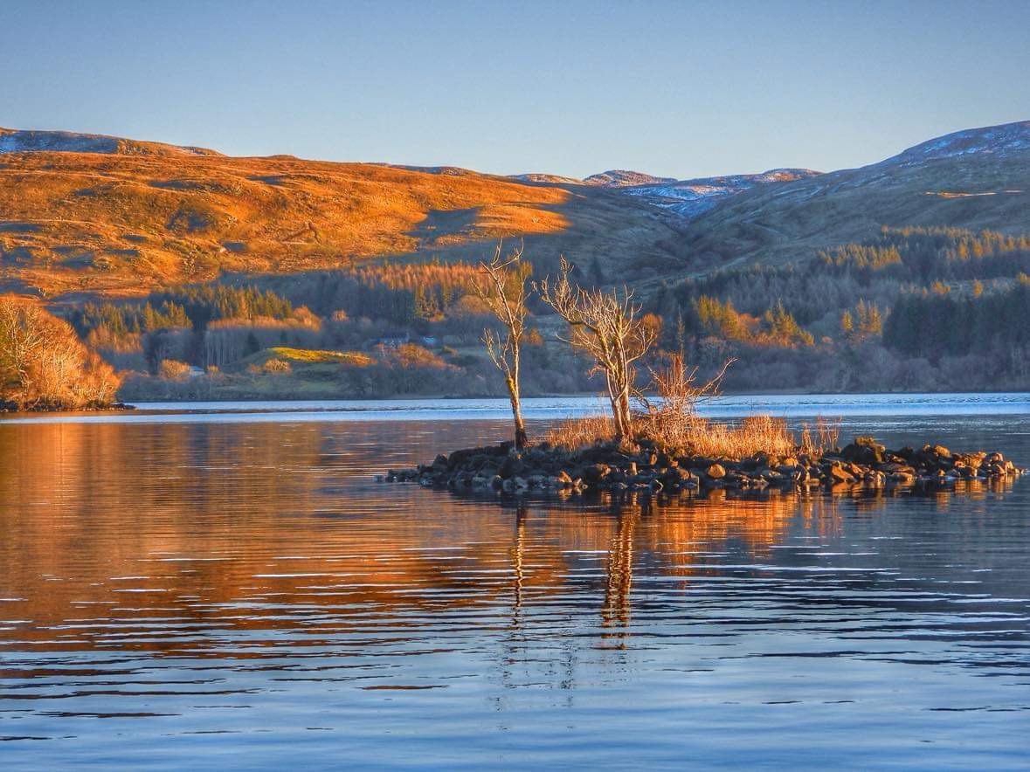
Chapter 4: Community Action Plan Initiatives and Proposals
Ford Village
Our vision for the future
Over the next three years we will build on our strengths to create:
• A village hall, which is a warm and welcoming space for the village and wider community.
• A community that has access to services and events which help to overcome Ford’s rural isolation.
• A well-connected community, outward and forward looking and with strong internal cohesion.
• A community with the infrastructure to face the future and to provide for the needs of our community.
• A community where the quality of life is excellent and where people are welcomed.
• A community that has access to the countryside and its associated fauna and flora.
•A green community which protects and sensitively develops
our natural assets

Slide 30
Theme 1: Community
Priority 1:
A village hall fit for purpose
• Seek and secure funding to repair and renovate the current hall so that it is a warm, safe, and welcoming place for Ford and the wider community.
• Provide a plan to renovate the hall and grounds once funding is secured.
• Provide funding to support local events and groups without charge in the hall.
• Open the hall to external organisations and events for a minimum charge.
Priority 2:
A decarbonised and modernised hall
• To seek further funding to secure the future of the hall for the next two decades.
• Create a project plan that will deliver this future for the hall.
• Decarbonise the energy use of the hall.
• Examine the opportunities to broaden the use of the hall – a shop, public toilets, and village café.
Priority 3:
Strengthen local traditions and bonds through social events
•Once again, put on annual events popular with the local community, which have been traditional for a long period: e.g., Christmas Party, Summer Gala Day, Halloween
• Ensure that other events are regular features of village life: e.g., pop up pub nights, Quiz Nights, coffee mornings, cinema nights, barbecues.
•Apply and secure the appropriate licences.
Theme 1: Community
Priority 4:
Overcome rural isolation by providing the groups and organisations requested by the community
• Use the village hall committee to facilitate the creation of groups which promote interests, education, skill development, and community building.
• These groups will help tackle loneliness and promote mental health and community resilience.
• The groups will be led by local people, supported by the village hall committee, and will reflect suggestions provided by the CAP consultation.
• These groups will include: Astronomy Club, Gardener’s Club, Knitting Club, Board Game Club, History and Heritage Club, Walking and Wildlife Club, Circuit Training.
• Identify and secure funding to support these groups going forward.
Priority 5:
Improve and professionalise community communications
• Build and develop a village hall website
• Create a Facebook presence for the Village Hall
• Develop a communications strategy and policy.
• Publish a paper newsletter which is delivered to the local area at least once a season.

Slide 31
Theme 2: Access
Priority 1:
Use the hall to support access for all to community activities
• Maintain a village hall so that it is warm and welcoming all year round
• Provide access to the hall free of charge for local groups
• Provide access to the hall at a minimum charge for groups from the wider community
• Social events to be heavily subsidised for local people
Priority 2:
Explore opportunities to improve the access of local people to the environment, history, and wildlife of their locality.
• Access to the local area for leisure reasons was identified by a majority of local people. This was particularly relevant to Loch Awe’s shoreline in and around Torran Bay and the southern end of the Loch. The committee will support local individuals and groups who seek to broaden access to our local area
• Develop and strengthen relationships with local land owners to ensure local footpaths and tracks are accessible.
• Create and support two groups based out of the village hall, which develop local people’s understanding, knowledge, and access to local flora, fauna, and history
• Develop links to existing wildlife, environment, and history organisations: e.g., Argyll Beaver Centre, Kilmartin Museum
• Explore the use of the village green to maximise its potential for the local community
Theme 3: Environment
Priority 1:
Decarbonise the Village Hall
• To seek further funding to secure the future of the hall for the next two decades.
• Create a project plan that will deliver this future for the hall.
• Decarbonise the energy use of the hall.
Priority 2:
Examine the possibilities of developing a community garden
• Investigate the possible use of the village hall land to create a community garden
• Consult with local residents regarding a community garden
• Explore what other villages do in this area: e.g., Kilmartin and Lochgair
• Set up a Gardeners Group within Ford Village
Priority 3:
Look for opportunities to improve the environment around the village
• Be aware of opportunities to improve the local environment through flower/tree planting.
• Tackle “dog poo” through raising awareness, education and placing dog poo bins around the village.
• Cooperate with groups that seek to improve and secure the fauna and flora of the local environment.

Slide 32
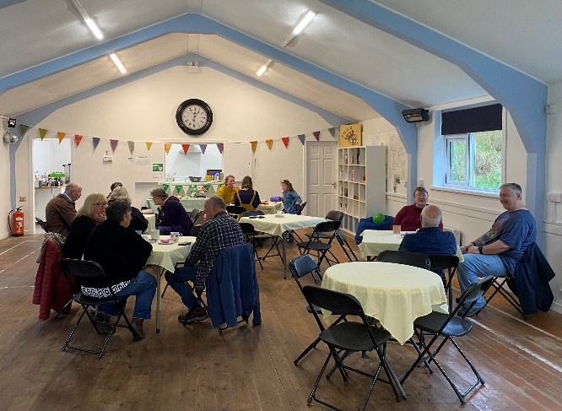
Theme 4: Wider Links
Priority 1:
Support local businesses
• Ford Village Hall Committee will fully support the Fair Work First Commitment. In seeking contractors to provide services to the Hall, we will give priority to those who can demonstrate that they pay their employees a living wage, regardless of gender, are committed to providing their employees with a workplace voice and skills training, and avoid restrictive and unfair workforce practices such as zero-hour contracts
• The Committee will support local businesses when we seek partners to fulfil aspects of the CAP and provide support to social events
• The Committee will support local organisations and businesses by providing opportunities for them to gain access to the local community
Priority 2:
Strengthen and build links with local organisations
• Ensure that the Hall hosts the monthly meetings of the SWI
• Work with local alternative energy companies to provide a channel for consultation with the community.
• Work with local charities, stakeholders, local councils to improve the standard of living of local people: e.g., Kilmartin Museum, Forestry, land owners, Dunadd Community Council, other local village halls/committees, local and regional funding groups.

Slide 33
Appendix 1: Compliance with validation criteria
The following tables lay out how this document meets the criteria of validity for registration of a Local Place Plan
Registration requirement | Where found? | Additional information
1: A copy of the finalised Local Place Plan | This document.
2: Confirmation of the Community Body’s status | Introduction. | The body submitting this plan is the Ford Village Hall Committee.
3: Contact details for your organisation | Introduction. | These details as well as copies of our Articles of Association can be got from contacting Steve Walker at fordvillagehallargyll@gmail.com
4. A map of the boundary of the Local Place Plan | Introduction. | The map is a boundary plan of Ford Village.
5. Statement of your proposals as to the development or use of land or building. | Chapter 2. | 5 Local Place Plan Proposals taken from the Ford Village’s CAP.
6. A map showing proposals for development or use of land or buildings | Chapter 2 | Overview Map at the beginning of Chapter 2. Proposal-specific maps are also provided.
7. A statement explaining how the Local Place Plan has regard to the National Planning Framework and, Local Development Plan. | Chapter 3
8. A statement explaining how the proposals in the LPP align with, or differ from, the relevant policies and development proposals in the plans (in 5 above), and why it considers that the Local Development Plan should be amended in light of this | Chapter 3
9. Before submission of your plan, make sure you have sent an Information Notice and a copy of the proposed Local Place Plan to all relevant Councillors and Community Councils. (28-day minimum period). | Appendix 2 | To be completed – the 28-day notification period will run from midnight 7th April to midnight 5th May 2025.

Slide 34
Registration requirement | Where found? | Additional information
10: Records of when and to whom the Information Notice was sent (required local councillors and community councils) | Appendix 2 – to be completed
11: Evidence of the level of community support for the Local Place Plan and how the Community Body reached that view. | Introduction and Appendix 3 – to be completed.
12: Copies of additional relevant documents as appropriate. | To be completed.

