Slide 1

Councils are changing
What Parishes need to know about LGR in Greater Essex
Nick Eveleigh, Chief Executive

Slide 2
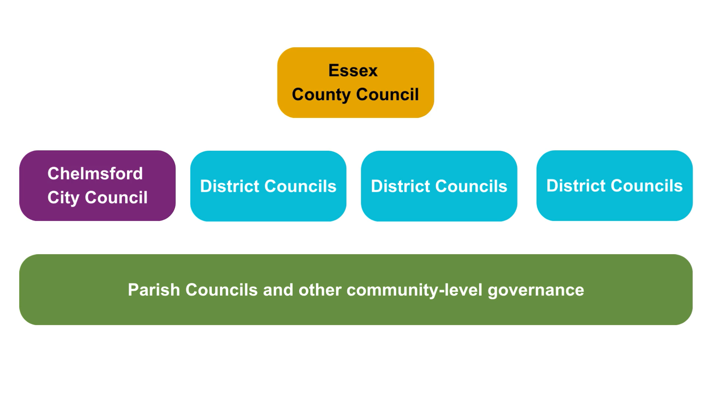
What’s happening?
The Government wants councils in Essex to look at new ways of organising local services.
At the moment, Essex has three tiers:
County Council
City/District Councils
Parishes and community bodies
Local government reorganisation (LGR) will combine tiers 1 and 2.
It will turn them into a smaller number of unitary councils, each responsible for all county and city/district services.
They will sit under a mayoral strategic authority.
Police, fire, NHS and other non-council public services are not part of this reorganisation.

Slide 3
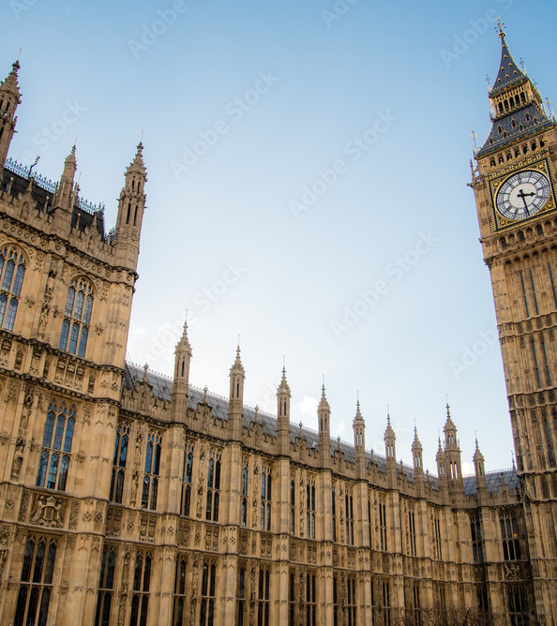
Why?
The Government thinks LGR will:
make services simpler and easier for residents and organisations to navigate
save money by reducing duplication
strengthen local leadership and accountability
enable devolution of powers and funding to local areas
Councils have had to submit proposals for how LGR should look in their area.

Slide 4
Why does it matter to parish and town councils?
1
2
3
One council
A single council to work with on planning, licensing, housing, highways, infrastructure etc.
Priorities continue for now
Chelmsford City Council will continue implementing its plans until vesting day on 1 April 2028, when the new unitary authority officially replaces it.
Some relationships will change
However, CEOs, directors and heads of service are more likely to change than frontline staff.
4
5
6
New Mayor of Essex created
There will no longer be a county council managing things like social care and highways, but there will be a Mayoral Strategic Authority providing direction to Greater Essex.
Your voice
Each unitary authority has a seat on the Mayoral Strategic Authority. The unitary councils will be your route to engaging with this new authority. Different models give you different levels of political representation.
Will we be reorganised?
What about parish and town councils? They aren’t part of this reorganisation, and the Government have remained silent about whether they have any plans for them after LGR.

Slide 5
What will happen to parish councils?
The Government have briefly mentioned “rewiring” the relationship, and a need for quality parish status.
In June 2025, the Minister for Local Government said the Government wants to promote Neighbourhood Area Committees as “a simplified and standardised system of local area-working and governance.”
NACs would administer fairly large populations, and do not have the same checks and balances as parish or town councils.
Outcomes have varied in other places where unitary councils were created:
  Cornwall – parish and town councils ended up with more responsibilities and a larger precept, but still had to raise the shortfall themselves.
  Christchurch, Bournemouth & Poole – Christchurch kept its PC, but elsewhere parishes were replaced with charter trustees. A draft proposal to reinstate parish councils was published in March.

Slide 6
Potential opportunities for parish councils
1
2
3
May be clearer
Easier to know where to go for support or to raise concerns. Only interact with one Council (although may want to interact with Mayor)
Simplified funding landscape
Less councils to apply to for grants and funding, freeing up time.
Networking
Larger local authorities may be able to bring together localities, charities, businesses from a wider geographical area.
4
5
Consistency
LGR may mean more consistency in how services are delivered. It would link up services that naturally work together, like housing and social care
Financial sustainability
The right sized unitary council could be financially resilient, with efficiency savings to reinvest in local priorities.

Slide 7
Potential challenges for parishes, towns and residents
Uncertainty
The Government will decide what happens. A consultation is due this autumn. Currently, there are four different proposals for Greater Essex.
Possible emphasis shift
Unitaries may need to spend more time and money on social care and highways, possibly affecting other services.
Lack of clarity around parishes
We will help to keep you updated as we hear more news from Government.
Unitaries that are too big could mean...
Distance from local priorities
Less empathy with local situations, issues and needs. Bigger authorities tend to mean more process-driven, rather than human, interactions.
Bumpy transition period
Trying to integrate too many systems and processes at once can cause teething issues which affect services.
Greater reliance on big contracts
Larger authorities tend to rely on major contracts, which can risk distance from communities and lower service satisfaction.
Loss of local identity
Local government boundaries need to be sensible, combining areas with shared aspects. They should relate to how people live their lives.
Unwieldy logistics
Areas with bad internal transport links or shaped into long, wide strips are not logistically practical.

Slide 8

The government has asked councils for proposals. They must show:
Sensible geography
A proposal should seek to achieve for the whole of the area concerned the establishment of a single tier of local government
Efficiency and resilience
Unitary local government must be the right size to achieve efficiencies, improve capacity and withstand financial shocks
High quality public services
UA structures must prioritise the delivery of high quality and sustainable public services to citizens
Local identity
Show how councils in the area have sought to work together in coming to a view that meets local needs and is informed by local views
Supporting devolution
New unitary structures must support devolution arrangements
Community empowerment
New unitary structures should enable stronger community engagement and deliver genuine opportunity for neighbourhood empowerment

Slide 9
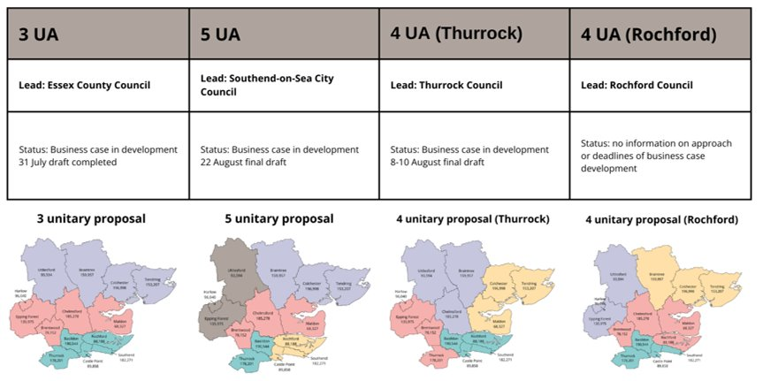
So what are the options?
Not everyone agrees on what exactly LGR should look like. There are four proposals for Essex:
3 unitaries | 5 unitaries | 4 unitaries (A) | 4 unitaries (B)
Led by Essex County Council | Cross-party support and collaboration between most district councils, including Chelmsford | Proposed by Thurrock | Proposed by Rochford
Puts Chelmsford with Epping Forest, Brentwood and Maldon | Puts Chelmsford with Brentwood and Maldon | Puts Chelmsford with Braintree and Uttlesford | Puts Chelmsford with Brentwood, Maldon and Rochford

Slide 10

Why we think five unitaries works best
Of all the options, Chelmsford City Council supports the five unitary proposal.
Stronger local identity Each unitary is based on natural communities, not a large remote authority
Empathy with communities above process, driving better outcomes for local people.
Nimbler, faster decision making and implementation.
Better partnership working: at this size, charities and community groups can build closer links with their council
Smoother transition, meaning lower initial costs and better services during the period of change.
Efficiency and savings: more resources can be directed where it counts, especially in social care
More resilient councils, financially stronger and better able to sustain vital services
Better political representation so councillors have enough time for their caseloads

Slide 11
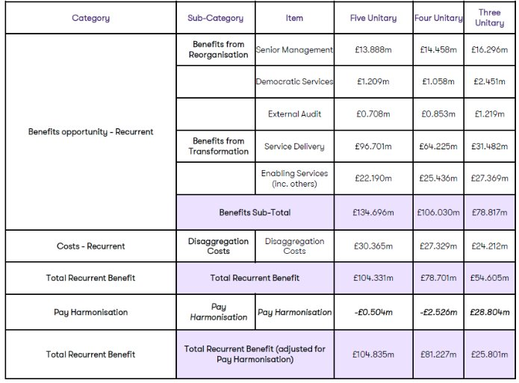
The finances for five stack up
Research by Grant Thornton highlights that the 5 model provides the best value for money.
It delivers the greatest prospect of potential savings and looks to be financially sustainable.
Peopletoo and Institute for Social Care Excellence analysis tells us councils with the population size of the 5 unitaries achieve lowest costs.
We’ve chosen to support this proposal after looking at all the evidence for the others.

Slide 12
How will residents’ voices be heard?
Strategically
You can engage with the elected Mayor of Greater Essex, who will set priorities on countywide issues like transport, skills, climate action and economic growth. The Mayor and unitary councillors will decide exactly how they want to engage once elected.
Locally
Unitary councils will oversee services like housing, planning, care, waste and roads.
Hyperlocally
Parish and town councils, where they exist, will still give neighbourhoods a direct say.
Mayoral Cabinet
Leaders of the new unitary councils will sit on the Mayor’s cabinet, so local voices feed into strategic decisions. Your “route in”.
Partnerships
Local councils will continue working with local businesses and business groups. Opportunities to influence through consultations, forums and partnerships.

Slide 13
What’s next: the Government’s timetable
Summer/
autumn 2026
Nov
2025
Mar
2026
May
2026
July
2026
May 2027
1 April 2028
Consultation
Government will consult the public on the LGR proposals that it deems to be viable
Decision
Government decision due about how LGR will look in Essex
Elections
Mayoral and county council elections expected plus those districts that elect in thirds
Draft Order
Government lays out legislation to make the changes happen
New teams
Teams established to manage the changeover
Elections
Councillors elected, first as a Shadow Authority, later to become Unitary councillors. 4-year term
Vesting day
Chelmsford and Essex councils stop existing. New unitary is up and running

Slide 14

How you can prepare
Engage early
Share how you interact with local councils, and highlight your community’s needs, when the government consultation starts.
Think ahead
Identify which council services matter most to your patch and analyse how you might future-proof. Consider how you could work with unitary partners and the mayoral strategic authority.
Collaborate
Work together with other parishes and community-level councils to have a stronger, collective voice on the issues that matter most to you in LGR.
Stay informed
We will update you as we know more. Follow Chelmsford City Council and the county council for news and opportunities to engage.

Slide 15

Questions

