Slide 1

Update to Parish Councils
Nick Eveleigh, Chief Executive

Slide 2
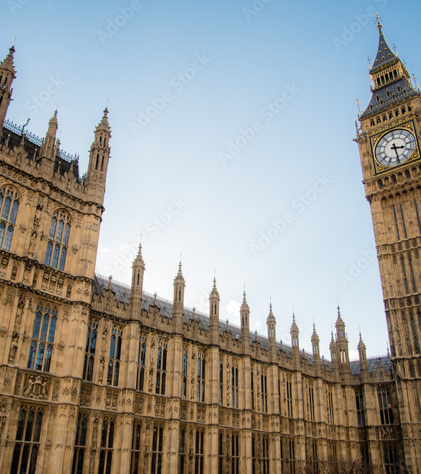
Why LGR?
The Government’s stated aims:
01
Simpler services
Easier for residents and organisations to navigate.
02
Lower duplication
Save money by reducing repeated activity.
03
Stronger local leadership
Clearer accountability for local decisions.
04
More local powers
Devolution of powers and funding to local areas.
Councils submitted proposals for how LGR should look in their area.

Slide 3
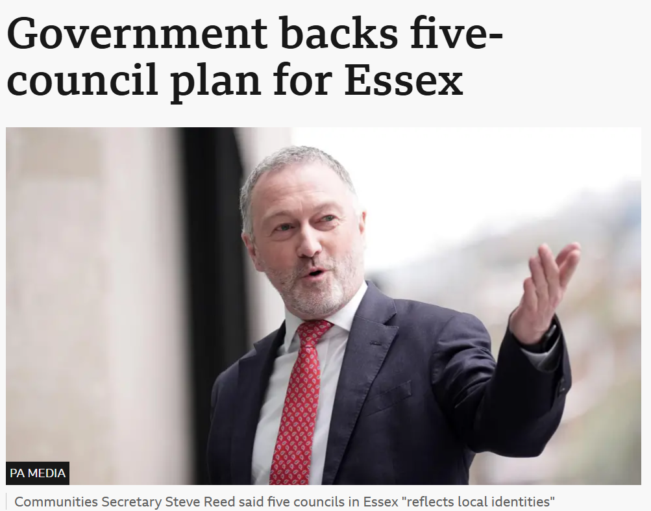
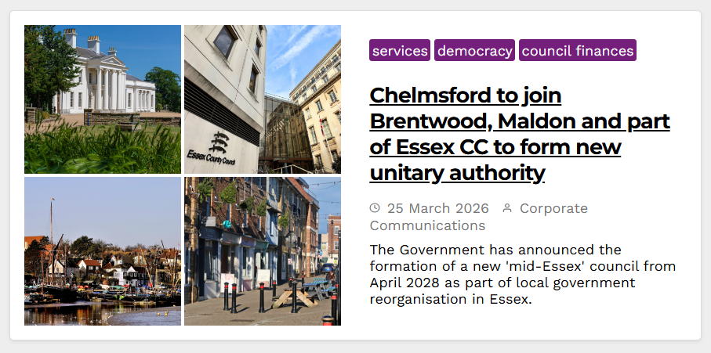
LGR Recent news
Notes:
The Secretary of State has decided to implement the proposal for 5 unitary councils, subject to Parliamentary approval.
Informal teams are now being setup to run workstreams on LGR until formal teams are officially implemented later this year.

Slide 4
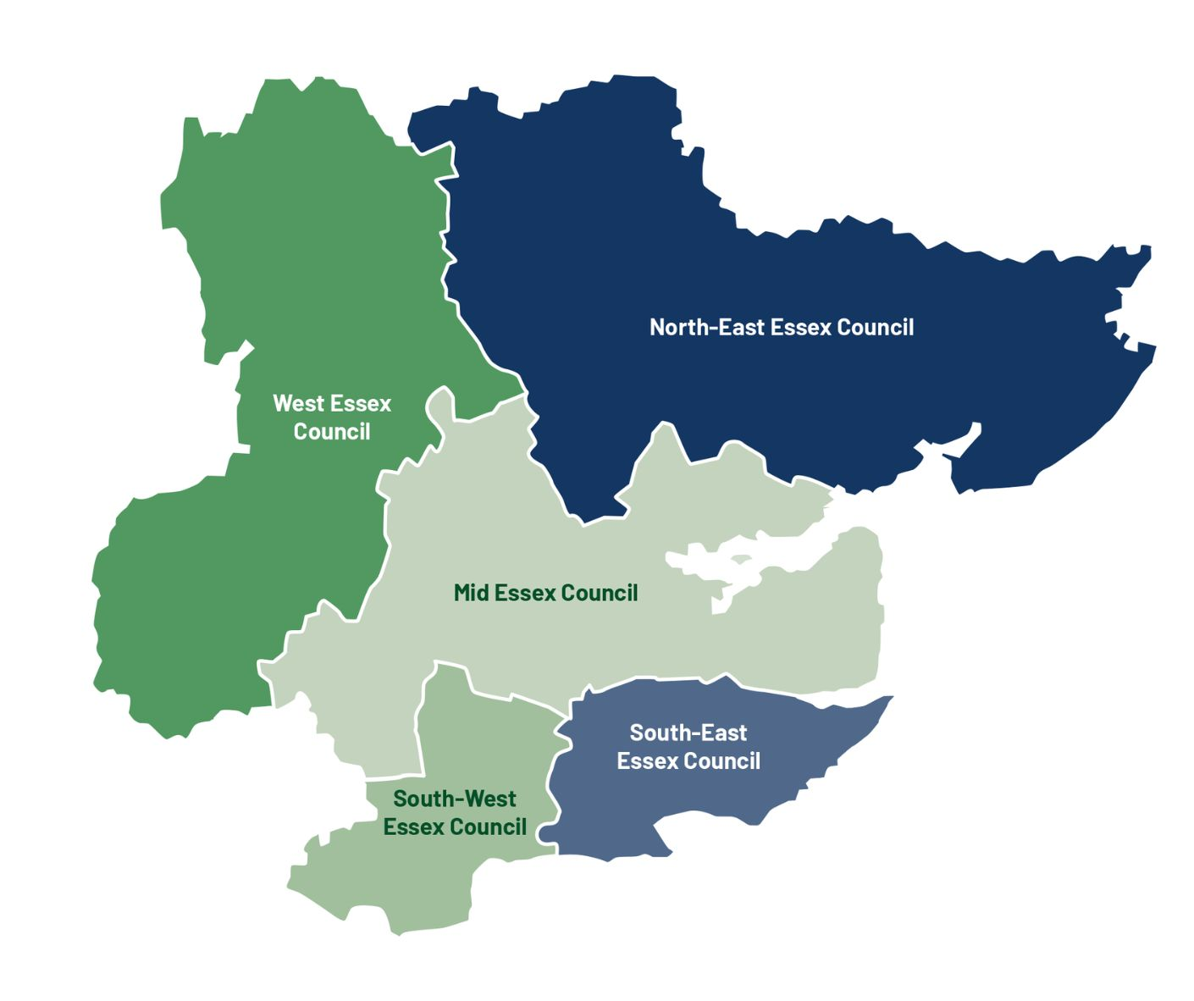

LGR recap: minded to decision
Mid Essex
(331,757)
Brentwood Chelmsford Maldon​​
North-East Essex
(510,162)
Braintree
Colchester
Tendring
South-East Essex
(360,317)
Castle Point
Southend
Rochford
South-West Essex
(368,745)
Thurrock
Basildon
West Essex
(325,609)
Uttlesford
Harlow
Epping Forest
Notes:
Our model was based on keeping local government as local as possible. Sensible geographies anchored by a major city, Natural social and economic ties and small enough to remain agile but big enough to withstand financial shocks

Slide 5

What’s next: the Government’s timetable
January
2026
March
2026
Jun-Sep
2026
Jan/March
2027
May
2027
1 April
2028
May
2028
Consultation closed
Government's public consultation on the LGR proposals ended
Decision
Government decision due about how LGR will look in Essex and informal joint committee established
Structural Change Order
Government lays out legislation to make the changes happen
SCO implemented
Government's Structural Change Order comes into effect and teams are established to manage the changeover
Elections
Councillors elected, first as a Shadow Authority, later to become Unitary councillors. 4-year term
Vesting day
Chelmsford and Essex councils stop existing. New unitary is up and running
Elections
Mayoral elections expected
Notes:
Timetable & Transitional Period
Existing councils remain responsible for services until abolition on 1 April 2028.
Shadow councils will be established and given preparatory functions including budgets, plans, statutory officer appointments, codes of conduct and allowances.
Preparatory work is permitted during the pre‑election
A Section 24 notice will be implemented, placing spending restrictions on the authority
What's the timeline?
Jan 2026: Government consultation ended
March 2026: Last month the Government announced that five new councils will be created for Greater Essex.
Jun-Sep 2026: Government lays out legislation to make the changes happen, also known as the SCO
Nov/Dec 2026: This SCO will officially come into effect in autumn/winter 2026 and around that same time, formal implementation teams will be formed to manage the changeover.
May 2027: Shadow elections new councillors elected
1 April 2028: new Councils begin
May 2028: elections held to appoint a Mayor of Essex to oversee the Greater Essex Combined County Authority.

Slide 6
Impact on Parishes
Parish councils remain
Local relationships
Parish Councils will remain, with
no increase in formal powers.
As the closest democratic body to
the public, they may see greater
community engagement as
Unitary Councils are created.
Fewer Councillors at local level will
mean developing new relationships with the unitary.
There is some potential for
devolved services if all parties are
in agreement.

Slide 7
Issues Raised
01
02
Planning issues
Purchasing of council assets
Parish Councils are feeling disenfranchised by the seeming lack of regard of consultee comments —possible training by the Planning office for Cllrs.
Parish councils across the city report being encouraged by CCC to pursue the purchase of assets but are often refused at the final stage of the process.
Notes:
Planning - We carefully consider all comments to planning applications and local plan allocations but as decision maker we need to consider national and local planning policy alongside other material considerations to make robust and defensible decisions.
We can offer training on this. We do organise Parish Forums on planning matters where all Parish Councils are invited, but often they are poorly attended. We do not have the next one scheduled but we can organise the next one for mid to late July.
Assets - Asset Categories: Under Review, Strategic, Non-Strategic

Slide 8

Questions

