Slide 1
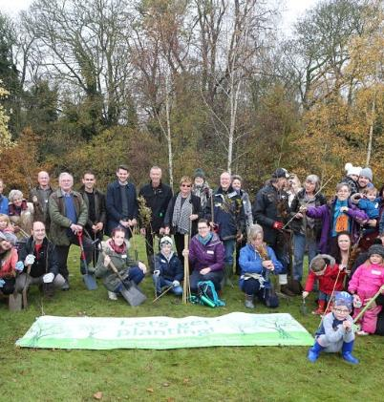
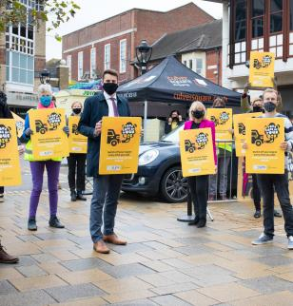
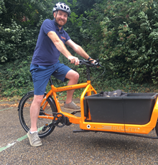
Colchester Borough Council and the Climate Emergency

Slide 2
Structure
Introduction – Council and the Climate Emergency – What does it mean? What is the importance of tackling climate change?
Our work and the impact it has
How Parishes can help/make an impact
Signposting to resources
Q and A
Notes:
Tackling CE and net zero = overall goal/impact
Our work – will look at various aspects of our work to show how we are embedding consideration of environment within each
Will try and link throughout how this can be useful for Towns/Parishes

Slide 3
Time for a quick poll!
Notes:
Poll link for completing - https://forms.office.com/r/zTrEtTQkgE

Slide 4
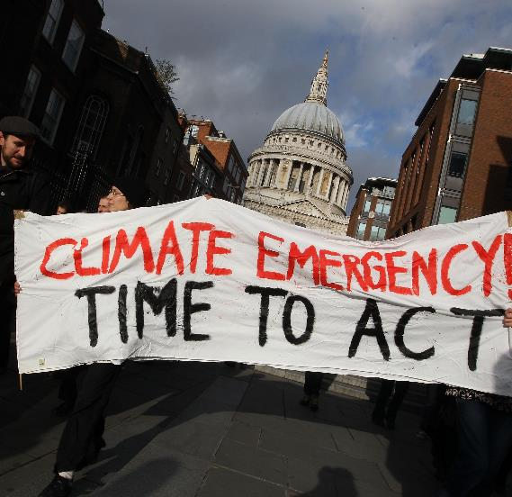
What is the Climate Emergency?
2015 Paris Agreement
UK net zero by 2050
CBC net zero by 2030
Notes:
Paris Agreement – Keep temps well below 2 degrees increase, and try to limit to 1.5 degree increase over pre-industrial levels.
Members sign up to reduce emissions ASAP - UK net zero by 2050 relative to 1990 (43% reduction so far)
CBC target goes beyond emissions e.g. protecting green space, reduce waste

Slide 5
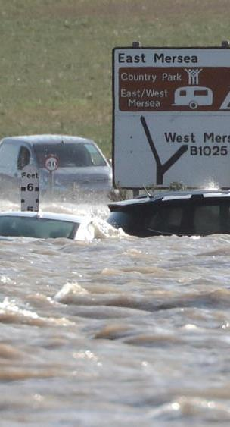
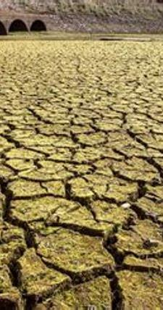
Climate change is already occurring
UK annual temperatures already 1.2°C above pre-industrial levels
UK mean sea level rise ~21cm since 1900
Storm surges/flooding
Heatwaves - >30 °C for 6 consecutive days in East of England
Future climate change
High levels of water scarcity in Summer
More common and sustained heatwaves
Increased flood risk in Winter (particularly along coast)
Notes:
4/10 hottest summers ever have come in last 20 years

Slide 6
What could future climate look like?
Notes:
Video – play first 3 mins to give people the idea

Slide 7
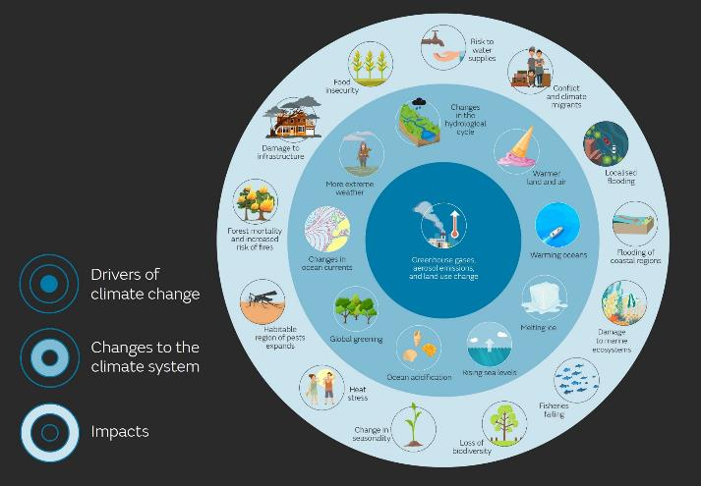
Impacts of climate change
Crop losses significantly increase
Biodiversity loss
250,000 properties at risk of flooding in East of England
Impacts on wellbeing/livelihoods – ‘eco anxiety’.
“It is the biggest challenge any generation of children has faced in the past 10 decades”
Notes:
Wheat production lowest yield in 30 years due to wet winter preventing roots from developing and hot, dry summer stunting their growth
Eco anxiety – Recognised as being greatly concerned about future state of Earth due to climate change
Quote came from meeting of local school Council’s who discussed climate change and pollution
Warming conditions mean that various plant and animal species have to migrate/die in response to climate

Slide 8
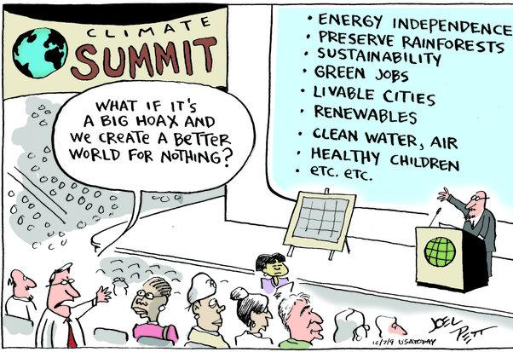
Co-benefits of tackling climate change
Cleaner air
Increasing physical activity
Warmer homes
Saving money – energy bills
More jobs
Maintained green spaces
Notes:
1 in 20 deaths in Colchester linked to air pollution
Rowan House - £68,000 annual savings from project to increase energy efficiency and installing heat pump to replace gas boiler for heating
Key messages – The ‘so what’ for residents

Slide 9
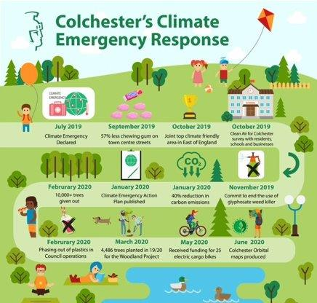
Some highlights so far!
Publishing Climate Emergency Action Plan
Woodland and Biodiversity Project
Colchester eCargo bike library
Clean Air for Colchester
Notes:
Slide just shows some overall highlights of our work in 2019-20 –
CEAP – Published in Jan 2020 – updating this year
Woodland and Biodiversity project – Expanded from its original goal – more than just tree planting
eCargo bikes – Electric bike with a storage elements on front of the bike or as a trailer – Ideal for deliveries etc that may have been done in a car/van – Loaned out to a variety of businesses as well as for use by the Council.
Clean Air for Colchester – Headline goal of improving air quality by encouraging more cycling/walking and encouraging no idling behaviour

Slide 10
Our Emissions (direct)
CBC Net Zero emissions target
Assets
Fleet
Staff travel
Council operated buildings
Sheltered Housing stock
Electricity & Gas consumption
Waste production and water consumption
Business mileage
Commuting
Electricity and gas consumption (in shared space*)

Slide 11
2019/20 Emissions (6,198 tCO2e)
6,198 tCO₂e

Slide 12
Our Emissions (indirect)
Indirect emissions (not inc in Net Zero target)
Investments
Procured Goods and services
Leased buildings
Upstream Fuel & Energy Activities
CBH General Needs stock (5281 properties) and fleet*
Colchester Amphora Trading Limited (Income)
Top 10 contracts by monetary value and sector
Elec/gas consumption from buildings (assumed)
Emissions from generating/transporting elec & gas we use in ‘direct’ operations

Slide 13
2019/20 Emissions (27,540.3 tCO₂e)
27,540.3 tCO₂e
Notes:
Emissions from investments have not actually decreased significantly – Procured goods and services has increased more, based on when big contracts were live (e.g. Sports Park)
Calculating your own emissions – Can link them to calculator provided by Local Partnerships or mention Impact tool which is really useful

Slide 14
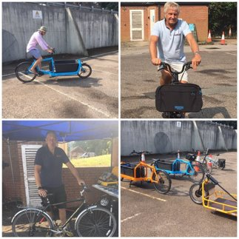
Changing the way we work
Notes:
Project Management – Created an assessment for staff to consider (and measure) impacts of their projects on emissions/environment
SVP – Useful for understanding social value contractors deliver for contracts – considers environmental benefits (e.g. electric vehicles)
Travel Plan – Promote cycling and walking to work – Picture shows bike event held for staff to repair and try out different bikes
Establishing COWG
Ecosia

Slide 15
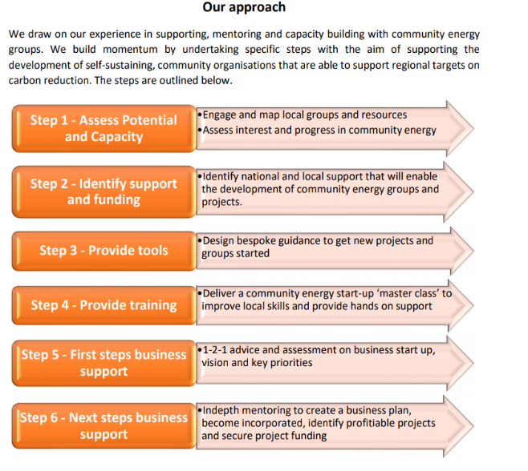
Off gas grid homes and Community Energy
Many in rural parishes
Opportunity to reduce emissions
Support available – Rural Community Energy Fund and Community Energy South
Notes:
Rural Community Energy Fund – Provides technical/monetary support for community group led projects to generate renewable energy
Community Energy South – Can provide mentoring support to help communities set up renewable energy projects.

Slide 16
Wellbeing & Prevention - Communities
Asset-based Community Development
Helping communities take action
Signposting them to support/advice/tips
Notes:
ABCD approach – breaking down barriers and helping to utilise strengths in the community
Parish provides ideal level to engage with residents
Many ideas of community action that could be facilitated at Town/Parish level – litter picking groups, climate action groups, conservation groups, TerraCycle collections (Rowhedge recyclers).
Signposting to resources to help them save energy/use greener energy, energy switching sites (including ECC run schemes), Green Doctor, Ways to protect the environment generally too – See Eco Colchester website and Festival.
Involving community in any projects – e.g. designing litter bins with children’s artwork, getting schools to design signs about changes to mowing/wildflower areas, getting cafes/pubs involved with any Refill initiatives, food waste collections.

Slide 17
Woodland and Biodiversity Project

Slide 18
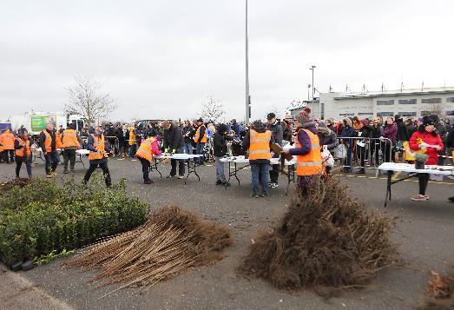
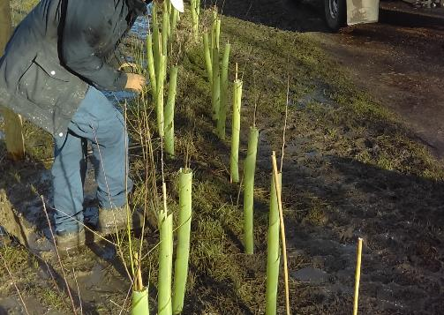
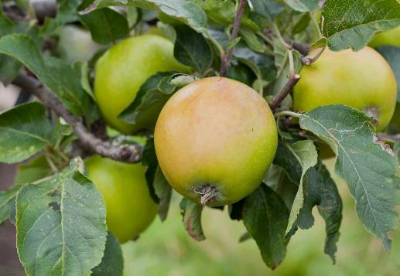
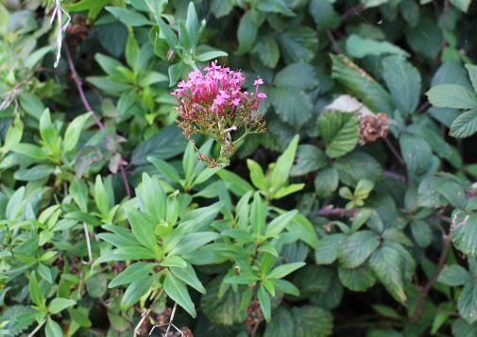
Planting and greening
Planting trees and hedges
Self generating sites
Trees for Years
Greening Colchester Policy
Edible Community Orchard
Wivenhoe Project

Slide 19
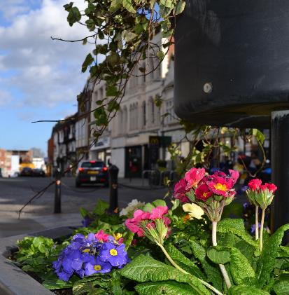
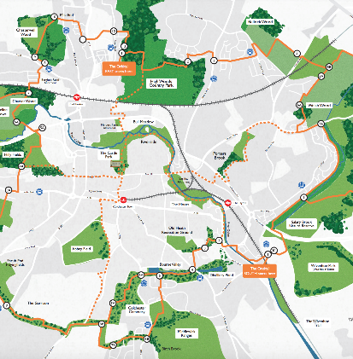
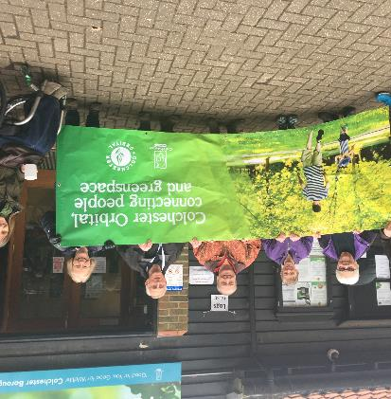
Colchester Orbital
Town Centre
Fixing the Link
Urban planting

Slide 20
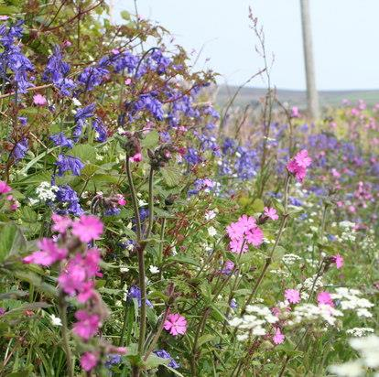
Wildflower verges – Wivenhoe Town Council
Trialling approach to reduce mowing of verges during March - September
Encourage wildflower growth
Higher levels of biodiversity - pollinators
Notes:
WTC have been trialling approach to reducing mowing of verges based on trials/work in collaboration with CBC
Anyone from Wivenhoe on the call who can share how this is going?
Intention is to share any information with other Towns/Parishes once this is finalised.

Slide 21
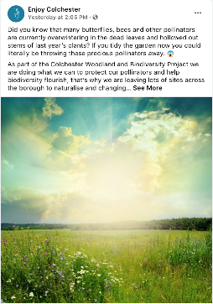
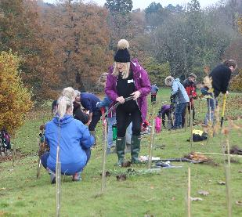
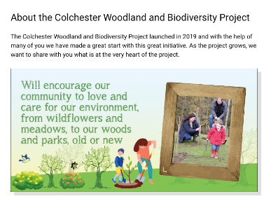
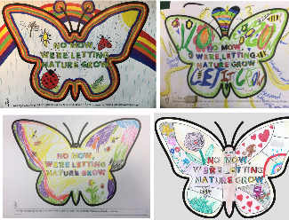
Public Engagement
How?
Schools
Volunteer Network
Website
Social Media

Slide 22
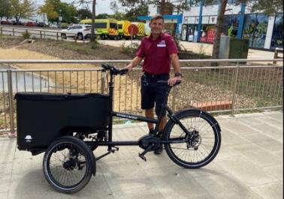
Transport
Procuring first electric vehicles in 2021
Installing electric vehicle charge points to support EV transition
Using eCargo bikes
‘No idling’ policy
Notes:
Promote sustainable staff travel as mentioned
Will be procuring our first EVs in 2021 – Mainly smaller vehicles. Plan on the right shows how we’ve thought about how we transition rest of fleet (with help from EST)
Already using eCargo bikes within our fleet – used by CBH, Highwoods rangers. Ideal for short, routine journeys
No idling – as part of Clean Air for Colchester project. Plenty of resources to share – facts on no-idling, banners, flyers etc. Could support within the Parish Council

Slide 23
Wivenhoe Town Council Urban Arrow Shorty & Tender 1500 Pick Up
“The ecargo bike has made a huge difference to my working day. I use it to travel around Wivenhoe emptying bins, litter picking, checking council facilities and carrying out other ad hoc duties.
Using the bike, rather than being on foot, means that I am able to cover more ground each day and get more done.
The bike is also easy to use and has generated a lot of interest from residents.”
Notes:
Michael from WTC

Slide 24
Managing assets
‘Fabric first approach’ – Increasing energy efficiency
Sourcing renewable or low carbon energy
Green tariffs
Notes:
Increasing energy efficiency to get energy demand as low as possible, before looking at source of energy – Fabric first – LEDs, Insulation
Then begin to look at source of energy (is PV a viable option - ?), Could a heat pump be installed?,
Rowan House – project funded from Govt
Solar PV – on lots of assets including L.World, Crem
Easier option to start with is to source electricity from a supplier offering a green tariff (shows you’re supporting renewable energy, does not mean your buildings will use 100% renewable energy though). CBC do this – do have to pay a price premium

Slide 25
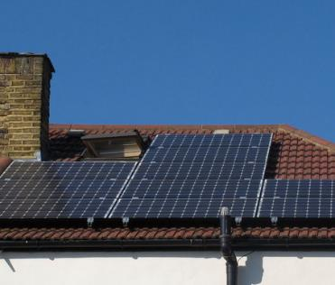
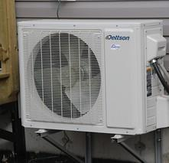
Colchester Borough Homes
Maintaining CBC’s social housing stock, ensuring residents can live in comfortable, energy efficient homes
Nearly 3000 solar PV arrays installed on roofs across Colchester
185 homes with air source heat pumps
Lower emissions
Lower costs for residents
Improved physical/mental health
Notes:
Around 6000 homes in the housing stock
Employ a fabric first approach used before low carbon and renewable energy technologies (energy efficiency).
Upgrading all homes to EPC D in this year – 2021/22.
Installation of insulation, heat pumps, solar PV, glazing improvements etc
Co-benefits – warmer homes mean better health outcomes

Slide 26
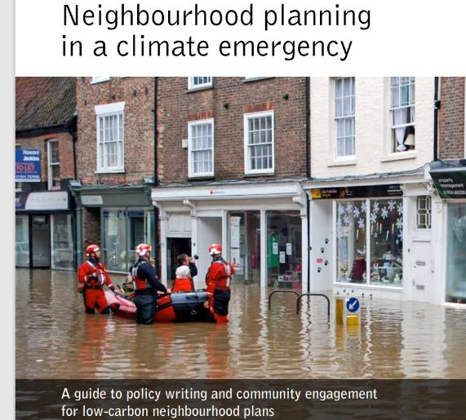
Planning
Neighbourhood plans – Valuable in tackling climate change
Can use to:
Designate walking and cycling routes
Identify sites for future housing (built to high env standards)
Tackle flooding by incorporating street trees and green roofs
Detailing sites for supporting renewable energy generation
Notes:
Neighbourhood plans – set out planning policies for locality – written by local community
Really good resource produced by CSE – Highly recommend – Gives useful questions to consider asking when making/revising Neighbourhood plans
See plan from Frome Town Council - Neighbourhood-Plan-01-Final-version-Low-Res-29-07-16-100dpi-1.pdf (frometowncouncil.gov.uk)

Slide 27
Procurement
Notes:
SVP – helps understand the social value contractors deliver who work with us – both social factors (e.g. jobs offered to army veterans etc.) to environmental factors (e.g. environmental accreditations, sustainable travel options for staff)
Green products – Thinking about how you can buy products with less packaging (plastic), reducing demand for products, buying products made of recycled materials (e.g. stationery, paper). Even in procuring materials for small projects e.g. park benches, playground equipment – Can this be made of recycled materials, or from sustainable timber for example?

Slide 28
Opportunities for Parish Councils
Providing information for locals on ways to be more green
Facilitating local climate/environment groups
Manage greenspaces in an environmentally friendly way
Setting up community recycling facilities e.g. TerraCycle, Community compost
Assessing env impacts of decisions and actions taken
Creating a Climate Action Plan for your parish
Notes:
Signpost local residents to businesses, organisations, community groups where they can get involved in this sort of work and support green businesses – could look at Eco Colchester website – also displaying useful info on your own website.
Not using pesticides etc – see wivenhoe/CBC approach. Plant trees (enquire with CBC)
Terracycle – point set up in Rowhedge. Composting – could be collected at an allotment or other (done by Bisley Parish Council- Bisley Community Composting Scheme | (bisleycommunitycompostscheme.org.uk))
CBC – env implications section in committee reports – or providing guide to consider and assess impacts – builds that into consideration of cllrs
Climate Action Plan – could build with community – Done by Frome, Blewbury Parish
Working with local climate action groups – may have expertise that’s useful to share and Council can help break down barriers.

Slide 29
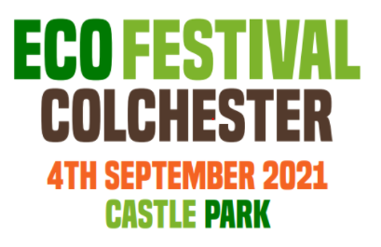
Want to find out more?
Free Community event
Everyday changes to protect environment
Food and drink, Children’s area, talks and entertainment
Eco Festival 2021 - Create Positive Social Environmental Change (eco-festival.org)
Notes:
Great free entry event in castle park. Run by Eco Colchester community group – all volunteer led!
Lots of local businesses, organisations, charities attending talking about how to make simple changes to become greener!
From general eco living tips, electric bikes, wildlife conservation and renewable energy
There’s also activities for children, talks and entertainment, food and drink and also health and wellbeing stalls (because we all need to take a break!)
4th September Castle Park – Something for everyone!
Also visit the Eco Colchester website – A hub of information for tips on eco living, help for businesses, schools and communities.

Slide 30
Further Resources
Colchester Borough Council Sustainability webpage
Frome Town Council resources
Impact Community Carbon Calculator
Wildflower verge management – Will share when produced
Community Energy Opportunities e.g. For off gas grid properties
FoE 20 actions for Towns and Parishes
NALC website and case study projects from other Towns/Parishes
CSE support on creating green Neighbourhood plans
Eco Colchester website – Simple tips for residents + Eco Festival (4th September!)
Notes:
Frome Town Council are one of the leading Town Councils taking action on climate change. Well worth checking out their webpage – Include lots of information on ideas/initiatives and also a webinar of a meeting between T&P Councils
Parish Council Climate Change Pack – Will circulate document after the meeting
Community Energy – See Greater South East Energy Hub
FoE – 20 actions for T&Ps
NALC – National Association of Local Councils
CSE – Centre for Sustainable Energy (organisation based in Bristol offering free support/resources)

Slide 31
Case studies

Slide 32
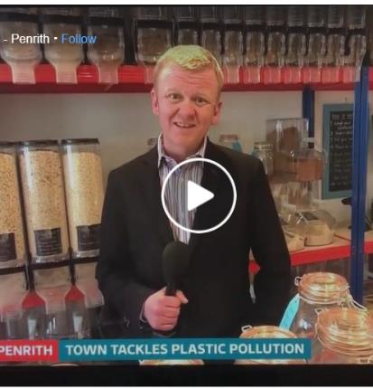
Penrith Town Council – Plastic Clever Penrith
Plastic Clever Penrith – Local climate change group
Help residents and businesses reduce plastic waste
Survey to find out single-use plastics being used by businesses
Voluntary scheme set up:
Plastic free guidelines at town events
Reducing single use plastics used by businesses (e.g. bottles, cutlery, cups)
Established ‘Refill’ scheme in Penrith
Notes:
Local climate change group – in a partnership the Town Council helped to conduct survey of businesses – use of SUPs and how alternatives were encouraged. Now taking action on this, promoting Refill scheme in cafes in Penrith (people can fill up water for free etc).

Slide 33
Brightlingsea Town Council Environment Policy and Action Plan
Example actions:
Reducing cutting of grass and creating wildflower meadow
Creation of own compost from grass cuttings and soil – use on estate
No disposable cups/crockery used for Parish meetings
Use in planning to promote env actions e.g. solar panels
Green tariff for BTC offices
Exploring EV charge points and heat pumps for heating
Notes:
BTC Environmental Policy Review | Brightlingsea Town Council
Reducing strimming from weekly to annual cut in some areas
Use grass cuttings, and mix with soil to make a compost that is used on Council estate (peat free)
Also encourage vendors near seashore to not offer single use plastics
Policy was useful for meaning that planning applications will now have to cover envt matters
Green tariff
Exploring installing EV charge point for grounds vehicles and also heating offices with GSHP

Slide 34
Any questions?
Notes:
Mention possibility of monthly drop-ins as an idea?

Slide 35
Contact Details
ben.plummer@colchester.gov.uk, 01206 508965

