Slide 2
Current Landscape of Crime - Essex
All crime in Essex between 2016-2022
Since Sustained reduction in ASB
Recorded crime increased over the last three years but fell by 11.4% in 12 months to March 2021
Violence with Injury increased over the last three years but fell by 13.8% in 12 months to March 2021
Public confidence increased from 65% in 2019-2020 to 75% in 2020-2021 (81% in Q1 2020 – 2021)

Slide 3
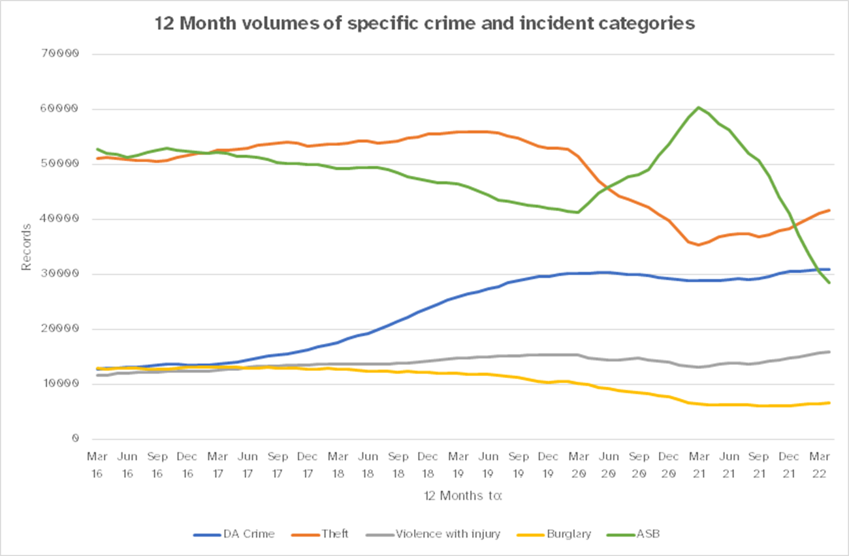
Crime Trends

Slide 4
Braintree
Braintree Investment
More officers in your community
Community Policing Team
Town Centre Team
Community Engagement Officers
Children & Young Person Officers
More officers in specialist policing teams
PFCC £297,202 Safer Streets funding Collingwood Road and River Walkway area of Witham Town Centre (plus £150.069 match funding from partners including Braintree District Council, Fusion, Essex Police, CARA, Witham Town Council and Eastlight.)
This year, the Community Safety Partnership in Braintree has been allocated £17,739 from the PFCC’s Community Safety Fund 2022/23.

Slide 5
2021 – 2024 Police and Crime Plan
The 12 policing priorities to get crime down
Further investment in crime prevention
Reducing drug driven violence
Protecting vulnerable people and breaking the cycle of domestic abuse
Reducing violence against women and girls
Improving support for victims of crime
Protecting rural and isolated areas
Preventing dog theft
Preventing business crime, fraud and cyber crime
Improving safety on our roads
Encouraging volunteers and community support
Supporting our officers and staff
Increasing collaboration

Slide 6
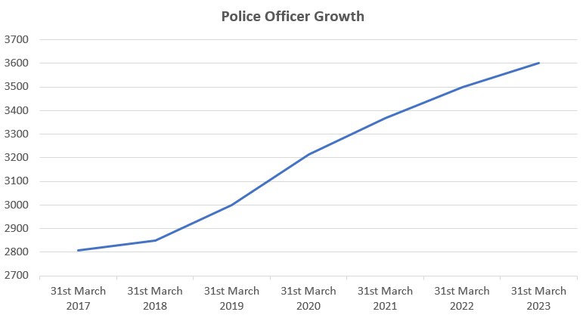
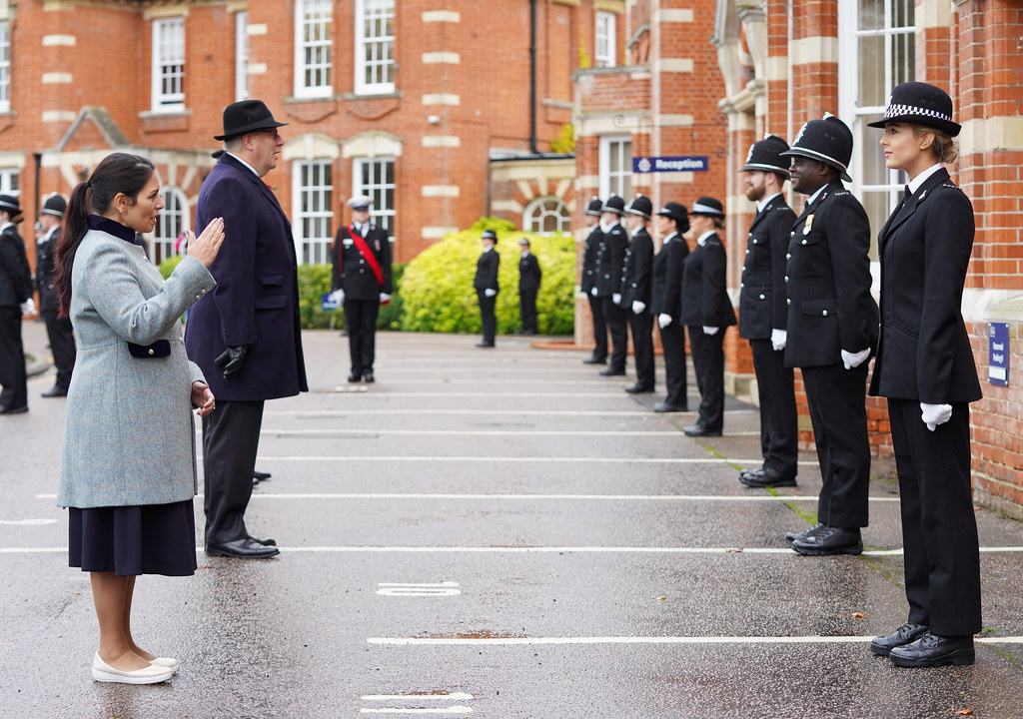
Essex Police 2022/23
Investing in prevention
3755 officers by March 2023
442 Specials, 2nd largest
Crime Prevention Strategy
Better working between emergency services – Fire, Ambulance, Police
Closer collaboration with partners – CSPs, Councils

Slide 7
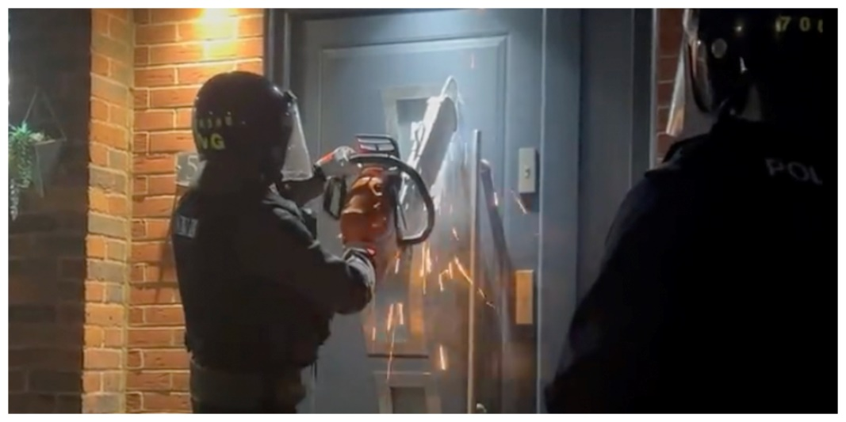
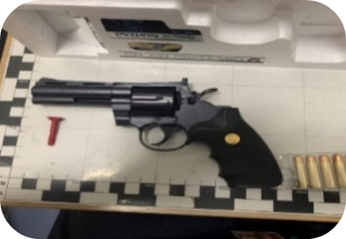
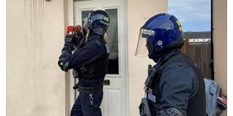
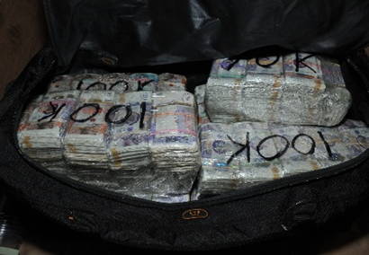
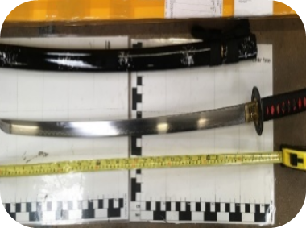
More enforcement against organised crime (Jan - April 2022)
Serious Violence Unit established July 2020 -67 officers
Investment in 30 officers and better technology in 2021-2022 precept
April – June 2022, the Serious Organised Crime Unit within SCD dismantled OCG recovered18 viable firearms with ammunition
SOC seized 19kg of cocaine and arrested a number of significant OCG nominals,
Recovered £38,000 and receiving a proceeds of crime forfeiture of over £800,000.
Essex police have recorded 53 OCG disruptions in April and May this year, making Essex the lead force for OCG disruptions in the Eastern Region.
Jan – March 2022
Arrests | 191
Searches | 153
Drugs seized | 1.4KG of Class A
Cash seized | £129,000
County lines disrupted | 74
Weapons Seized | 59
Line phone seized | 34
Notes:
Between June 2020 and October 2020
£128,211 worth of drugs seized
£230,320 is cash seized
51 weapons seized
127 people arrested
29 total years in prison to be served
24 County Lines dismantled

Slide 8
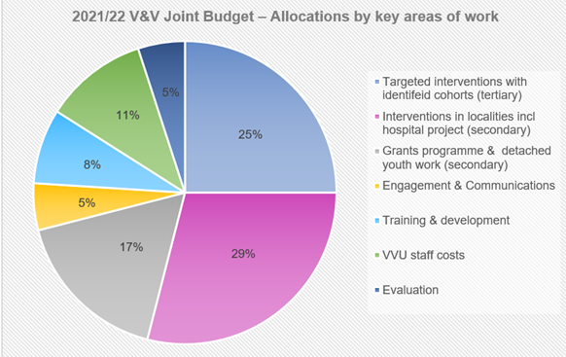
Reducing drug-driven violence domestic abuse
Highlights:
Since 2018 the Partnership has secured over £5m for Essex from central Government
Work in localities – Anticipate reaching 37,860 individuals in 2022-23
Growing the Violence & Vulnerability Unit to increase capacity and capability
Developing an evidence base of what works, including our nationally innovative Fearless Futures Project
Funding Source 2022-23
Home Office | £2,040,000
ECC | £500,000
PFCC | £627,000
Notes:
Work in localities – one example - jointly with voluntary sector (and Essex Youth Service) detached youth workers out in local communities (ward level) – Basildon, Chelmsford, Colchester, Harlow and Tending. April – Sept 2021 3,951 young people reached (with a focus on 10 – 14 years old). At risk of exposure to youth violence and gang activity because of their situation, locality. These are the areas with the next highest levels of youth violence in Essex. This project is funded jointly with Active Essex. Alongside detached youth work, we capture conversations to inform the work and our wider view (the most discussed topics with young people across the areas for the first half of the year - education; youth violence and gangs; and hobbies / leisure).
Work with identified individuals – one example – working with Essex Youth Offending Service and Essex Police, ‘ReRoute’ - space between arrest/charge and conviction – two gangs workers now in place reaching out proactively to young people (through Police OpRaptor activity – due to ‘involvement’ with gangs, identified as part of police county lines proactive work). Previously no co-ordinated support for this vulnerable group, and delays in court process many of these young people ‘left’ for significant periods of time.
As one of the 18 VRU areas - sharing case studies of our intervention work, impact on individuals and how V&V work supported them, ‘turning their life around’ to Home Office, as part of informing conversations – comprehensive spending review. Included presenting on the Fearless Futures Pilot Project to Minister for Policing.
The Basildon hospital project report found that “by offering tailored support, the service engaged 96% of those young people who had direct contact with a youth worker. One hospital staff member suggested that the service is “giving patients and their family a lifeline”. Out of the 150 young people who have accessed the service 73 per cent have signed up for further help once discharged from hospital. We know of at least two young people who are no longer in gangs due to the support they have received. It’s such a privilege to be a part this initiative and do our part to support the young people in our local community.
Targeted detached Youth Workers - Essex Youth Service is completing work with young people of college age in Harlow, Chelmsford and Colchester. They educate them about the unseen dangers of grooming and exploitation by exposing the realities and dispelling the perceived attraction to being involved in gang life and drug dealing.
Missing Chats, there is a programme called Choices is a peer-led six-week group programme for young women essentially who are at risk of going missing but also who are at risk of child exploitation. It also has an intensive one to one part linked to Missing Chats, for those who go missing regularly or are at risk of child exploitation. The funding is supporting -
intensive support for ten young people on a one to one basis
two six-week peer development groups for young women aged 13 to 16 in Basildon
a pilot transition group for young women aged over 16 living independently
a 20-week programme for young men aged over 12
a monthly group enabling young people to continue to access support after their intensive engagement
The Exploitation E-learning project (ECC) will raise awareness of all areas of exploitation, including gangs, County Lines, sexual exploitation, modern day slavery, human trafficking and missing persons. The work received £35,000 funding as part of the Violence and Vulnerability Programme established by the Police, Fire and Crime Commissioner (PFCC) and partners across Essex. The programme funds projects to reduce the risk of young and vulnerable people being groomed into a life of crime and help those affected by gangs to take the steps to leave.
Teens N Toast Club - Vulnerable young people are being enticed off the streets and away from potential trouble with the launch of a free youth club in Southend. The Club runs every Tuesday for young people aged 11 to 16 at YMCA Community School in Southend.
Essex Police is training its officers and partners to engage with young people in a new way. A new training programme has been put together to raise awareness of the opportunities to guide young people through trauma, away from a negative lifestyle and on to a more positive future. The three-day course focused on motivational interviewing and trauma informed policing for 100 people who have close links with the county’s youth
The harsh reality of being in a gang is being shared through music created by prisoners in Essex. HM Prison Chelmsford and the Finding Rhythms charity are working together to break the cycle of men reoffending when they leave prison. Those completing the six-day music-making course will not only achieve a BTEC qualification, but write, compose and record an album of original music.
Southend-on-Sea Borough Council is working with a school in the borough by providing alternative learning opportunities and diversionary activities to turn around the lives of those with challenging backgrounds. During the period the programme has been running attendance has increased from 57.2% to 70.4% meaning many more children are feeling more incentivised to come to school. Behaviour has also improved significantly and exclusions have dropped by over 80%.
Bar N Bus - Bar N Bus youth workers worked throughout the summer holidays to provide a range of positive activity programmes for young people. Founded in 1993, Bar’N’Bus works in partnership with local churches, councils and schools to serve communities through providing community based youth work and in-school counselling. The range of summer activities provided included: 23 Detached Youth Work Sessions; Four Outreach Events (street artists and football coaching); a three day football ‘bootcamp’ for young people from the Avenues area of Canvey Island and 33 1-2-1 support sessions linked with local secondary schools in South Essex. Young people spoke to youth workers about a range of issues, from concerns around exams, education and their futures, through to healthy living, hobbies and leisure. Conversations were also held on topics such as substance misuse, gangs and criminal behaviour and mental health. Those who attended left the sessions feeling they had been listened to, with an idea of where they could go for support, with new skills and an uplift in mental health.
Changing Lives in Harlow - Over 200 Harlow children were supported this summer by Changing Lives, Roots to Wellbeing programme. The Roots to Wellbeing sessions supported young people struggling during the Coronavirus Pandemic by addressing issues around confidence, creativity, relaxation, worry and anxiety, and sleep problems. Changing Lives was set up in 2018 to raise children’s awareness about the dangers of gangs and gang activity. The project prevents them from getting involved in anti-social behaviour and criminal activity by encouraging young people to play sport, try physical activity and get involved with social enterprise workshops. Mind West Essex delivered summer workshops to children on how to become calm, controlling emotions through breathing and learning more about each other. The resources were uploaded on to YouTube and www.changinglivescommunityservices.com so they could be available to all who needed them during social distancing restrictions.
Chelmsford 5th/9th Scout Group - Chelmsford 5th/9th Scout Group have faced wind, rain and Covid-19 as they have battled to keep delivering services over the Pandemic. The VCCF money helped pay for much needed maintenance on the Scout hut roof which had continued to leak in combined wind and rain spells. Money was also used to help clear the grounds which had got so overgrown without the Scouts there regularly, and to pay the insurance on the Scout Hut which the Group had been struggling to pay due to the loss of, and reduction in, subs income through not being allowed to meet fully due to Covid. The funding has meant the group has been able to stay active, secure their meeting venue for the future and still run small and online meetings. But what’s probably more exciting is that the rest of the money will be used to purchase new mess tents ready for the 2021 camping season – following destruction of their previous mess tents in a storm at camp in 2019.
London Bus Theatre Company - Young people in Canvey Island have been exploring their passion for the Arts, while gaining a qualification, thanks to the London Bus Theatre Company. Over the last few months, the London Bus Theatre Company has supported 18 young people to gain their Arts Awards – a recognised award that goes towards UCAS points. There are four sections to the award: The first part is choosing an arts activity and developing skills. The second section is reviewing live performances online. The third is researching a favourite artist and the final part is sharing skills with others. The young people have been working on monologues, drawings, dance, singing and photography. The young people have really enjoyed the project and have said it's fantastic to be taking part after being so isolated this year - as the awards can be delivered adhering to COVID restrictions. It is hoped that 30 young people will gain the award thanks to the VCCF funding. The Arts Award is a great way for young people to boost their confidence, develop transferable life skills, make new friends and combat loneliness.
Proximity Schools - Proximity Schools work in three schools, Gable Hall Secondary, Hassenbrook Academy and Corringham Primary School. They began work in 2011 supporting the most vulnerable and at risk; in 2012 they started intervention work in schools and now support over 200 students and families each week across Stanford-le-Hope and Corringham. Through clubs, mentoring, the MADE course, alternative education programmes, workshops, and supporting parents; they support individuals to reach their full potential and have hope for a bright future. The Proximity Engagement Pathway employs a three-tier approach: Tier 1, a whole school approach, through to Tier 2 which concentrates on group workshops building confidence, resilience and social skills, through to Tier 3 which is more intensive one to one mentoring. Supplementing this, Proximity also run parent webinars which focus on supporting children during the Coronavirus pandemic; and offer GSCE Maths and English Tuition to students to catch up on schooling missed. In the six weeks of being back working in school full time Proximity supported 35 parents over three parent webinars, 2000 children attended school assemblies (focusing on inspiring children to know their worth) and 72 students received GSCE Maths and English tuition.
Waltham Abbey Youth (WAY2000) - Waltham Abbey Youth (WAY2000) provides leisure facilities for the young people of Waltham Abbey, together with a confidential counselling facility based at King Harold Academy. When lockdown began in March 2020, all facilities had to stop, but there was still a need to support the town’s young people. The group’s counsellor established a programme to keep in touch with those who were not only having to cope with the stress of lockdown, but issues such as trying to study at home and managing a change in family life. Vulnerable young people, and those considered at risk, were also referred to the service by the Wellbeing and Safeguarding Lead at King Harold Academy. The young people were given booklets to record their thoughts about COVID19, and a second workbook to keep them motivated and to encourage positive activities that would provide a sense of achievement. Using emails, phone, text and letters the young people were contacted regularly, and given activities to work through to promote relaxation and exercise as crucial in dealing with stress and anxiety. From the start of lockdown to the end of September, 41 students were supported, with over 1300 contacts made. This was made possible by extending the hours of the WAY2000 counsellor thanks to funding from sources including the VCCF.

Slide 9
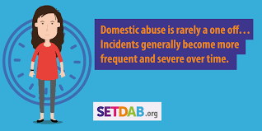
Protecting vulnerable people and breaking the cycle of domestic abuse
Building confidence in reporting
Awareness campaigns
J9 awareness programme
Supporting victims
£20m invested since 2016
£1m COVID specific support (Inc SA)
3.5 additional Domestic Abuse advocates in 2022-23 bringing us to 31 IDVAs
Changing Behaviours
DRIVE - Targeted 1-2-1 work
high levels of physical abuse reduced by 82%,
sexual abuse reduced by 88%;
harassment and stalking behaviours reduced by 75% and
controlling behaviours reduced by 73%.

Slide 10
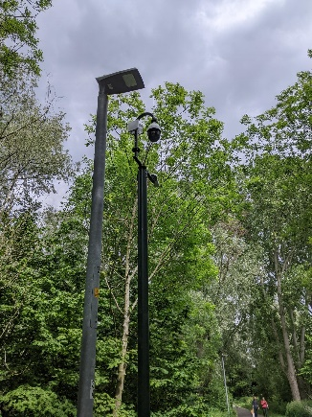
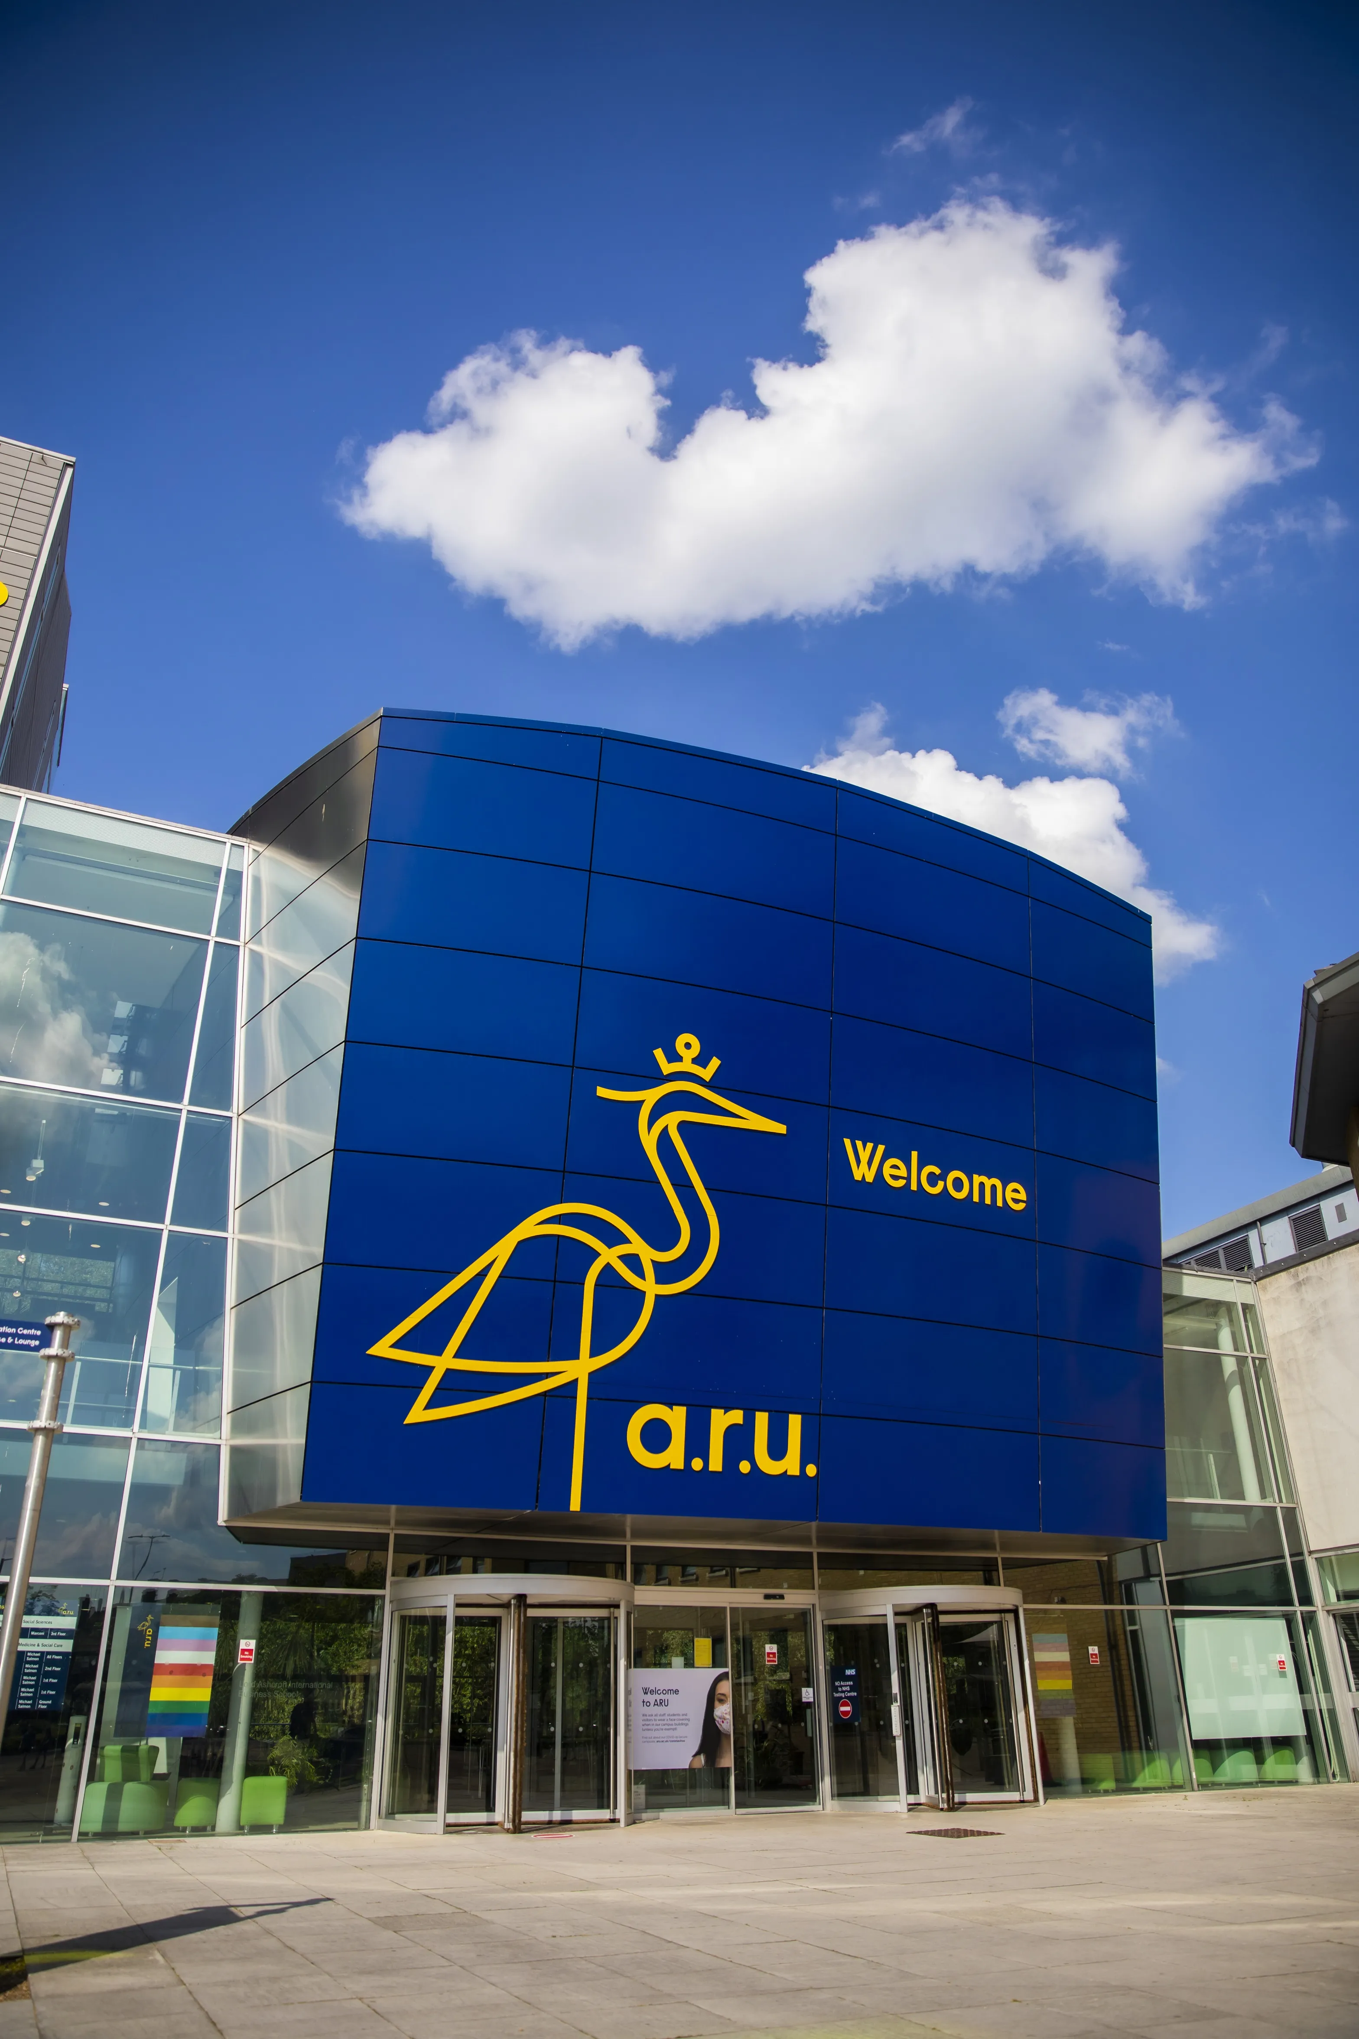
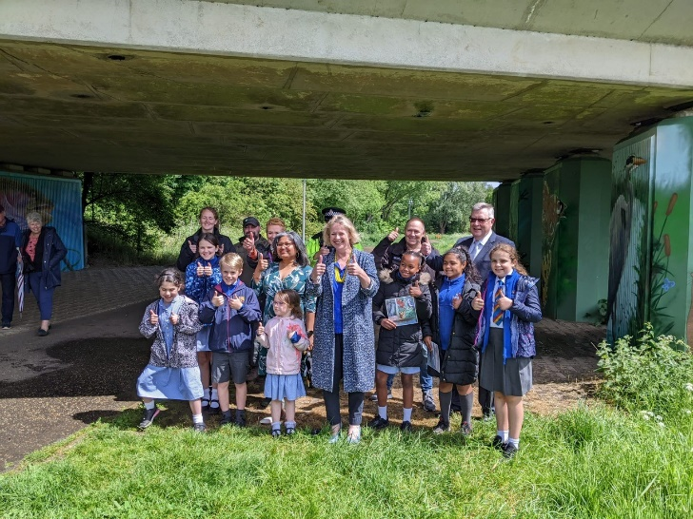
Reducing violence against women and girls
Offending
Essex experienced a 6.2% increase (2,315 more) in the number of VAP offences committed against females in the 12 months to August 2022 compared to the 12 months to August 2021; this compares to an 8.6% increase (2,435 more) in the number of VAP offences committed against males in the same period.
Violence against women and girls strategy
Building women and girls trust in police standards, culture and approach to VAWG
Relentlessly pursuing perpetrators
Strengthen prevention work by contributing to safer spaces for women and girls
Witham Town Centre £447,271 (SSR4)
Grays, Thurrock £625,000 (SSR2)
Bunny Walks, Chelmsford £550,000 (SSR3)

Slide 12
Fire and Rescue Plan Draft Priorities

Slide 13
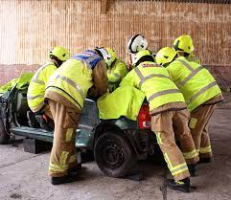
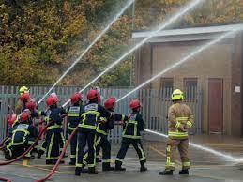
Journey so far
13% reduction in dwelling fires over last five years
6,646 safe and well visits
7,540 smoke alarms fitted 1,125 sensory alarms
1071 full audits and 113 desktop audits
100,831 children reached in last year
7770 hours driving ambulances since start of pandemic
68 staff volunteering at vaccination centres

Slide 14
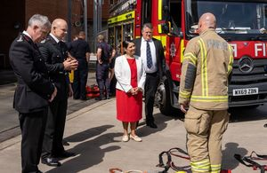
Looking forward
Investment areas in Essex
Improved training provision
Investing in prevention activity
Improved fire protection capacity
Recruiting and retaining on-call firefighters
Fire Reform Whitepaper
Need for reform widely accepted
Revised governance (Mayor, PFCC or single councillor)
New College of Fire and Rescue and ethics
Bring into law majority of Grenfell Inquiry recommendations

Slide 15
Precept Survey 2023/24
Precept survey opens Friday 21st October 22 – closes Sunday 27th November 22

