Slide 1
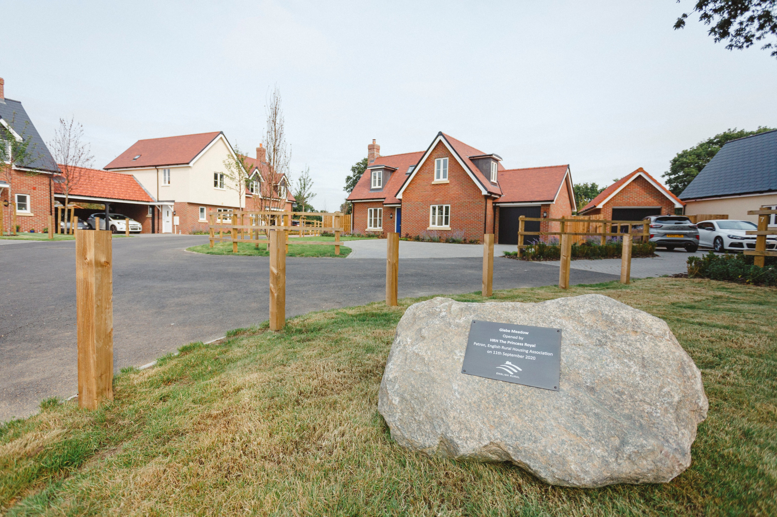

Rural Affordable Housing
for Communities in
Braintree District
Roxwell, Matt Pereira Photography

Slide 2



Communities have the power to
influence change
How often have you heard about, or even experienced, the problems of a lack of affordable housing in rural areas?
High house prices forcing residents to move from the village.
A family member or employee has difficulties finding somewhere suitable to live
A local amenity or asset has closed because the people who would support it have had to move away.
A business has relocated because the owner or workers cannot afford to live in the village.
  A small scheme of affordable homes on a suitable site can breathe fresh life into a village and ensure local people can stay in their community, whatever their age or circumstances and help to sustain local services such as shops, schools and pubs.
Notes:
High House prices – Rightmove - Properties in Essex had an overall average price of £404,127 over the last year. Risen 12% since 2019.
Rising energy costs.
During the pandemic, we experienced a huge increase in demand for housing, a small supply of houses, and the desire for more space and rural living as people opt to move out of the capital.
As of Feb 22 for example – Zoopla - Average house price for first time buyers in Chelmsford - £330,000 – two bed flat. Household income you’ll need to buy - £73,250
Good quality affordable housing allows people on low incomes to live in the community where they have been brought up, have family and friends and in which many of them will work. It also allows them to contribute to community life

Slide 3

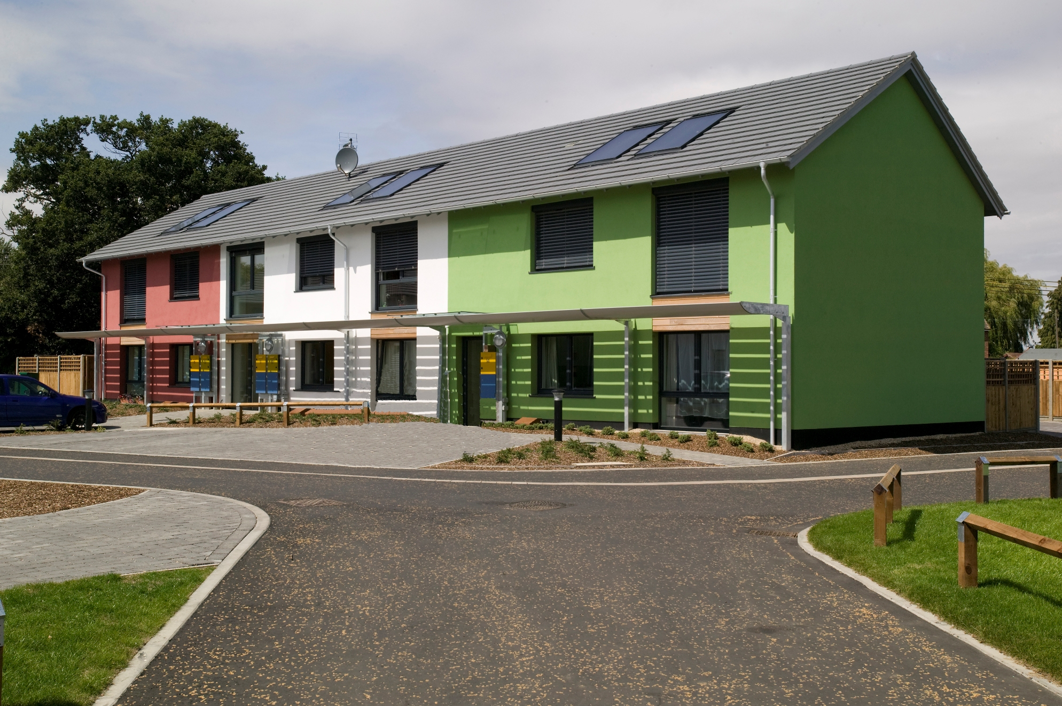
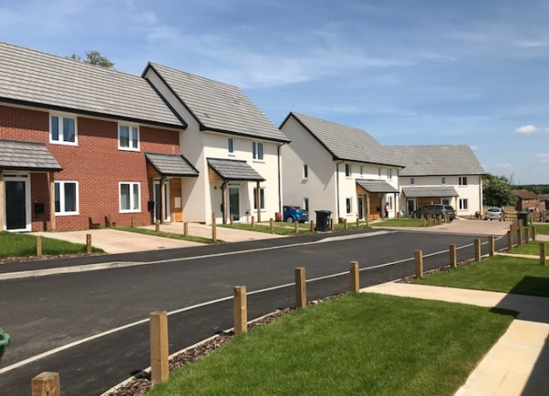
Rural Housing Enabler
RCCE’s Rural Housing Enabler (RHE);
Acts as an independent advisor providing close impartial assistance to Essex parishes in developing affordable housing for people with a local connection.
Liaises impartially between communities, local authorities and other partners such as Housing Associations. Community Engagement is paramount!
Schemes are typically small scale and developed on Rural Exception Sites which allow affordable housing to be safeguarded and prioritised in perpetuity for local people.
Rural Housing Alliance’s Practical Guide for Parish Councils on Rural Affordable Housing is available.
Wimbish
High Easter
Wickham Bishops
Little Hallingbury
Notes:
Stress importance of Community Engagment – attendance at PC meetings, community consultation events, site finding etc.
Stress INDEPENDENT aspect.
Discuss what is affordable housing
A common definition of what is affordable is that the household pays no more than 33% of their income on rent and spends no more than 3.5 times their annual income on mortgage payments.
Housing for sale or rent, for those whose needs are not met by the market
Parish and Town Councils are an essential part of the structure of local democracy and have a vital role in acting on behalf of the communities they represent;
give views, on behalf of the community, on planning applications and other proposals that affect the parish
undertake projects and schemes that benefit local residents
work in partnership with other bodies to achieve benefits for the parish
alert relevant authorities to problems that arise or work that needs to be undertaken
help the other tiers of local government keep in touch with their local communities.

Slide 4
What is affordable housing?
Housing for sale or rent, for those whose needs are not met by the market.
Rent
Sale
Rented through a Registered Provider (Housing Association or Local Authority)
Social Rent
40-60% of market rent.
Affordable Rent
80% of market rent.
Shared Ownership
Part rent/ Part Buy with a Housing Association.
First Homes
New build discounted market sale homes for first time buyers only
Discounted Market Sale
Sold at least 20% of market value, discount remains in perpetuity when sold on.
Notes:
Annex 2 of NPPF
Come in all shapes and sizes but these are the most common offerings.
Starter home – scrapped – replaced with First Homes.
First Homes – impact on other tensures including social rent and shared ownership as 25% of all affordable must be First Homes.
A common definition of what is affordable is that the household pays no more than 33% of their income on rent and spends no more than 3.5 times their annual income on mortgage payments.
Rent to Buy
Homes let to working households at a lower cost to give them the opportunity to save for a deposit to buy their first home. The rent (including service charge) is set at or below 80% of the market rent for an equivalent home for at least five years to allow a tenant to save for a deposit or purchase sooner via Shared Ownership. Full details are set out in the Rent to Buy guidance.

Slide 5
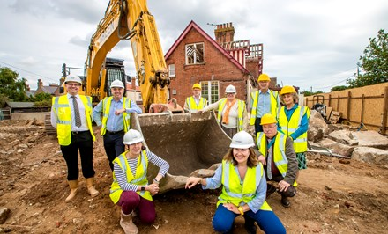
Who builds affordable
housing?
Not for Profit Housing Associations
For Profit Housing Associations
Local Planning Authorities
Communities
Financed via mixture of Homes England grant, loans, mortgages and other investments.
Notes:
AHP 21 – 26
Priority is social rent
The Affordable Homes Programme provides grant funding to support the capital costs of developing affordable housing for rent or sale. As the Government’s housing accelerator, Homes England will be making available £7.39 billion from April 2021 to deliver up to 130,000 affordable homes by March 2026 – outside of London.

Slide 6
Vital role of Local Councils
Parish and Town Councils are an essential part of the structure of local democracy and have a vital role in acting on behalf of the communities they represent;
give views, on behalf of the community, on planning applications and other proposals that affect the parish
undertake projects and schemes that benefit local residents
work in partnership with other bodies to achieve benefits for the parish
alert relevant authorities to problems that arise or work that needs to be undertaken
help the other tiers of local government keep in touch with their local communities.
  Affordable Housing projects can often help diverse communities come together
Notes:
That’s what happens at a LPA level but obviously our mission here at RCCE is to empower local councils to realise options available to them to support their communities.
Links in well with the role of Local Councils in identifying and supporting the needs of their community.
A small scheme of affordable homes on a suitable site can breathe fresh life into a village and ensure local people can stay in their community, whatever their age or circumstances and help to sustain local services such as shops, schools and pubs.

Slide 7
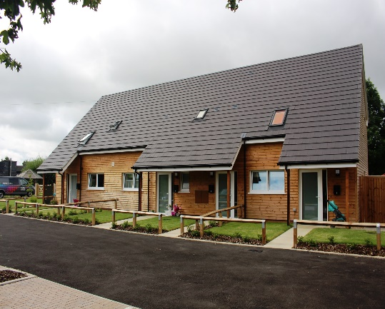
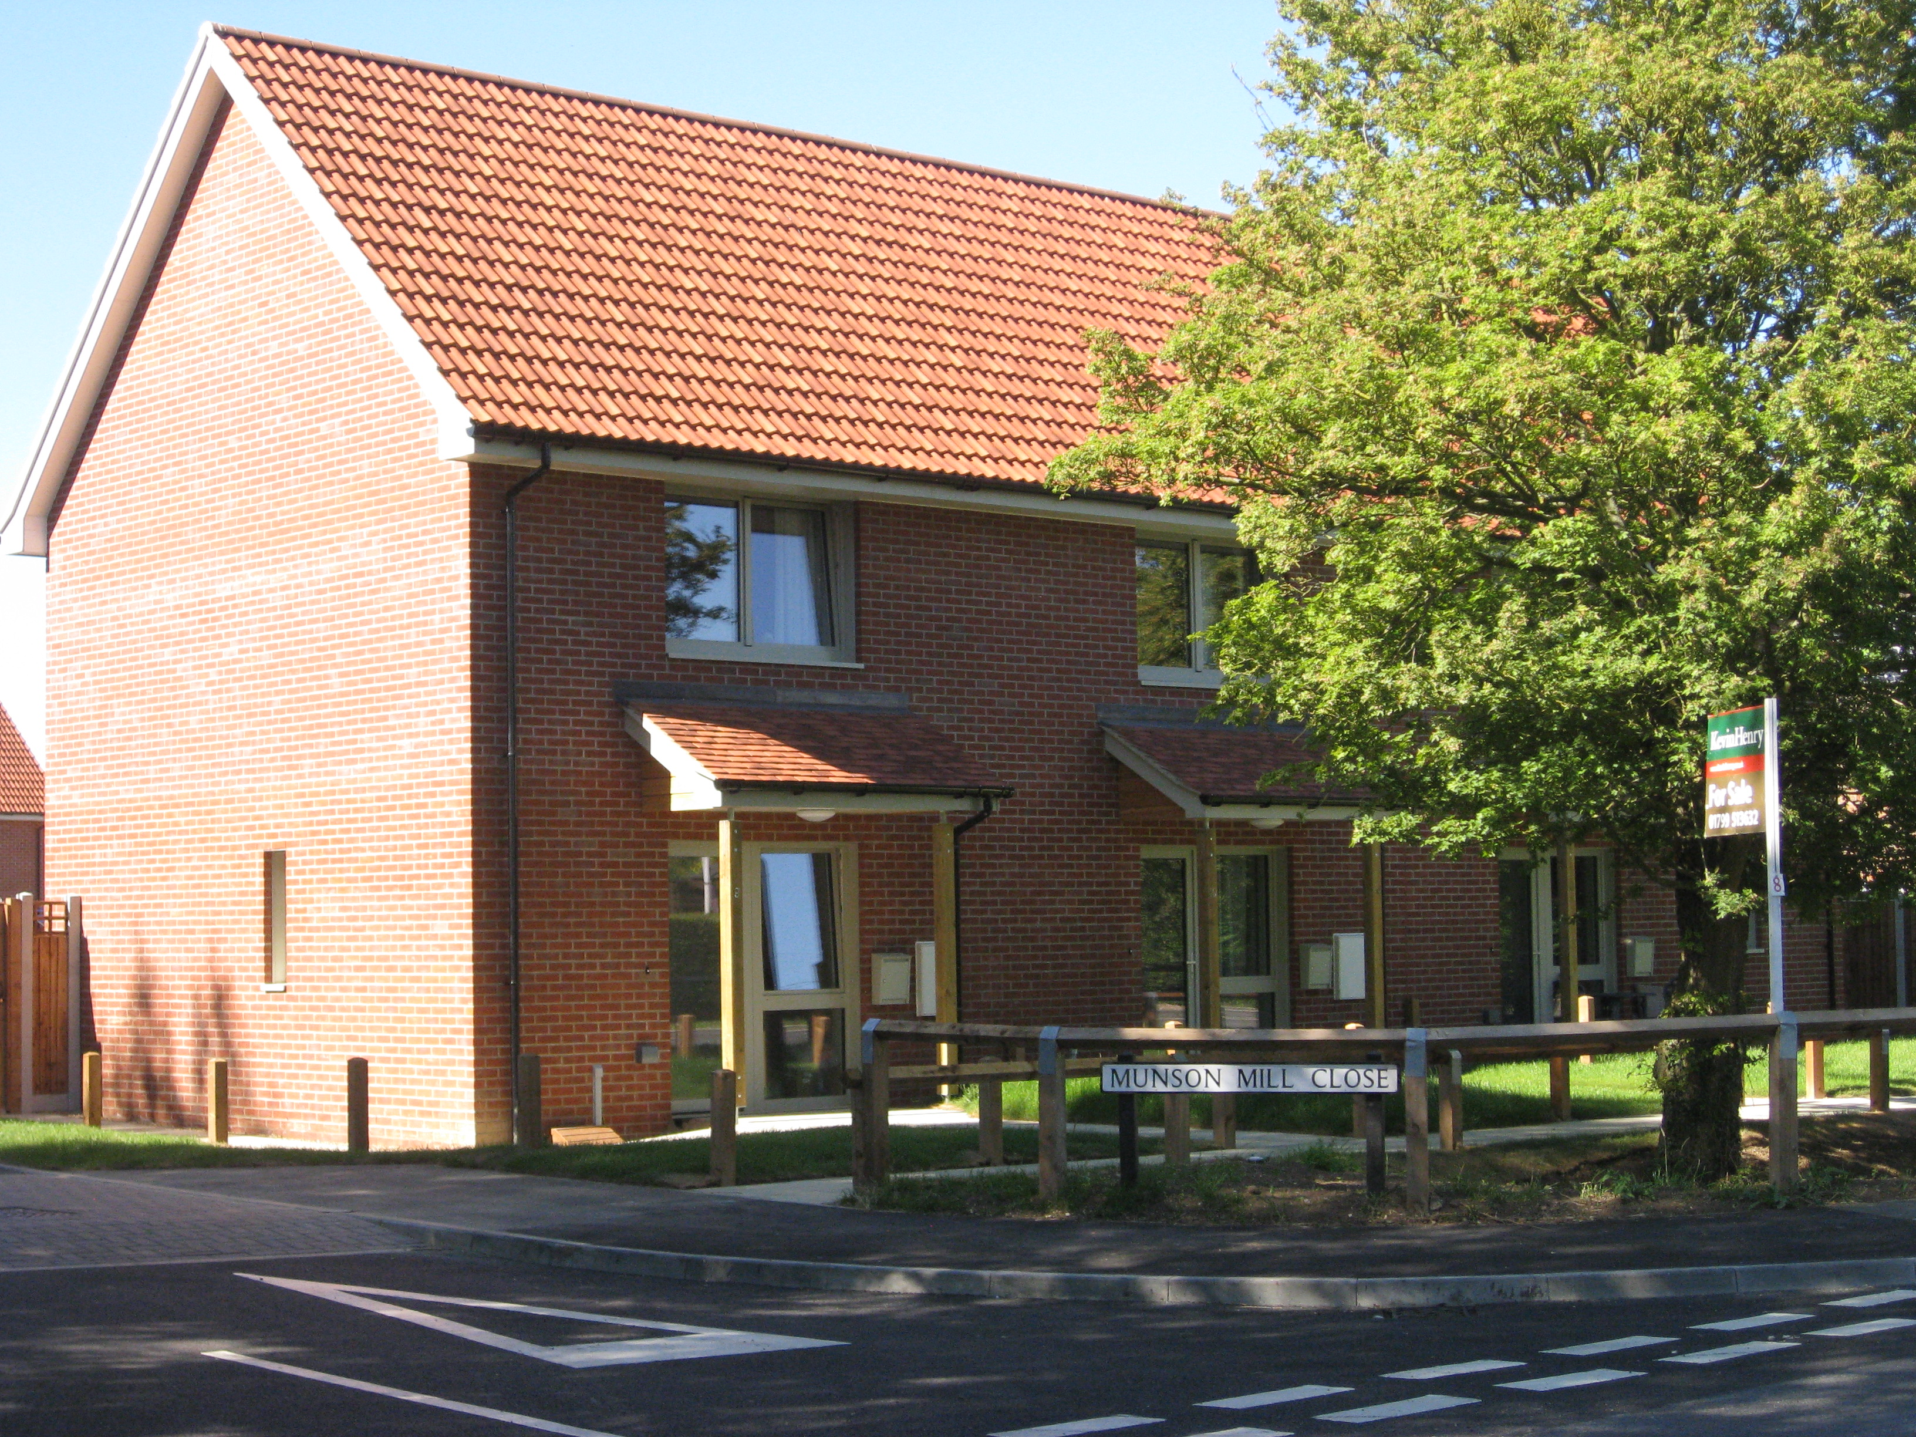
Rural Exception Sites
Where can these homes be built? And how many?
A Rural Exception Site is a plot of land abutting the development boundary with the aim of providing affordable local needs housing in the village.
This land will only receive planning permission for affordable housing in perpetuity. It is an “exception” to the development sites detailed in the local plan.
A small amount of open market may be permitted, only if required for cross subsidy.
*This planning policy is only applicable to parishes/hamlets of less than 3,000 residents*
Development is restricted in size/ tenure to the need identified.
English Rural | Unlocking the “Magic Ingredient”: How Rural Exception Sites Could Be the Game-Changer for Affordable Housing in the English Countryside
Crishall
Wimbish
Notes:
STRESS LESS THAN 3,000 in POPULATION
The Parish Council leads this process.
Affordable housing for those with a strong connection to the parish in perpetuity – locked into the land via S106 agreement.
Need to comply with RES Policy of the Local Authority.
Site finding must be transparent – take community with you.
All sites will be considered and assessed for viability and planning.
There would be a legally binding agreement to ensure that people with a local connection would be allocated the houses as priority.
Local Connection means people who;
currently live in the parish & have done for a number of years
used to live in the parish but had to move away
have close family in the parish
employed full time in the parish
These homes also stay affordable in perpetuity;
Rented homes on exception sites have had the ‘Right to Buy’ removed.
Shared owners can only purchase a maximum of 80% of the house. Any vacated properties would again become available for local people as a priority.

Slide 8
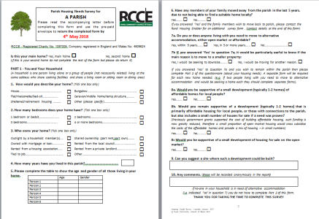
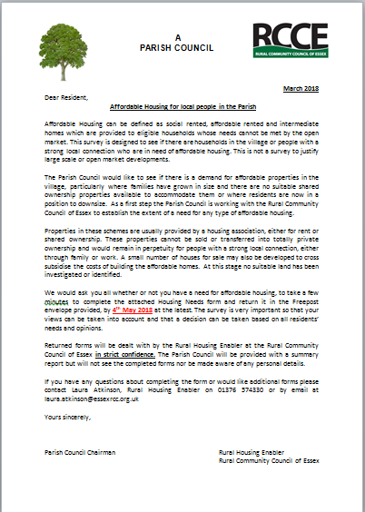
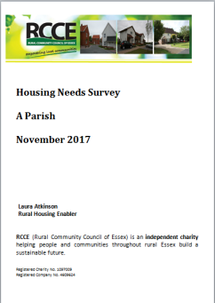
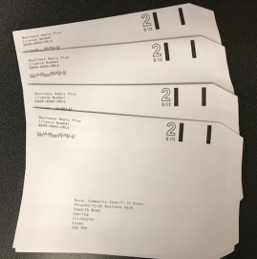
Housing Needs Surveys
How do we know our village needs affordable housing?
A Housing Needs Survey can be the first step towards making a local scheme happen, engaging with the whole of the local community to assess current and future housing need.
A questionnaire is distributed to every household in the parish with the aim of identifying local housing need.
Everyone is given the opportunity to state if someone in their household requires alternative accommodation.
The survey identifies not only if there is a need but indicated number, size and tenure of homes required.
A report is produced providing a detailed account of the results plus parish specific recommendations.
Notes:
This is the evidence needed for a RES.
Land needed to fulfil the need only.
HNS distributed by the parish.
Parish can adapt the letter to suit them.
Survey needs to stay as standad as poss.
Anonymous feedback – confidentiality will be maintained. Report to PC is aggregated results – not identifiable.

Slide 9
Local Connection
How can we be sure the homes will be prioritised for local people?
  There would be a legally binding agreement (S106) to ensure that people with a local connection would be allocated the houses as priority.
Local Connection means people who;
  currently live in the parish & have done for a number of years
  used to live in the parish but had to move away
  have close family in the parish
  employed full time in the parish
These homes also stay affordable in perpetuity;
Rented homes on exception sites have had the ‘Right to Buy’ removed.
Shared owners can only purchase a maximum of 80% of the house. Any vacated properties would again become available for local people as a priority.
Notes:
Mention the Housing Register and how residents do still need to be on this to apply for this type of housing.

Slide 10
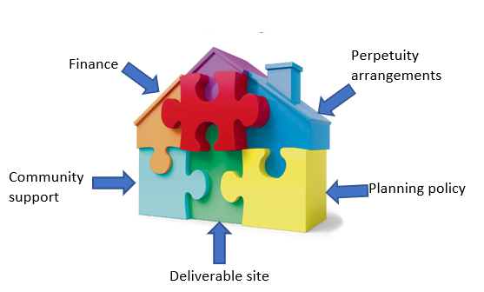
Partnerships
Partnerships are essential for bringing forward a successful scheme.
Parish/Town Council
Landowner
Housing Association
Local Authority
Notes:
Community ENGAGEMENT throughout the process.
For traditional Rural Exception Sites and a fair proportion of Community Led Housing projects, Housing Associations are often engaged to develop and manage the affordable housing schemes. Once a need has been established (via a Housing Needs Survey) and there is a desire to look at developing a small scheme, the RHE can advise on a selection of Housing Associations from which the Parish Council can decide who fits best. This might be guided by existing knowledge of schemes in the area and/or by assessing the Housing Associations credentials in a face to face meeting. The Housing Association will become an integral partner moving forwards, providing essential technical and legal support (land negotiations / architects/ viability assessments etc.) as well as taking on the construction and future management of the properties.
Running parallel to the decision around which Housing Association to engage, identifying suitable land is key. Land for rural housing can come from a variety of sources, from a local individual / family or farmer, to a parish /district council or large estate. Deciding on the most suitable location is a process which starts with the Housing Needs Survey, where local residents are asked for their opinion and suggestions on where new housing might go in the parish. Using this information, it is normal practice to take part in a village ‘walk’ with relevant key partners to start evaluating the pros and cons of certain locations and sites. Local maps are crucial here, especially those that show the development boundary as Rural Exception Sites tend to be found on the edge of the village envelope rather that in the centre of the village. Parish Councillors will bring important local knowledge to this exercise especially with regards to landowners and their appropriate engagement opportunities.
Once this has been done, talking to the Local Authority planning department for some informal advice around which of the potential sites could be supported is an important step and often involves the support of a Housing Association and/or Local Authority Housing Enabler. Informal discussions with landowners may also be possible in advance of more formal negotiations, if the landowners are known or local to the parish. It is worth noting here that land for Rural Exception Sites is usually purchased at slightly more than agricultural land prices but significantly less than that to be expected if unrestricted planning permission was allowed.
Only once land is secured can the scheme progress, so this stage is incredibly important and can be quite sensitive. Parish Councils will always have the support of its partners to guide and advise to ensure the best outcome for all. The RCCE’s RHE would only be too happy to help with this process and welcomes the opportunity to discuss your local affordable housing aspirations in more detail.

Slide 11
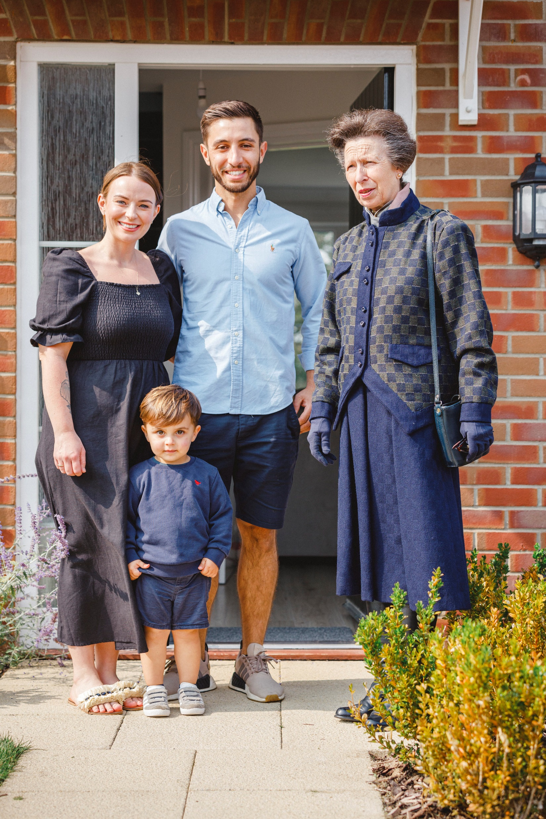
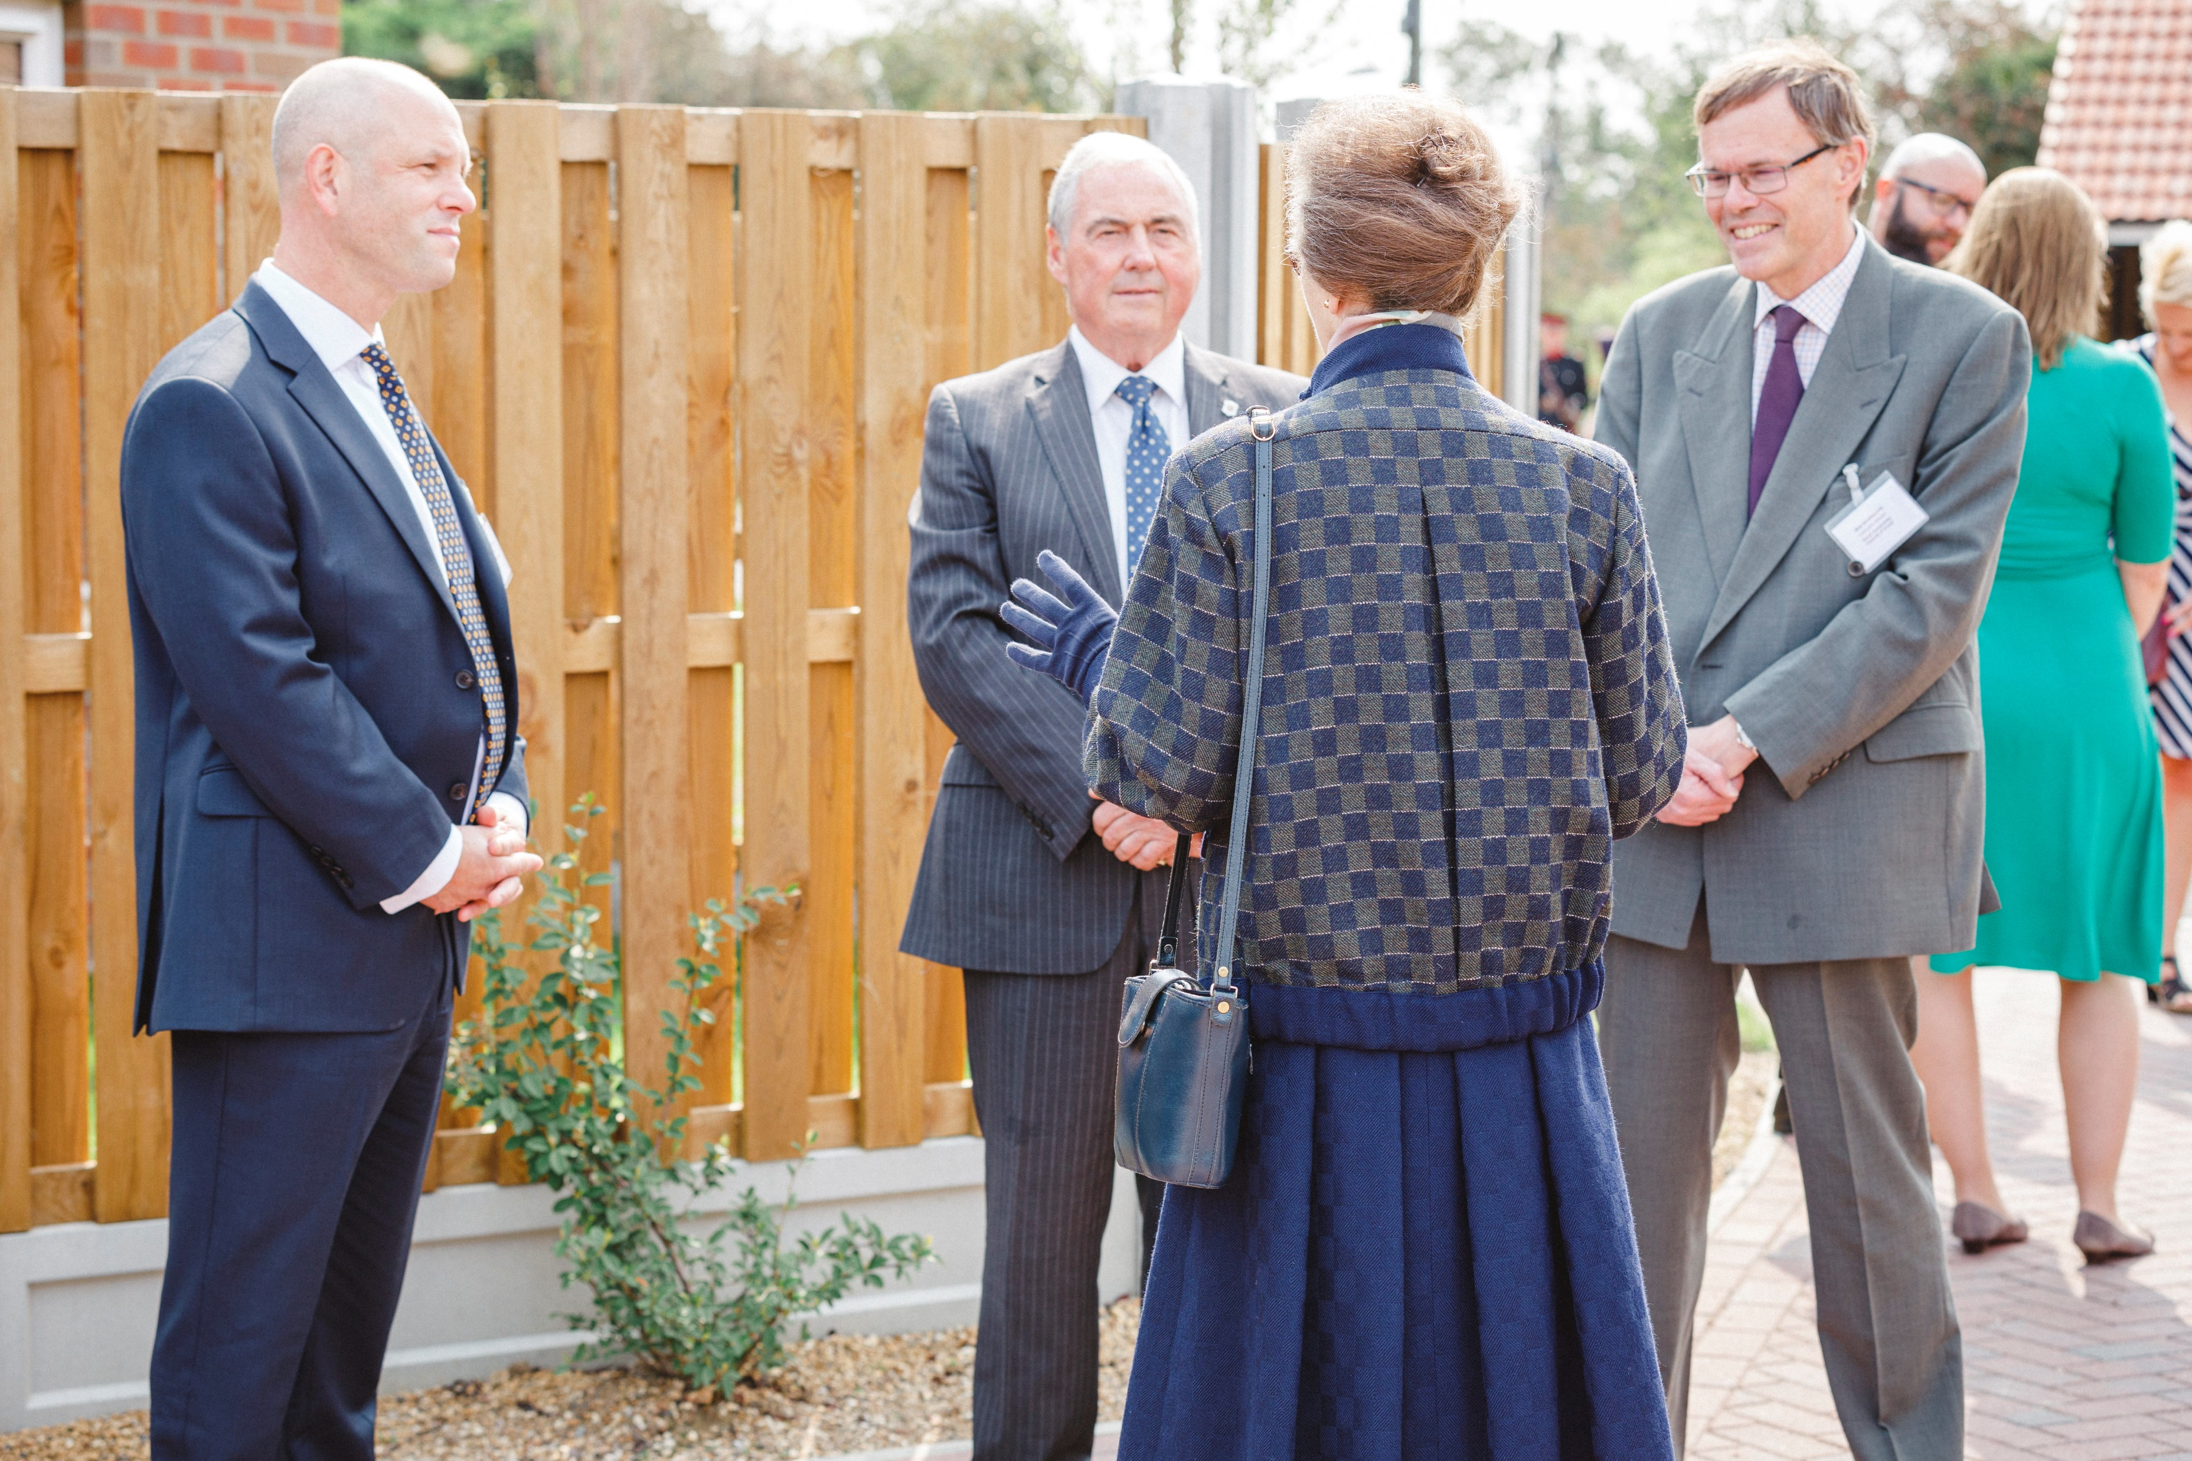
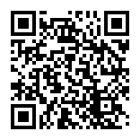
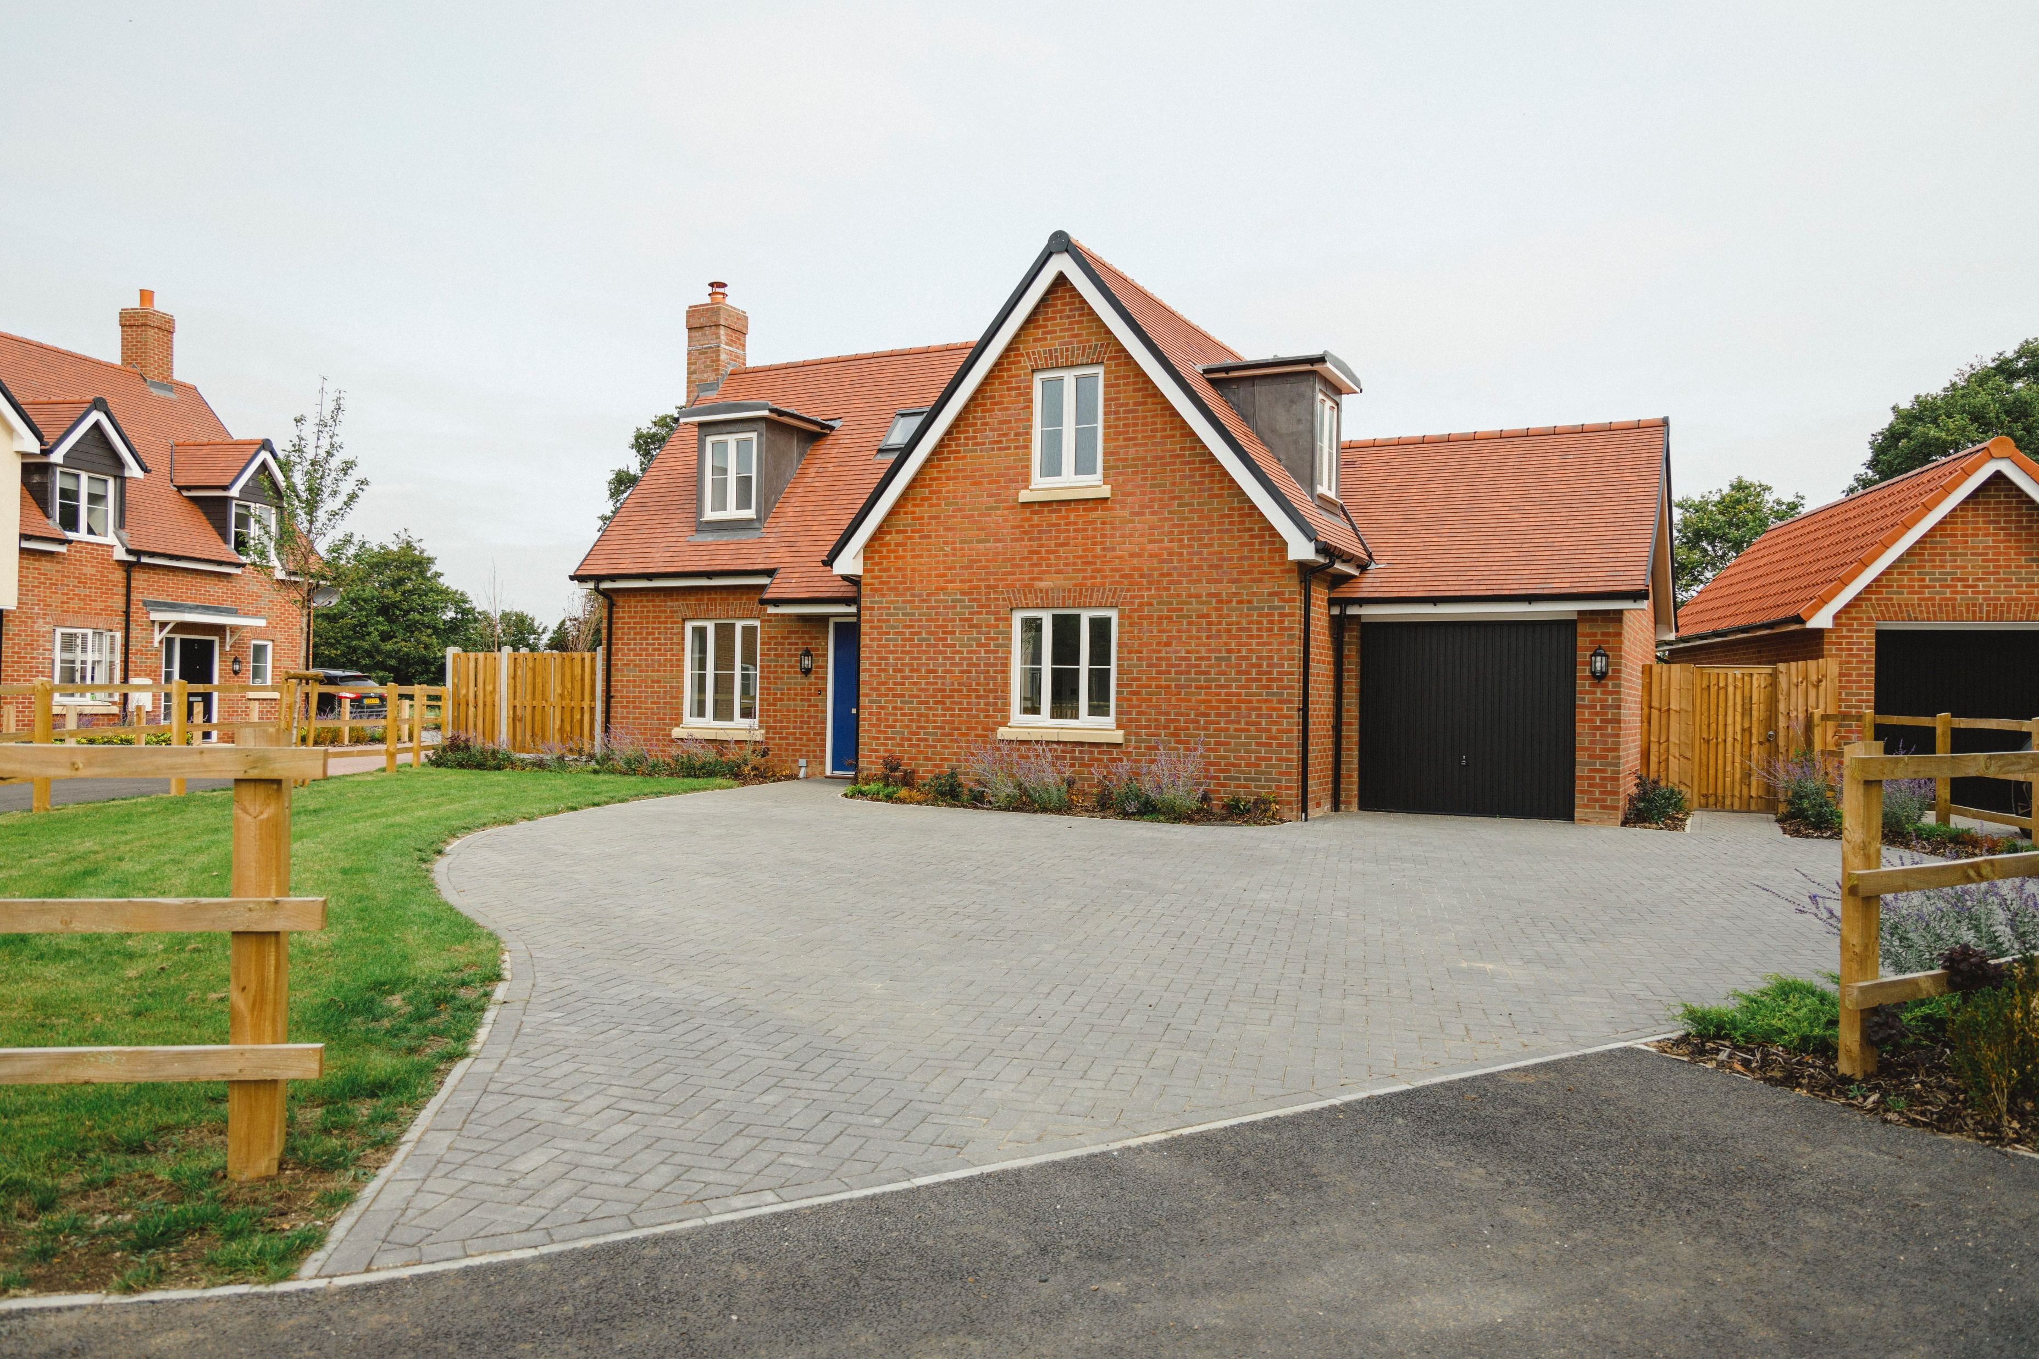
Roxwell Case Study Video
In conjunction with ACRE, we developed this case study video
“The reason for the need of alternative housing for us was the sheer price of rent. Another big factor is the safety aspect for us. The problem with private renting, aside from the extortionate rents, is the fact that the owner can decide to sell and you’re left in a position where you have to move…..At least here, we know that we don’t have that worry hanging over our heads and can really make the house our home. Being so close to my parents really helps with childcare too as my mum has been the main childcare for our son”.
Abi, Resident
https://www.youtube.com/watch?v=Ri_eA7Gir8A&feature=youtu.be
Notes:
HRH The Princess Royal visited the village of Roxwell in Essex to officially open English Rural’s new affordable housing development on Friday September 11th 2020. Recently completed, this small development of seven new homes at ‘Glebe Meadow’ provides homes that will benefit local people. Five homes have been made affordable to local people living, working in or with close family connections to the village. The remaining two homes have been sold to local people at 75% of open market value – a discount locked in perpetuity.
The local community, Roxwell Parish Council, Chelmsford City Council, the Chelmsford Diocese and English Rural have worked together to provide the village with a legacy for future generations.

Slide 12


Contact me!
  If you have any questions, please contact;
  Laura Atkinson
  Rural Housing Enabler &
  Community Led Housing Advisor on laura.atkinson@essexrcc.org.uk
  Or 07305 052578

